Slide 1
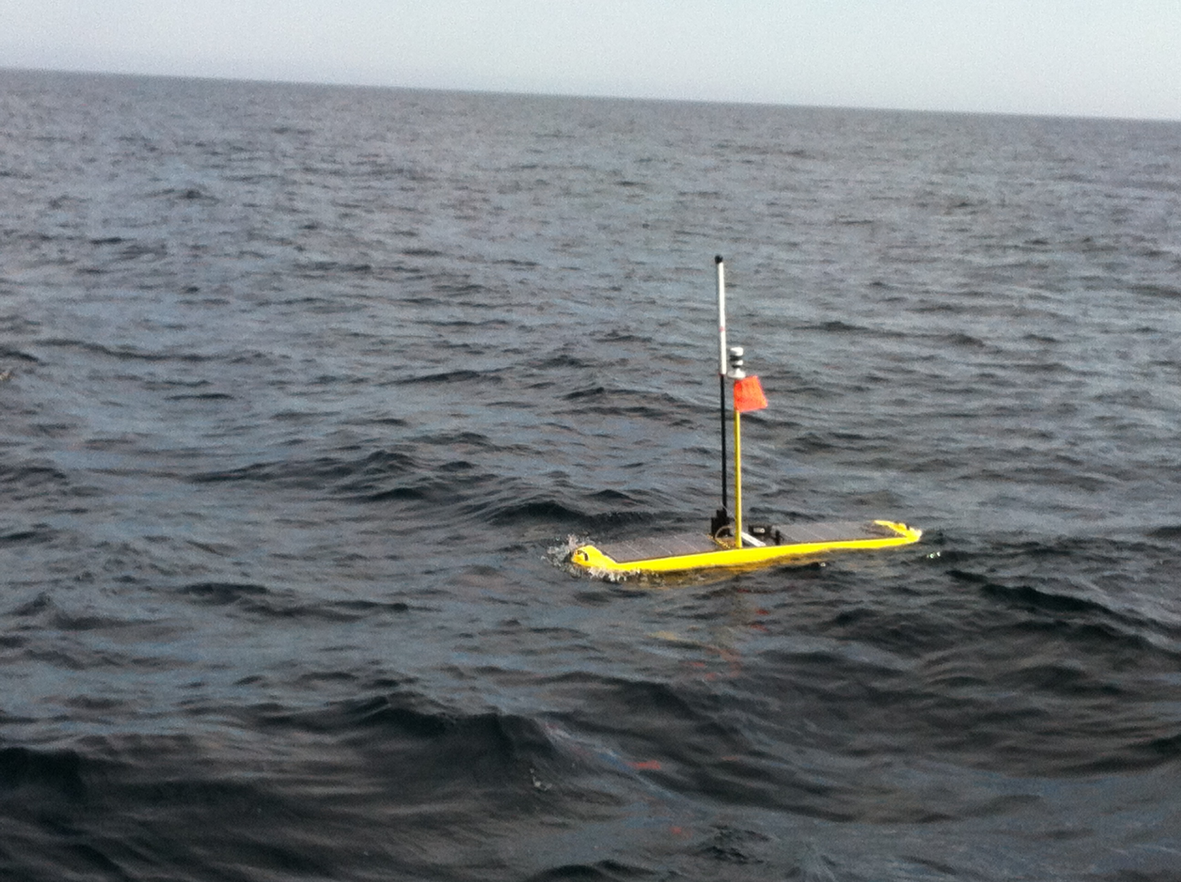
WGMS Piloting Primer
Piloting, Avoidance and Pod Downloads

Slide 2
Wave Glider Management System
Web-based piloting interface (otn.wgms.com)
Queues and sends commands using Iridium’s Short Burst Data format
Commands take time to arrive on the platform
Commands can be rejected or ignored
Waypoint-based navigation
Set points to achieve and the order in which to achieve them
Can also add areas of exclusion to avoid hazards
Notes:
So, as you probably (hopefully, since you’ve all logged in and changed your passwords) already know, piloting of the Wave Glider is done via the Web. The Wave Glider Management System queues and sends our commands using Short Burst Data, which means that our commands are lagged by the Iridium Mailbox check time (usually 5 minutes), and it will take us up to two times as long to find out that our commands might be rejected, or ignored. Nothing happens quickly in WGMS. We pilot using waypoints, by and large, we set and upload a series of points, we call them a course, and we ask the WaveGlider to follow them. We can also add areas of exclusion, but you’re very unlikely to need to do that in day to day piloting, so I have left it out today.

Slide 3
3 days >> 1.5 hours
4 major things we need to be able to do
Give a vehicle a new waypoint
Redirect a vehicle away from another vessel
Shut off extraneous equipment to save power
Download a VR4 station
Know when it’s not working and what to do
Know when it’s completed
Notes:
I’ve left a lot of things out today. The original LRI course was 3 days between classes and hands-on work with the glider. The piloting part was a full day of class with 122 slides, and I’m going to do my best to come in under 1.5 hours to give us time to play in WGMS a bit at the end. I’m going to hit on what I think are the 4 really important things we need to be able to do if we’re piloting our Wave Glider in the field. Give waypoints and courses, avoid collisions, shut down things to save on power, and of course, download VR4 stations. So, let’s have everyone login to WGMS if you haven’t, and jump in.

Slide 4
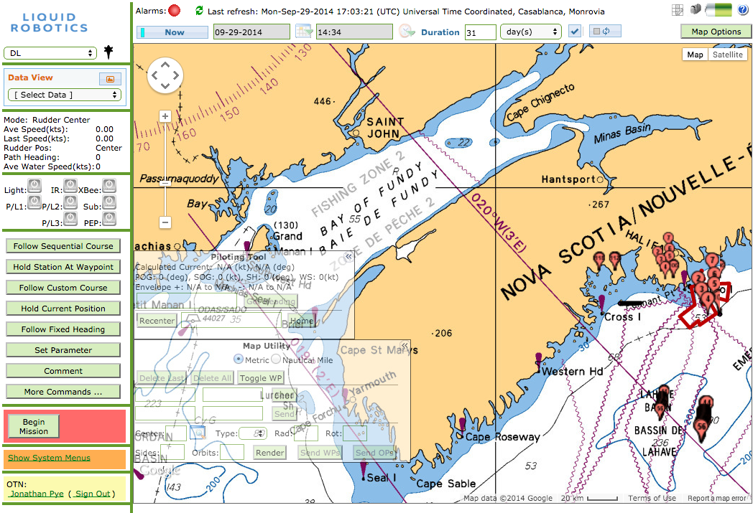
The WGMS ‘Dashboard’
Notes:
This is what LRI calls the Dashboard, it’s the main tool used for piloting and it’s the page you will have open by default for the most part. It’s comprised of the Map Toolbar on top, the Sidebar, and the Position Map. Below this Dashboard you’ve got an area for Communications, and the Command History, showing the history and status of each command that we’ve requested to be sent to the glider.

Slide 5
Map Toolbar
Date Range / Auto-refresh
What time range should be displayed on the map
When piloting, keep Auto-refresh enabled.
Affects the Map Panel
Alarms
Red: one or more active
Yellow: active but acknowledged
Green: no active alarms
Things that can cause an alarm:
GPS not functioning
Repeating telemetry (no update of position)
PROXIMITY WARNINGS / PATH ALARMS
Resetting an alarm:
Click on Alarms
Click the active (red/yellow) alarm
Enter a comment re: removing the alarm (ie: why it’s OK now)
Map Options / Battery
Quick-look at battery health
Map Options to add/remove chart layers and data sources being plotted in the Map Panel
Notes:
So on the Map Toolbar you’ve got Alarms – if it’s red, some of them are Active, and on a deployed glider that’s where you would be looking and clicking first. Yellow means the alarm is active, but someone has acknowledged it. Green means your glider is OK. If you want to clear an alarm completely, you can reset and get rid of them. You’ll want to make good notes on why the alarm is no longer a problem when dismissing it, as other pilots will want to read it. The Date Range line, which should read Now if you’re piloting a field glider, can change the date range of the things being displayed on the map. On the far right is Auto-Refresh, which keeps you up to date by refreshing every 5 minutes. On the far right is the Map Options button, which lets you set up what gets displayed on your Map, and a Battery indicator to give you a quick idea of battery health. There’s also a couple of shortcuts there to options you’ll want to be able to reach for quickly, Line Following and Fast Mailbox Check

Slide 6
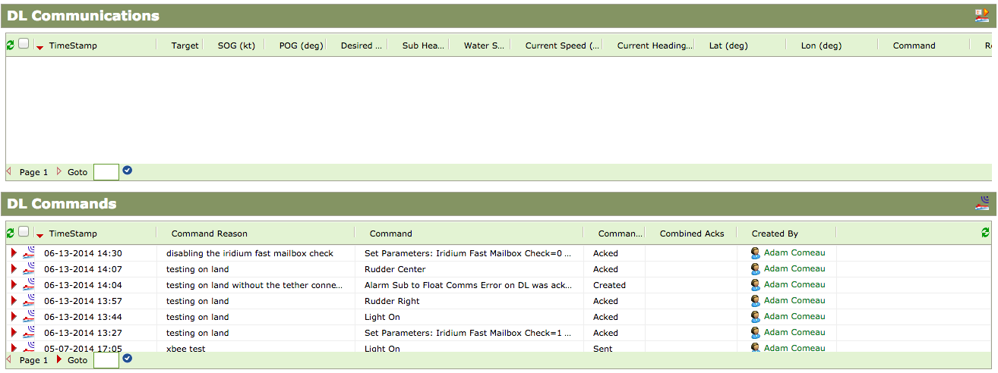
Communications and Command History
Communications between the glider and WGMS
Command history and comments from other pilots
Notes:
The communications table is where every piece of flight data from the glider comes in, and the Commands table shows every command we’ve sent to it with its Queued, Sent, Acknowledged (Acked) or Not Acknowledged (Nacked) status, as well as our comments to one another on what’s going on. Just before you start piloting a glider, it’s good to read through these to find out what’s been going on before you took over.
So there is a three stage process for a command you’re sending to the glider. First it will be Queued to be sent via SBD. Then it will be Sent via satellite, and then the glider will either Ack or Nack it, meaning it could or could not understand what you sent. Once it’s Acked, you can be sure the glider has acted on it. Nacked commands will usually give an error message that will help you correct the condition that prevented them from being Acked.

Slide 7
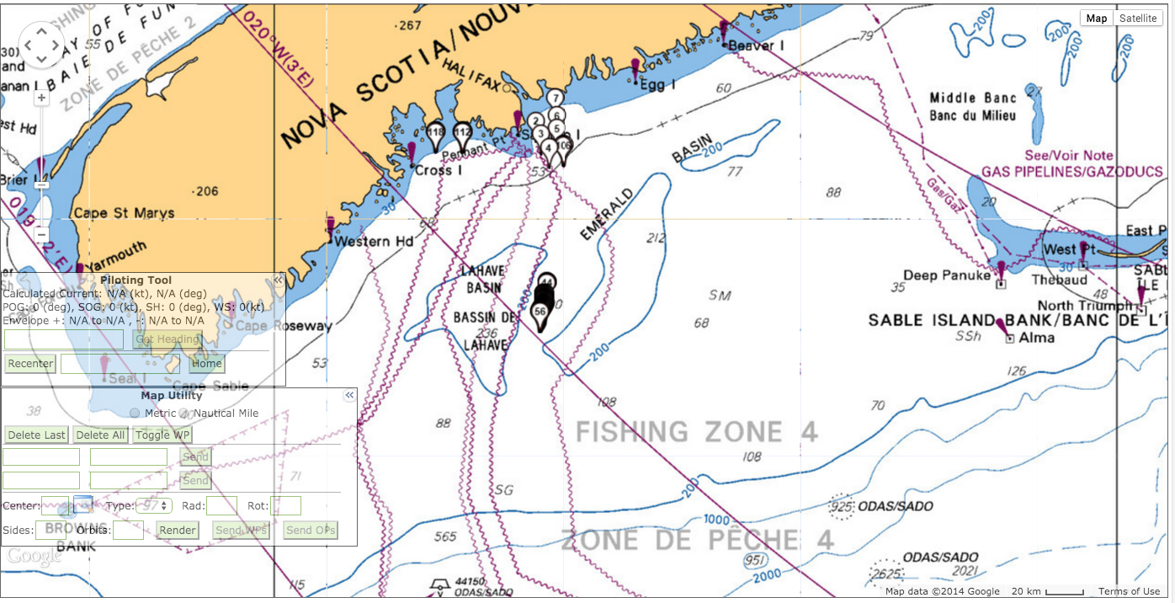
Map Panel
Google Maps pan and zoom navigation
Piloting tool - for current adjustments
Map Utility – for click-and-send waypoint generation
Notes:
The map itself is a Google Maps map with some custom tiling layers. There are overlays for a piloting tool to calculate heading in currents, and a Map Utility to quickly generate advanced patterns around a single center point. If you are playing around with the Map Options button above, you can decide what layers to put on top of the standard Google Maps images, charts are useful, and any and all AIS information should remain on when you’re piloting to help with collision avoidance.

Slide 8
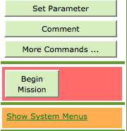
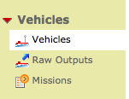
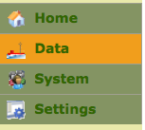
Reference Vehicle Creation
Build waypoints on our reference vehicles
Virtual WaveGliders that you can create courses and waypoints on w/o comms with a live glider
Creating a reference vehicle:
Show System Menus
Data
Vehicles
New
Notes:
So, now that we’ve gone over what things do, let’s get you all a pretend WaveGlider to play with. This command is a bit buried, so we’ll walk through it quickly. There are usually one or two ways to get everywhere in WGMS, so I’ll just show as many as I can.
Enable System menus, when the extra context menu appears on the left, click Data, then make sure Vehicles is highlighted, and click the New button up in the top center.
What we’re going to do is create a reference vehicle for everyone. Pilots use reference vehicles to plan larger missions without cluttering up a real glider’s waypoint list. You might even see in the listing there the ‘Storage Vehicle for OTN WPs’. We’re going to use them to get you more hands-on with the system. We won’t have the luxury of a GPS waypoint, so every so often it’ll re-zoom us into Hawaii somewhere, but we can work around that.

Slide 9
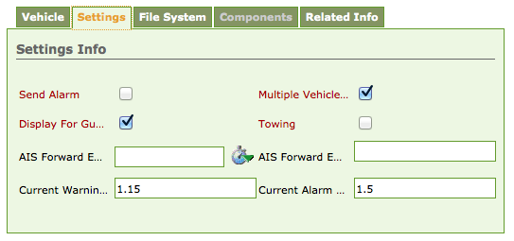
Naming and configuration
Give it a name and an icon style
Add it to the Multi-Vehicle view for now
Click ‘Display for Guests’ too
On the Home screen, select your own Reference Vehicle
Notes:
So now that we’re in our new Vehicle menu, we’ll give it a name, and an Icon. We will also head over to Settings and make sure we’re displaying it for Multi-Vehicle view and for Guests if you want to show everyone what you’re doing.
Once you’ve got it created, and the Settings updated, head back to the Home screen and select your own vehicle from the dropdown menu.

Slide 10
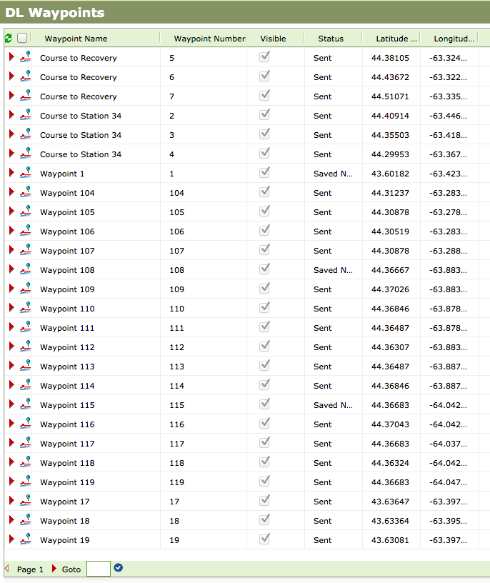
Task 1 – Upload New Waypoint
Waypoints
Vehicle specific
Manual construction
Or via Map Utility
Can be moved
Can copy between gliders within an org
Let’s build both examples
First in Vehicle menu
Then in Map Utility
Notes:
So, as I have alluded to, the waypoint list is specific to each vehicle. We can build them by hand, typing in lats and lons, or we can draw them in using the Map Utility. We can ‘move’ a waypoint, and we can send it between gliders within our OTN organization.
We’ll build one now using both the manual and the Map Utility methods. If we get time afterward, we’ll cover moving and transferring of waypoints.

Slide 11
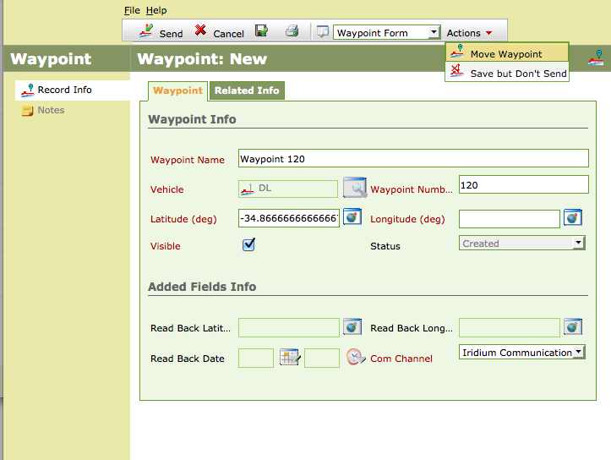
Task 1 – Upload New Waypoint
Vehicle Panel: System Menus -> Data -> Vehicles -> [your vehicle name]
(OR: click the icon below the Liquid Robotics logo)
Click Waypoints in the left bar
Click ‘New’
Red item titles indicate required fields
Add a lat/lon to your vehicle (decimal degrees)
Globe button is a Coordinate Converter for decimal minute
Click Send, or
Actions -> Save but Don’t Send
Close window – wait for ACK (only for live gliders)
Notes:
So, in the first case, you’ve got a latitude and a longitude, probably of a station, and you are going to put it in by hand. We’ll need to get to our vehicle’s page, which we can do via System Menus again, the same way we created it, or we can do it by clicking the icon for our vehicle below the Liquid Robotics logo.
This will bring up the Glider menu. On the sidebar for that is Waypoints. We’ll click that, and click New. Now we’re in yet another screen, and our red text tells us we need a name, a target vehicle, a waypoint number and a lat and lon. The lat and lon are the only things not pre-filled for us. We can put in decimal degree by hand, or we can click the conversion tool there to input decimal minute values and have them convert back to degree.
Once we have the form filled in, we can hit Send, which will save it and queue it to send to the glider. Or we can click Save but Don’t Send if we don’t want to have it on the platform yet, or at all, if we’re using this point to build other points.

Slide 12
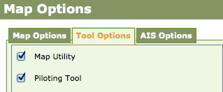
Task 1 – Upload New Waypoint
First – enable Map Utility Tool
In Map Panel – w/ Map Utility Tool enabled:
Mouse over desired waypoint area
Click – Green ‘Play’ waypoint will appear.
Click Send in Map Utility Tool window
Brings up Waypoint: New menu as before
Autoselects next waypoint
Can also do Actions -> ‘Save but Don’t Send’ from here
Notes:
Now let’s put in a waypoint using the Map and the Map utility. Clear out of any windows that might have popped up, head back to the Dashboard. We’ll make sure we have the Map Utility Tool enabled, that’s under Map Options. So Map Options, click Tool Options, and enable both the Map Utility and Piloting tools.
Now that we’ve got that, we just mouse over the desired waypoint area, click to drop our Green icon. No idea why they chose the Play button here for their icon. Now click Send in the Map Utility Tool window where that waypoint’s lat-lon has been populated. That doesn’t send it! It just brings up the Waypoint: New menu we were in before, autoselects the next waypoint, autofills the lat/lon, and now we can hit Send or Save but Don’t Send, just as before.

Slide 13
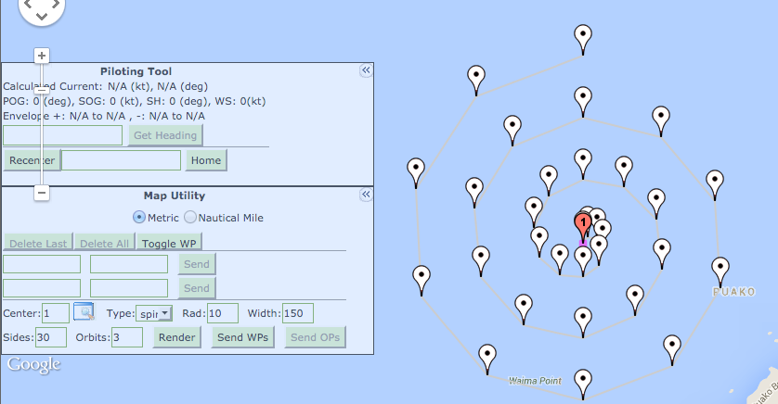
Task 1 – Upload New Waypoint
Advanced Course Shapes:
Circles, spirals, squares
Radius in metres
Sides – number of waypoints
Width – between orbits
Orbits – number of rotations for spirals
Render often, Send WPs once
Notes:
One of the jobs we’ll be doing is circling around a station during offloads, and so we need a quick way to drop advanced shapes around a centerpoint. The Map Utility lets us draw these shapes automatically and batch-send them. We specify a center waypoint number, and depending on our shape, we fill some of the other values. Circles need a radius and a number of sides (line-segments), and can take a rotation degree to change where the first waypoint is along the circle. Squares are diamonds by default, so if you want a square relative to latitude and longitude, you’ll need a degree of 45. Spirals make good search patterns, and they need a number of orbits to determine how many times to wrap a circle using the given number of sides.
Play around and build some shapes around one of your waypoints. You can hit the Render button as often as you want, numbers are not assigned to any waypoint until you hit Send WPs. Hitting Send WPs will tell you what the next available waypoint number is, let you specify your own to start from. Clicking Send WPs will, potentially frustratingly, send the WPs to the glider. Another good reason to build routes on a secondary glider if possible. Only hit Send WPs when you mean to upload the WPs directly to the glider.

Slide 14
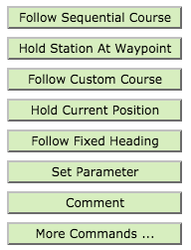
Sending Waypoints to ‘Live’ Glider
Glider downloads waypoint via Iridium-SBD
Does NOT head to it automatically!
Course execution via:
Follow Sequential Course
Hold Station At Waypoint
Follow Custom Course
Follow Fixed Heading
Notes:
Once you’ve sent waypoints to a glider, it doesn’t try to traverse them. You have to execute a course using one of the methods in the buttons on the left. They’re all pretty aptly named, but we’ll look at them a bit.

Slide 15
Sending Waypoints to ‘Live’ Glider
Sequential course: WPs 3-15, or WPs 55-64
Every WP in sequence, no skipping
Custom course: Create a course object and define it with WPs, point by point
Hold station at WP: Go there and stay there
Hold Current Position, Follow Fixed Heading
Single-ack commands for more timely avoidance
Notes:
Sequential course is usually appropriate, as our shapes are built sequentially and so this will traverse them in a way we probably intend.
Custom course lets us pick waypoints one by one. In practice it’s kind of a lot of overhead to go through.
Holding station at a waypoint lets us park a glider in a spot, it’ll use its station keeping to stay within a hundred meters or so, depending on currents.
Hold current position will do the same but at our current location.
The benefit of Hold Station at WP, Hold Current Position, and Follow Fixed Heading are that they’re single ack commands, one iteration of communication over glider SBD. They can be executed quickly when they need to be. In an emergency, you don’t want to drop a waypoint, wait five minutes to have it accepted by the glider, and then send a command to start heading to that point.

Slide 16
Who’s Driving?
LRI signs into piloting duties via comments section of glider ops.
To take over piloting:
Contact current pilot via telephone/email
request Pilot In Charge CHANGE (PICCHANGE)
Make a comment in the glider page
Hand off piloting – talk to your successor first!
Notes:
One thing we haven’t covered yet, and I guess this is as good a time as any to do so, is how to become the pilot in charge of our glider. LRI has a protocol they follow so that only one person executes action on a glider at a time, and we should do our best to mesh with that. When you are ready to take over, call LRI, or whoever the current pilot is, and make sure they’re OK with the transfer of responsibility. Make a comment in the glider’s command table using the Comment command. The protocol to sign on officially is PICCHANGE: and your name.
Similarly, you can’t abandon a glider until you’ve lined up the next PIC. If you haven’t seen him sign on this way, you’re still on the hook!

Slide 17
Task 2 - Redirecting the Glider from Threats
With AIS tracking, ships will appear as they are detected.
A 30 minute ‘intent’ track will extend out in front of their position, as it does for us
Proximity warnings and Path warnings are sent to pilots when a glider’s path crosses a vessel, or when a glider is within ~2km of a vessel, regardless of intent
We can never assume a ship sees us
We are designed to ‘lose’ any collision.
Nothing is more important than staying away from ship traffic
Notes:
Okay, so that’s piloting basics, let’s talk threats. If you’ve got AIS tracking turned on in your Map Options, you’ll see any ships the AIS receiver detects, or any other AIS receiver in the fleet for that matter. For our fleet of one, this isn’t as important. Ships detected by AIS get an ‘intent’ track drawn out in front of them. When we’re moving, the glider gets a –much shorter- track of its own. We will sign up to receive Proximity Warnings and Path Warnings, which are calculated by WGMS when paths cross, or when gliders and ships get too close together no matter which way they’re going.
If we’re getting warnings, or even if we’re not yet and we can see from the shipping lane orientation and the AIS intent that a ship is going to be looking to come our way, we are in avoidance mode. We can’t assume a ship sees our platform, we must remain aware that we’re designed to lose any collisions, and that our priority is now staying well clear of any ship traffic that might come our way. Here’s how to do that.

Slide 18
Task 2 - Redirecting the Glider from Threats
Enable Fast Mailbox Check / Turn on Light
Glider only checks in with Iridium every 5 min.
Fast Mailbox Check brings that down to 1 min.
Become Visible ASAP – Turn on Light
Determine threat ‘intent’, execute Course Correction
Is it moving, where is it going and when will it get there?
Take 90 degree heading away from obstacle path
Set Telemetry Report Rate
From every 5 mins to every 2 mins
Once danger is passed, turn off light and return to previous course. Turn off FMC, set TRR back to 5 mins.
Acknowledge any proximity-related alarms
Notes:
So we’ll go over the steps first, and then see how to do them. First, we are going to enable Fast Mailbox Check. This will tell the glider to check for SBD messages every minute instead of every 5 minutes. This will let us work more quickly. Still very slowly, but more quickly. Doing this first is critical, because we have a lot of commands to run, and we can’t wait for them to ack at the standard time rate. Once we’ve got that sent, we are going to turn on our Light to try and be more visible. Even in the daytime, this can make sense.
Now that we’re more agile, we’re going to determine what our course correction should be given the threat’s intent. Protocol is to take a 90 degree heading from the threat, away from the path it will follow, so that you don’t cross its intended path. Currents may change your calculation there, but all things being equal we don’t like to cross in front of a ship, even if we think we can make it in time.
Now we have our plan and it’s being executed, you might even like to wait for the ACK here, because if anything happened we’d want to put a new course in again before continuing with the protocol. Finally, we’re going to increase our Telemetry Report Rate to get more information on where our glider is. The default is 5 minutes, and it can be as low as 2 minutes, so we’ll set it to 2 minutes, so we get a position and intent for our glider every 2 minutes. This will be nice if we’re in changing currents.
Once the potential threat is over, we will turn off our light, return to our previous course, turn off Fast Mailbox Check (which is expensive and maybe a bit power hungry too) and set the Telemetry Report Rate back to 5 minutes (Which is definitely power hungry). We’ll acknowledge and clear any alarms that the close call may have brought up.

Slide 19
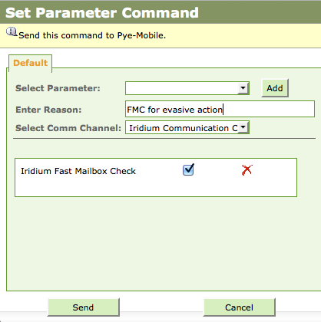
Task 2 - Redirecting the Glider from Threats
Fast Mailbox Check:
Window will pop up
Enter a Reason message
Hit Send
Turn on Light from Sidebar:
Enter command Reason
Hit Send
Notes:
So first, here’s how you enable Fast Mailbox Check. Hit the mailbox button that’s hiding up above Map Options on the Dashboard.
This takes you straight to the Set Parameter Command, and pre-populates Fast Mailbox Check as active. Enter a reason why, and hit send.
Similarly, on the sidebar, there’s a power button next to Light. It brings up the appropriate window, enter your command reason, and hit Send.
Command reasons maybe seem a bit tedious but the creation of records in real time is invaluable to future pilots, and to anyone trying to figure out what happened afterward. You can examine how other pilots handle situations and why they do the things they do, and learn from the folks who do it more often than we do.

Slide 20
Task 2 - Redirecting the Glider from Threats
AIS and intent:
‘Intent’ lines drawn on all AIS-detected vessels
Also drawn for our vehicle
Objective - Take the heading that avoids the threat path most completely
90 degrees from threat path, avoid crossing if possible, avoid fighting prevailing currents if possible
Use Follow Fixed Heading to redirect quickly
Monitor the threat throughout for course changes
Notes:
So our mailbox check is on, our light is on, and now we have to determine how to stay away from the oncoming vessel. The standard advice given is to get 90 degrees away from the intent line, without crossing. You can use Follow Fixed Heading to quickly break off in that direction. Keep monitoring the ship to make sure that its intent has stayed the same. If it continually corrects towards you and slows down, now you’re maybe looking at the AIS details and trying to determine contact information.

Slide 21
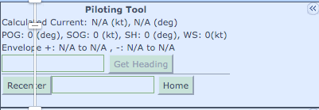
Task 2 - Redirecting the Glider from Threats
Piloting Tool – Better headings with currents
Enter your desired heading in first box as POG.
Click Get Heading. This is the direction to aim for in order to achieve the desired net heading. Enter this value into Follow Fixed Heading
If the desired heading is outside the envelope of possible headings given your speed and the current strength you cannot achieve that heading. If you are in avoidance mode, make alternate plans.
Notes:
If you’re in a fairly strong current, your fixed heading won’t take you where you actually want to go. That’s where you use the piloting tool to calculate an actual heading to take. Put in your desired heading in the Path over Ground (POG) field, and click Get Heading. This will give you the current corrected heading to input to get moving in the direction you want to be moving. When there is current data, you will see an ‘Envelope’ calculation. Given your speed, your movement may be restricted, sometimes called Drift Mode, and you won’t be able to go in the direction you might like to go at all. Then you’re going to need another plan for avoiding a ship, whether it’s fighting the current to stay on the right side of things, or going with the current to get away from the collision area, even if that brings you across the path of the ship.

Slide 22
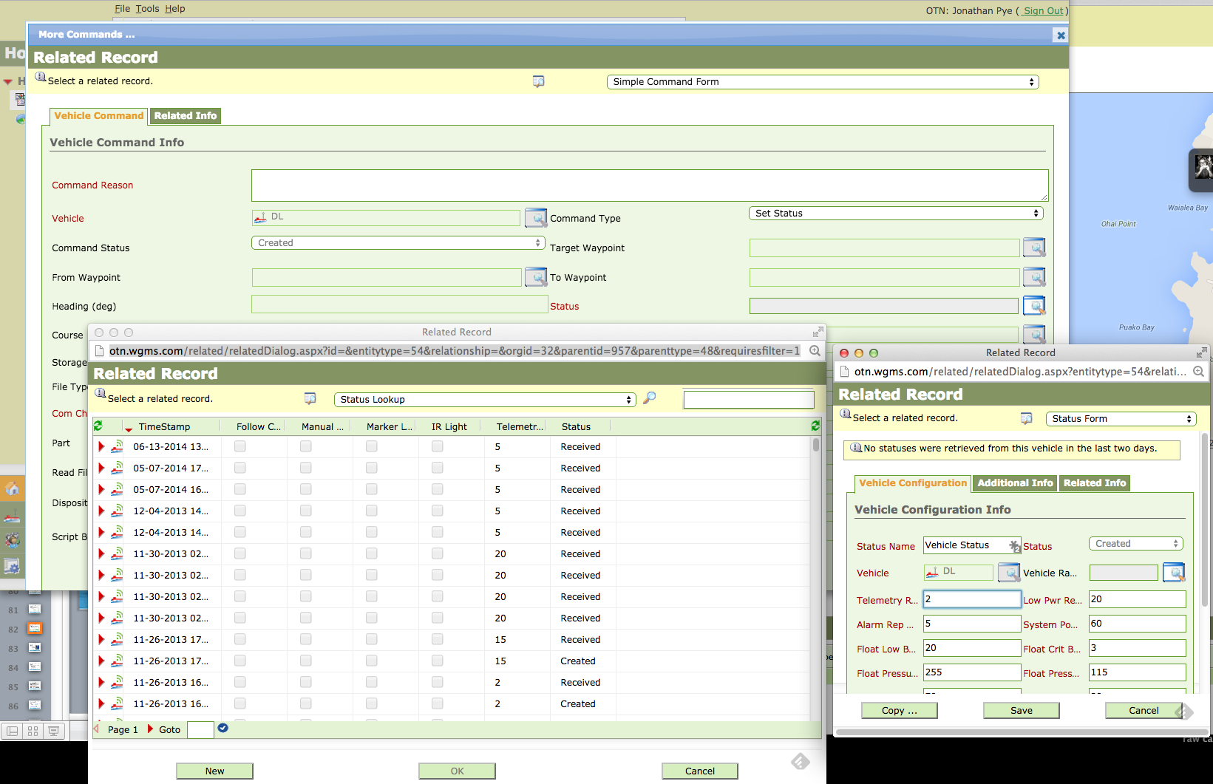
Task 2 - Redirecting the Glider from Threats
Adjust Telemetry Report Rate – convoluted – done last
Notes:
Now for the hard one. The last thing to do is adjust the telemetry report rate, and as near as I can tell, this one is still buried. No nice shortcuts for this one. So here we go. Click More Commands. Set the Command Type to Set Status. Click the magnifying glass next to Status and that will open a Related Record window. In that window, we are going to click New. That will open a New Related Record window. We are going to set the Telemetry Report Rate in that window to 2. We are going to save that. Then we are going to be back with our first Related Record window and we’re going to click OK. Then we’re going to be back in our More Commands window and we’re going to click Send. 1 minute later, we will have Telemetry every 2 minutes.
A shortcut for this next to Fast Mailbox Check would be wonderful.

Slide 23
Break
10 mins
Reset your test glider’s TRR (5), turn off FMC and light
Notes:
Maybe if there’s time we can take a break here, stretch legs. Play around a bit more, if you’ve been following along and have set your fake glider to collision avoidance mode, here’s a chance to dig around and see if you can change it back.

Slide 24
Our 4 Critical Tasks
Waypoints and Courses
Collision Avoidance
Power Savings
VR4 Offloading via VM4
When it isn’t working and what to do
When it’s completed and we can move on
Notes:
So that was piloting and collision avoidance. For these two tasks, we don’t have anything to actually send to, and our demo gliders are not going to pick up any of these commands we send them. So we can go through the motions, but we won’t need to click Send at the end of these commands. This will just give you an idea of how to communicate with the power hogs on the Wave Glider and settle them down, and how to communicate with our VM4 and get it offloading stations.

Slide 25
Task 3 - Power Savings
LRI will power down sensors at ~200 wh
LRI will ‘park’ glider if power reserves below ~100 wh, outside traffic areas and currents
Things we can do to save on power:
Set Telemetry Report Rate to 15 minutes (same as when we set it to 2 during collision avoidance)
Turn off science sensors
Discontinue offloading / turn off payload bays
Notes:
We won’t be the only people piloting our platform this winter, so we should all be aware that LRI likes to start power management at 200 wh. In adverse conditions, they may even start it at 250 wh. So if you come in one morning and you don’t have science sensors sampling, or one of the payload bays is off, first thing to do is check the command history and see when and why that might have been the case. If we’re the ones piloting when it’s time to commence power management, and this can be a decision we make internally, who can make that call, when to make that call, but it wouldn’t make sense to stray too far from what LRI will be doing, here’s how you might shut off some of the extra bells and whistles.
The first thing LRI does is extend the Telemetry Report Rate. By only checking in with GPS every 15 minutes it takes one power-hungry item and puts it on a reduced schedule. They can set it to 10, or to 15 minutes.
If that’s not enough conservation, we can turn off science sensors. We’ll already be sampling at a reduced rate, so if the sensors have to turn off altogether it means we’re being very conservative about our remaining watts.
If we’re in truly dire straits, we’ll be discontinuing all activity and waiting for solar help. Basic glider respiration can be pretty high too, so there’s a chance that even this won’t be enough, in which case we’ll be looking for a nice place to park.

Slide 26
Task 3 - Power Savings
Reference Material: How to operate the Dalhousie system.docx
Turn off CTD: ctd -f
Turn off Fluorometer: LWScript --invoke D SystemStop
(assumes Lua script is loaded as ‘D’)
Notes:
Now, these don’t have to happen quickly, so it’s advised to follow the reference materials we already have, and be very deliberate about shutting down science sampling. It’ll probably be a decision that is arrived at in committee anyway, so I don’t anticipate any of this being an absolute emergency. As pilots, we’ll be providing you with everything you need to refer to when building commands, and the commands to reverse these ones are all outlined in that reference material. But we’re just concerned with shutting down right now.
Everything from here on out begins with the More Commands button, and usually with Write Console Script. We are going to be talking to the instruments via the science computer. For the CTD, we use board address 257, and the command the science computer runs to stop it is ctd –f
For the Fluorometer, it’s board address 8256, and the script that gets run is LWScript –invoke D SystemStop. I can talk about why if you’d like, but that’s the command that will stop the fluorometer and the pump from coming on.

Slide 27
Task 3 - Power Savings
Cut power to Science Payload Bay
Click Set Parameter
Select Payload of Science Bay and click Add
Make sure you uncheck the box to signify no power to that Payload
NB: Science payload might be 3, might be 1
Check mission parameters in the mission document
Notes:
Now, if we want to stop power to the whole science payload bay, we click Set Parameter, we select the Payload that the science bay is hooked up to, and we click Add.
We uncheck the Payload 3 Power box, and we send that command.
For some of last mission we were plugged into Payload 1. Make sure you know what payload the science bay is plugged into. That might be found in the mission document.
If we get beyond turning off the science payload in our power management scenario, it’s likely going to involve LRI and a sophisticated recovery or manual / long term recharging plan.

Slide 28
Task 4 – VR4 Offloading
Reference Material: VM4 Sensor Guide
OTN Uploading Protocol
Database of stations loaded onto glider pre-mission, can be updated
Pass commands to the VM4 with Write Console Script – board address 8222
Once on station, offload command syntax:
vm4 --offload remote [StationID]
Notes:
Okay, now we’re on the home stretch. Here’s how you offload a station! Again, there’s lots of reference material. Vemco’s reference is wordy, but complete, and we have written a one-page uploading protocol that is pretty applicable.
The database of stations with station numbers has been uploaded in the shop, hopefully. We can update stations in the field, but only one at a time, and it would be very tedious and expensive to do a bunch of them via Iridium. Presume that your stations in question are loaded, though the reference sheets will tell you the commands required to load a new station if it turns out your station isn’t in the database on the glider already.
VM4 commands also go through the More Commands -> Write Console Script pathway. The VM4’s board address is 8222. Assuming you’ve navigated to a station, your command syntax is as follows: Replace the station ID there with your station ID. Don’t put it in brackets or anything. There are no spaces in the station IDs, and they’re usually of the form HFX### or CBS###, etc.

Slide 29
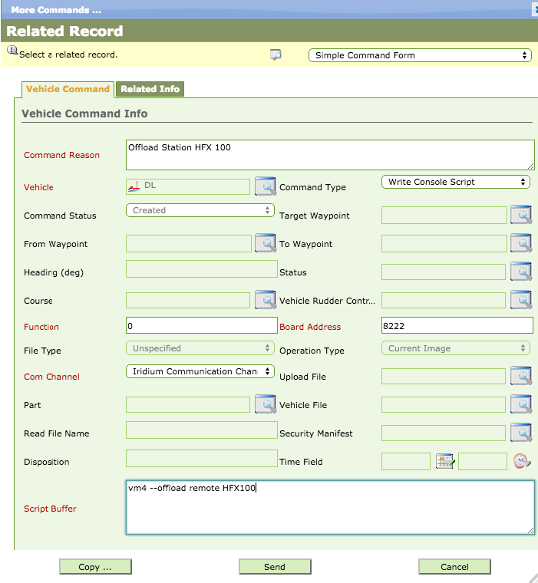
Task 4 – VR4 Offloading
But first we have to get there…
Notes:
So here’s what that looks like in the window for station HFX100.
-click-
But first of course, we have to get there.

Slide 30
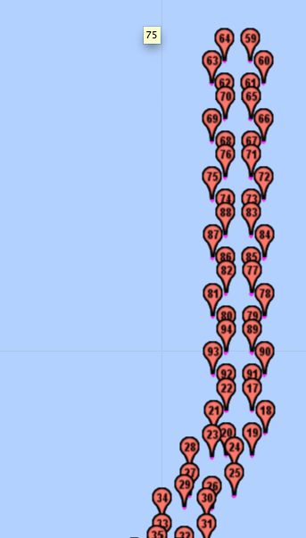
Task 4 – VR4 Offloading
Create waypoint at station location
Create circle around station WP at radius 350m
Used 6 sides last year
Can move on when downloaded
Preparation:
Load waypoints for multiple stations ahead during transit
Use Sequential Course to navigate each circle
Notes:
To orbit a station, we’re looking to create a waypoint AT the station location as best we know it, and then create a circle around the station WP at a radius. We used 350m last year, and we had good connectivity at all points for as long as we had a functioning cable. We used a 6-sided circle, but honestly we probably could have run straight over the points and gone on our way and had it downloaded in time. We aren’t starved for time in that way, so feel free to run the circle before moving on. It keeps your glider in a known place while you verify the download, too. Once the download’s complete, you’re free to lay in your next course.
You might load the station waypoints onto your Reference Glider, build the shapes there, and import them for a few (10-12) stations when you’re about to try and offload them. You can batch-import waypoints, and we can look at how to do that after the slides run out here. Your circles are going to run in order, so find the range of them and use a Sequential Course from min to max to traverse them.

Slide 31
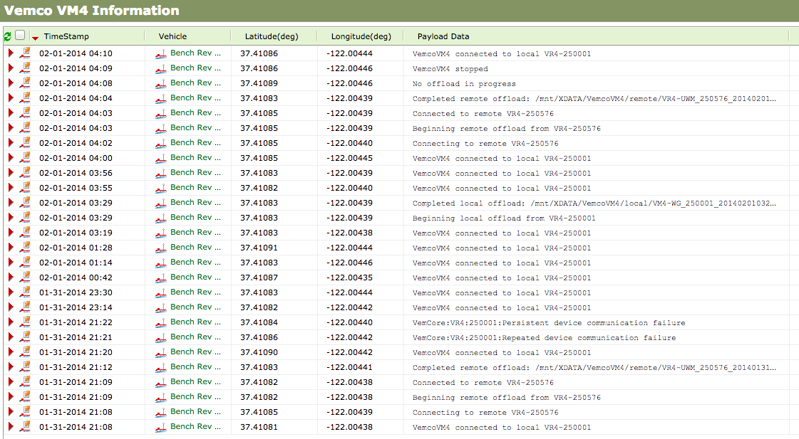
Offload Status Page
Offload status will be in System Menus under Data
VM4 Information
Beginning
Completed
Progress if slow
Error/failure messages too

Slide 32
Task 4 – VR4 Offloading
Changing settings on VM4 – gain, baudrate
Per-station settings
Command syntax is:
station -- update [station_name] local_tx_rate=1200 local_tx_power=-21 remote_tx_rate=1200 remote_tx_power=-21
tx_rate values:300,600,800,1066,1200
tx_power values:0,-3,-6,-9,-12,-15,-18,-21
All other values are invalid
Notes:
If you’re having trouble downloading a station, if it’s slow or there are errors, we can lower the baudrate, or play with the gain. This affects only the station you’re currently connecting to. Don’t use invalid values or you’ll get a NACK

Slide 33
Task 4 – VR4 Offloading
If a station isn’t centered on your watch circle:
Get station range command:
station --range [station_name]
Range to station will appear in WGMS messages
Under Data tab -> Vemco VM4 Information
Return string: Station [station_name]: range=318.808m, bearing: 262.949
Can now re-center circle, or hold at waypoint
Notes:
If you think the problems are that you’re not in the right spot, but you connnect sometimes, you can issue a station –range command to get a station and bearing back from the VM4. You can use this to recenter your course over the new location for the station, or go to that waypoint and hold there, though we do run circles in order to keep the glider moving and not running tight circles.

Slide 34
Other VM4 Commands
Station Health – remote and local
vm4 --health local -> anytime
vm4 --health remote -> when offloading a station
Gives battery info, hard drive capacity, ping counts
Abort – has been buggy in the past
vm4 --abort
Stops an offload attempt in progress
Notes:
Some other things you can do with the vm4 is ask for local or remote health, getting battery info, etc.
One thing you can do that we had to do a lot last year, is abort an offload attempt in progress. If you’re not in the right place, or it’s slow and you want to adjust the settings, you’ll have to abort first. In the early going this caused errors that forced us to reset the sub and science payload, but we hope those days are behind us.

Slide 35
That’s it!
Play around in WGMS, hit the Help button
Lots of info there on other options we didn’t cover
Lots of general piloting tips
Avoid tight turns, avoid 180s
prevent umbilical twist

