Slide 1
HQ Workshop 2014
OTN SandBox
Presented by Marta Mihoff
OTN Database/Data Process Manager

Slide 2
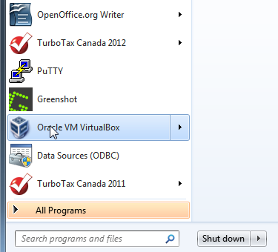
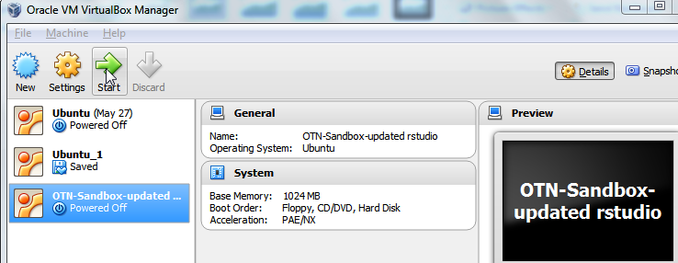
Start Oracle Virtual Box and OTN SandBox
Open Start Window
Click on Oracle VM VirtualBox
Start OTN Sandbox
Notes:
- Hands up for anyone who has done the prep work and installed the virtual box and otn sandbox?
Before I start talking I would like those who have to start up the box and otn appliance.
It will take a few minutes to warm up

Slide 3
Outline
Background
Platform Overview
Data and Program Management
Exercises
Update the ‘sandbox’ folder
Create working folder
Data folder management
File Conversion
White-Mihoff False Filtering Tool
Distance Matrix Merge
Mihoff Interval Data Tool
Cleanup Tool
Wrap Up

Slide 4
OTN Sandbox Backround
Symposium 2013 researcher requests
Fall 2013 request from Steve Kessel and Eddie Halfyard
Reverse engineered Easton White’s code
Presentation Platform
Winter development and testing
Notes:
We had a number of requests from the 2013 symposium.
In the fall we some researchers asked if we could replicate something Easton White had done in an attempt to eliminate detections from ice reflections.
Easton was kind enough to give us his Lemon Shark ms database.
We were able to reverse engineer the process and develop facsimile code which gives the same results.

Slide 5
OTN SandBox Platform
Free open software Black Box
Oracle Virtual Box
Vagrant VMware Integration

Slide 6
OTN Sandbox Appliance
Postgresql 9.1 database
PGAdmin
Python 2.7
Rstudio (only part visible)
TMB – Statistical Modelling Package (R)
Notes:
RStudio is there is because it has a very nice user interface and connects easily with the other languages and databases.
None of the underneath programming is done in R
The only visible part is the RStudio interface.
For you eager beavers the database and python is available.
You can write your own python and R-scripts or access the database directly.
Instructions are in the Appendices of the Install document.

Slide 7
OTN SandBox Tools
White-Mihoff False Filtering Tool
Builds a file of suspect detections
Creates a file of filtered detections
Creates a distance matrix
Distance Matrix Merge
Outputs a matrix overriding distances with researcher input
Mihoff Interval Data Tool
Creates a file of Compressed detections and a file of interval data
Miscellaneous
File Conversion (UTF8)
Cleanup

Slide 8
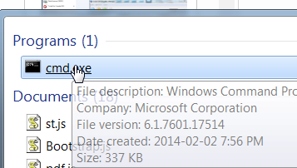
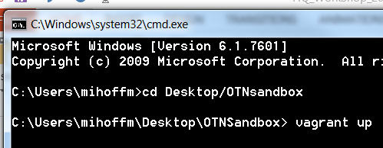
Start Sandbox
Click Start button
Type cmd in search box
Click cmd.exe to open command box
Navigate to your OTNsandbox folder (see install document)
Then execute command ‘vagrant up’
Notes:
You may start your session using the ‘vagrant up’
If a new version is available you will be asked if you want to upgrade
You don’t have to upgrade.

Slide 9
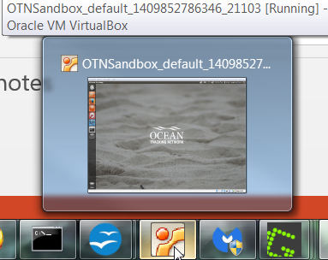
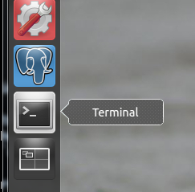
Update OTN sandbox folder
Click the
Icon on your task bar
Click the
Icon on L.H.S.
Notes:
Any time the otn team makes a change to our code you may need to update the “sandbox” folder
This is how you do it

Slide 10
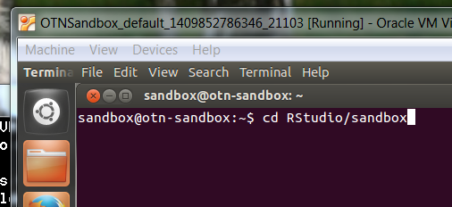
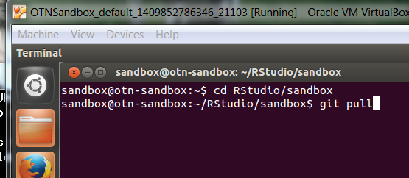
Update OTN sandbox folder
Type ‘cd RStudio/sandbox’ on the command line
Enter
Type ‘git pull’ on the command line
Enter

Slide 11
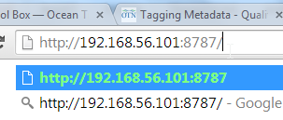
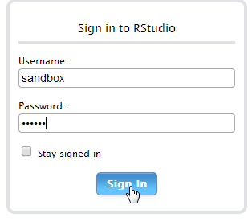
Sign In
Open Chrome or Firefox
Paste sandbox URL
Sign in
Username: sandbox
Password: otn123
Will not work with VPN turned on
Notes:
This is not an internet link
And you do not need to be connected
Will not work with VPN turned on
Brian and Jon will be circulating helping with connection problems
Pause
When most are connected move on to exercises

Slide 12
Data Folder Management
Manage your own data
Current working data folder is always “data”
The “data” folder in Rstudio is a direct link to folder “data” in your Desktop/OTNsandbox folder
Never Delete or Rename folder “data”
You can copy folder “data”
And you can copy into folder “data”
Notes:
The programs in the toolbox always look for the input files in folder data
They also write all files to this same folder

Slide 13
Program Folder Management
All programs are in folder `sandbox`
Warning:
This folder contains all the software developed by the OTN team.
This folder gets replaced when there are upgrades.
Do not keep any of your programs in this folder.
Notes:
Create a new folder to store your edited programs

Slide 14
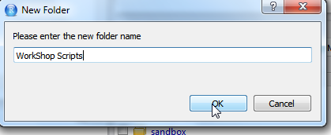
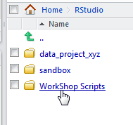
Exercise: Create a work shop folder
Click New Folder button on Files Menu
Type in folder name
Click OK

Slide 15
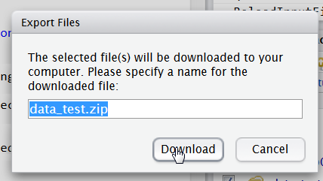
Exercise: Export a file
Check the box beside the folder you want to export
Click the More drop down list
Choose Export
Click download
Navigate to where you want to save the folder
No need to export folder “data”
Notes:
No need to export folder “data”

Slide 16
Exercise: Manage Data Folder with Copy
In Desktop/OTNSandbox
Right click folder ‘data’
Choose copy
Paste into same folder OTNsandbox
Rename copy to ‘data_cod_2008’
Delete everything from folder ‘data’
If you open folder ‘data’ from Rstudio at this point it will be empty

Slide 17
Exercise: Sample Data
Open folder Desktop/OTNsandbox
Check that folder “data” is empty
If not, copy contents to another folder
Right click file: SampleWorkShopData.zip
Choose Extract All
Notes:
All programs look for input file in folder “data” and write files to this folder
The detection file you are working with must be in folder data

Slide 18
Exercise: Sample Data
Accept the file path
Check the box
Click Extract
Notes:
All the workshop files are in this zipped folder

Slide 19
Exercise: Manage Data Folder
In the Extract foldr open “data” folder
CNTL A – to highlight all
Right click
Choose Copy
Navigate to folder OTNsandbox/data
Paste
Now if you open “data” folder in Rstudio all the workshop files should be there

Slide 20
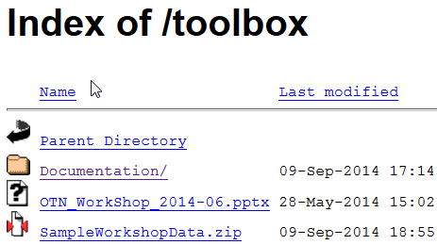
Documentation and Software Location
Introduction page with links
http://members.oceantrack.org/data/otn-tool-box
Direct Location for most up to date Documentation
http://members.oceantrack.org/toolbox/
Notes:
The most recent version of the OTN Sandbox can always be found here
This presentation can now be found here as well

Slide 21
Folder Structure: Documentation
There is extra stuff for geeks in the Appendix of the Install guide
Update Sandbox Tools Instructions would be used after initial install to add new functions or fixes
Troubleshooting will be expanded as users report problems and we find solutions
Notes:
In the documentation folder there is a separate file for each tool
I have highlighted the non tool specific ones

Slide 22
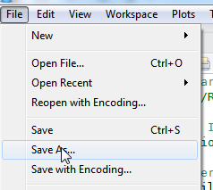
Exercise: File Conversion
Open sandbox folder
Click on file_conversion_driver.r
File will open in upper left window of GUI
Save file to WorkShop Scripts folder
Notes:
The Postgres database which runs in the background expects UTF8 formatting
Any way that gets your files into this encoding is acceptable
During pilot testing we found that MACs do not have an easy way to do this
So we have provided a conversion function
If you get file errors, run your input files through this function

Slide 23
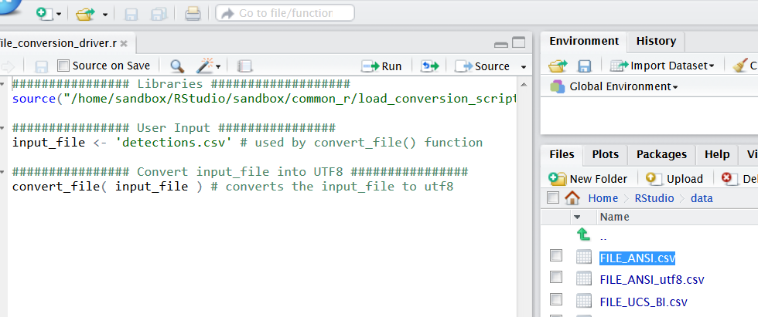
Exercise: File conversion
Open data folder
Cut and paste the file name into the script
Save the script

Slide 24
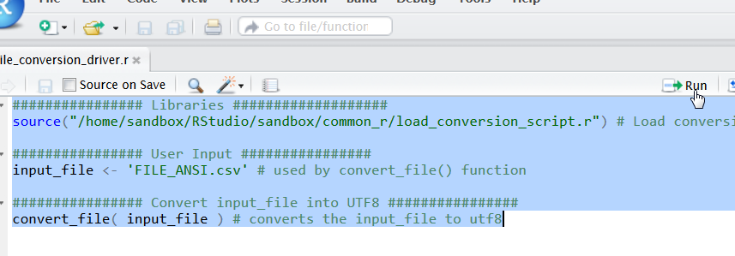
Running R-scripts
Highlight the lines you want to execute
Click the run button
Notes:
You can execute a single line or multiple lines at once.

Slide 25
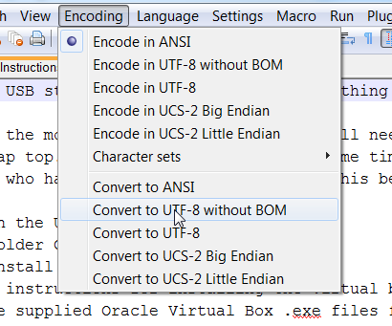
File Conversion: NotePad++ Encoding
Open file in NotePad++
Click Encoding on Menu Bar
Button indicates encoding
Click Convert to UTF-8 wo BOM
Save file
Notes:
Another way to convert files is with Notepad++
Those who have it installed
Go to the USB stick and right click on the file WorkShop Prep Instructions.txt
Open with notepad++
The other option is to open notepad++ and navigate to the USB stick and open the file that way

Slide 26
False Filtering: Minimum Requirements
Column: unqdetecid must be present.
Must contain unique values.
Column: catalognumber must be present.
This can be an animal id or a transmitter id.
Column: datecollected must be present.
Must be format YYYY-MM-DD HH:MI:SS
or YYYY-MM-DDTHH:MI:SS
All digits must be present
Column: station must be present.
Notes:
If the count of unique values does not match the count of records the file will be rejected.
Can be a simple sequence number or any other combination of characters you choose.
Whatever you want to use to group the detections together.
All digits must be present.
If your seconds are missing you will have to add them.

Slide 27
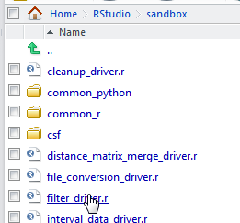
Exercise: filtering suspect detections
Open sandbox folder
Click on filter_driver.r
Will open in upper left window
Save to WorkShop Scripts folder
Notes:
You can open a file by clicking on it in the right hand pane
Or you can navigate to it using the file button on the menu line

Slide 28
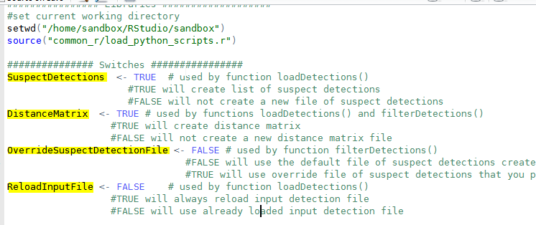
Exercise: Filtering Control Parameters
Highlight this entire section and click the run button
Notes:
You may not want us to create a file of Suspect detections as you have your own file
You may not want us to create a distance matrix as you already have one
ReloadInputFile is there for working with very large files.
With 1.5 million the load can take some time, so you don’t want to reload if you know you are working with the same input file
Otherwise it will make no difference if you leave it True

Slide 29
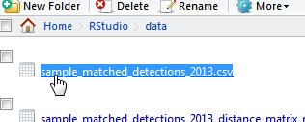
False Filtering: Set input values
Open data folder
Highlight input detection file and copy
Paste into script window over detections.csv
Notes:
This is where you specify the input parameters.
Filename is self evident
Time_interval is default 60 minutes. This was used in Easton’s original code. He says this is how long it would take an animal to travel between stations.
It has a different use here. It is used to identify isolated detections
The version id is interesting if you want to see what happens when you change the time_interval value to 50 seconds
We are not going to work with that today

Slide 30
Exercise: Filtering Functions
loadDetections()
Input a detection file
Outputs a file of suspected detections
And an optional distance matrix
filterDetections()
Input a detection file and a file of suspect detections
Outputs a file of filtered detections
And an optional distance matrix

Slide 31
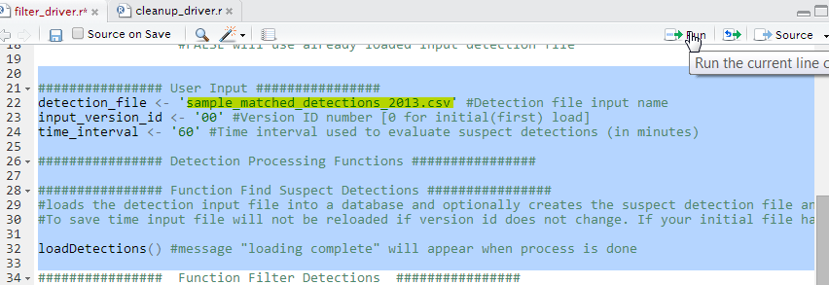
Run the load step
Paste the file name between the quotes
Highlight this section of code
Click the run button
Notes:
When you have executed this section of code
You will see the output messages in the console on the bottom L.H.S.
There will be messages giving the names of output files and record counts

Slide 32
Output Messages: Load Step
Notes:
Your first message will be different as this will be the first time you have run it.
My first message tells me that the initial file did not get reloaded
Watch out for this if you are expecting a fresh reload. This would be the case if you edited the initial input file
To force a fresh reload set the Boolean ReloadInputFile to TRUE
And of coarse you need to execute that statement

Slide 33
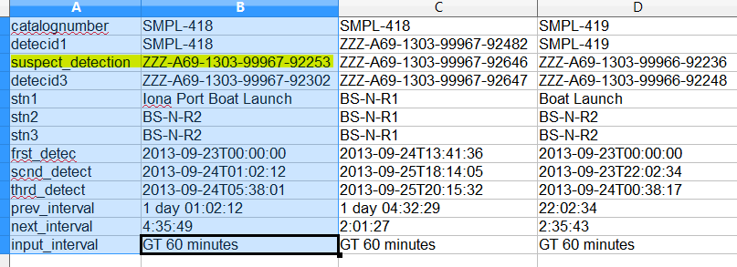
Data: Suspect Detections (transposed)
Each row represents info about three consecutive detections of one animal
The column value for suspect_detection represents the unique id from the input file
Notes:
This is file of suspect detections Transposed so I could get it on one slide
Each column represents three consecutive detections of a particular animal
Look at the highlighted record. It appears in this file because
The time interval between the first and second detection was more than 1 day
And the time between the second and third detection was more than 4 hours
Both intervals are more than 60 minutes.
Note that it is the Second detection which is the suspect detection
We have also given the unqdetecid for all three detections so you can go and look at what is happening around the suspect one.
The column suspect_detection represents the unique id for the middle detection. This is the value which will be used to filter.
You can delete or add records to this file.

Slide 34
Run the Filter Step
If you have your own file of suspect detections or have edited the one the tool created
This is where you override the input file
Otherwise the program will use the one created in the previous step
Notes:
Once you have examined the suspect detection file and are happy
You are ready to filter the detections
You can use your own file of suspect detections if you want by setting the Boolean to TRUE
Remember in the beginning we set the value of OverrideSuspectDetectionFile to FALSE
so the IF statement will evaluate false and the override statement will be ignored

Slide 35
Output Messages: Filter Step
Messages will tell you:
What file of suspect detections was used
What the input detection file was
Record counts
Output file names
Notes:
The output files will be use in the distance matrix merge and the interval data tools
You will be able to cut from this pane and past into the scripts

Slide 36
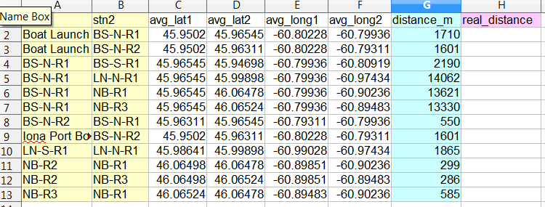
Data: Distance Matrix
Notes:
Station pairs will only appear in this file if an animal travelling from stn1 to stn2 or from stn2 to stn1
Only one of the pair stn1/stn2, stn2/stn1 will be in the file
You should understand what is meant by avg lat and long
If a deployment had more than one receiver during the detection period and they were at slightly different positions, the average location is used in the distance calculation
Care must be taken when processing detections for multiple years when you know that the stations were not close together.
The blue column is a program calculated distance
The lavender column is what you would fill in if you had a better distance to use. Your override file would only need records for station pairs you want to change.
The program will ignore the extra records.

Slide 37
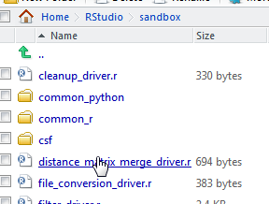
Exercise: Distance Matrix Merge
Open sandbox folder
Click on distance_matrix_merge_driver.r
Will open in upper left window
Save to WorkShop Scripts folder
Notes:
This is the function you use when you want to adjust the distances between stations
The values you put in the real_distance column will override the straight line calculation
You only need rows in the override file for pairs you want to change the distance for
Rows with a null value in real_distance will be ignored

Slide 38
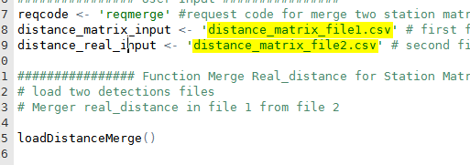
Exercise: Distance Matrix Merge
File for distance_matrix_input was created in false filtering step
Highlight file sample_distance_matrix_override_values.csv in the data folder and paste into distance_real_input expected value
Notes:
The highlighted area is the two files you have to paste into here
The first one is the output from the filtering step
The second is a file you provide for distances you want to change
For this exercise go to the data folder and cut file
You can use the same override file for multiple projects
If you have a station pair in your override file which is not in the first file it will be ignored
This way you can manage all your special cases in one place
The override file would also be a place to pseudo group stations by setting the real distance to zero.

Slide 39
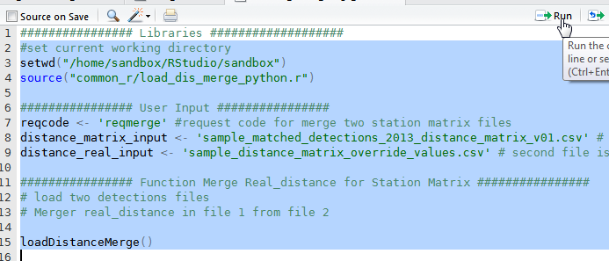
Exercise: Distance Matrix Merge
Highlight entire script
Click Run
Notes:
Once you have pasted in the two file names
Copy the output filename from the output messages in the Console
We will paste it into the next script

Slide 40
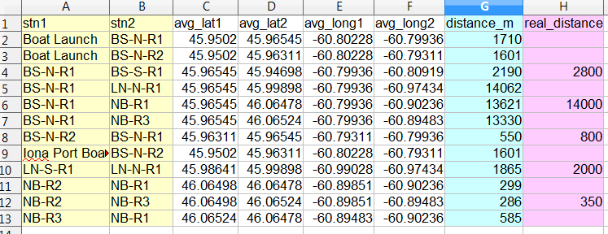
Data: Distance Matrix
Notes:
Station pairs will only appear in this file if an animal travelling from stn1 to stn2 or from stn2 to stn1
Only one of the pair stn1/stn2, stn2/stn1 will be in the file
You should understand what is meant by avg lat and long
If a deployment had more than one receiver during the detection period and they were at slightly different positions, the average location is used in the distance calculation
Care must be taken when processing detections for multiple years when you know that the stations were not close together.
The blue column is a program calculated distance
The lavender column is what you would fill in if you had a better distance to use. Your override file would only need records for station pairs you want to change.
The program will ignore the extra records.

Slide 41
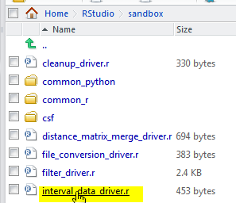
Exercise: Interval Data
Open sandbox folder
Click file interval_data_driver.r
Will open in upper left window
Save to WorkShop Scripts folder

Slide 42
Exercise: Interval Data
Grabbing filenames for subsequent steps
Find them in the output in the output Console. Bottom L.H.S.
Notes:
Now we want to grab the file names to use with this tool
The file of detections was the output from the filter step
You can grab this from the output console on the bottom L.H.S
The distance matrix can be this one or the one output from the matrix merge tool

Slide 43
Exercise: Interval Data
Grab the output file of detections from the last step of the filter step
Grab the output file from the distance matrix merge step
Paste values into the script
Save the script
Notes:
- Now paste the file names into the script

Slide 44
Exercise: Interval Data
Execute the script

Slide 45
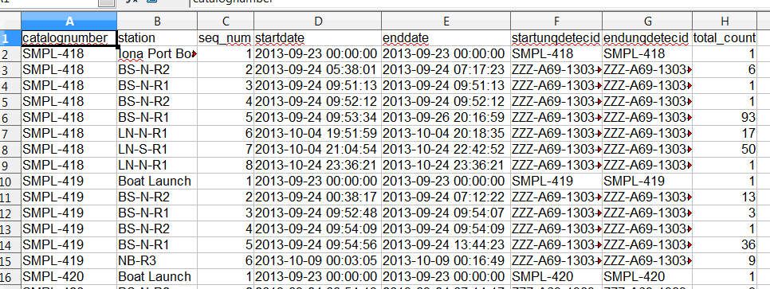
Data: Compressed Detections
Notes:
If you export the output files and opened them in XLS or Open Offices this is what you will see.
This will be a set of sequential records in the order of the stations the animal was detected at.
Each represents the station, the arrival time, the departure time, and the number of detections at that station during that time.
The file will be sorted by what ever value you used for the catalognumber (tag name, animal id)
And the order the stations were visited by the animal.

Slide 46
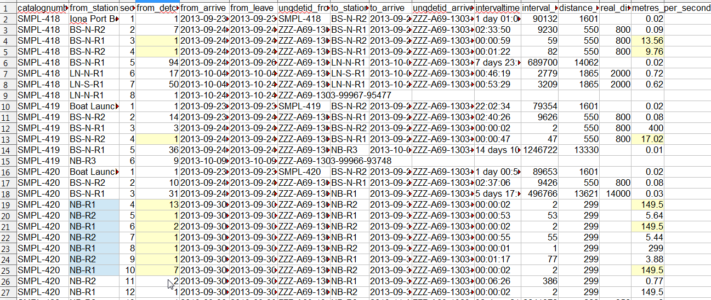
Data: Interval Data
Notes:
This file shows the time interval the animal took to travel between stations
The velocity appears in the last column
You can look for anomalies here.
I have highlighted in yellow some suspect values
If you look at the blue col from_station you see the animal appears to be moving between stations NB-R1 and NB-R
Sometimes very quickly.
In reality the animal is probably somewhere in the middle, and being detected on two station at the same time.
Depending on what you are trying to do you can manipulate this output by playing with station names
or play with real distances.
For example: You can change the station names for these two stations to R2-R1, then the lat and long will get averaged
Or you can change the real distance between these stations to zero.
Another thing that may be useful is to ask us to build a station mapping tool.
Presumably from this you can identify other false detections where the travel time and station sequence is impossible
You would then start to add records to your suspect detection file and go through the process again

Slide 47
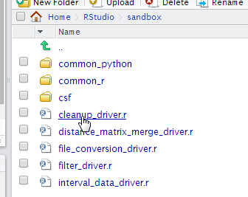
Exercise: Cleanup
Open sandbox folder
Click on file cleanup_driver.r
Will open in upper left window
Highlight entire script
Click Run
Notes:
This function is provided for when your sandbox starts to run slowly.
It will delete all the tables that have accumulated in the postgres database
It will not touch anything in your data folders
If you have done some development on the database then these tables will also be dropped
Please ask for assistance if this is the case
Otherwise there will be no impact on your work

Slide 48
Teach yourself to program
Free open software
Extremely powerful
Standardized
Python
Python(x,y): rival to MATLAB and Rstudio
PostgreSQL
Notes:
One of the best things you can do to further your career is teach yourself to program
You will be way ahead of your colleages who have not bothered to do this
You may think you don’t have time
But consider how much time you would spend doing these very simple, common, everyday tasks if we had not provided these programming solutions.
With some basic programming skills much more complex questions can be answered
In reality you do not have time not to learn to program

Slide 49
How? Coursera and Code Academy
Code Academy Python course:
http://www.codecademy.com/en/tracks/python
Rice University: An Introduction to Interactive Programming in Python Next session Sep 15 https://www.coursera.org/course/interactivepython
University of Michigan: Programming for Everybody Next Session Oct 6 https://www.coursera.org/course/pythonlearn
Johns Hopkins: R Programming Part of the "Data Science" Specialization Next session Oct 6 https://www.coursera.org/course/rprog
Notes:
There are some wonderful online courses. For these ones no programming experience is required.
Coursera is an education platform that partners with top universities and organizations worldwide, to offer courses online for anyone to take, for free.
I can attest to the quality of instructors and course sylabus
They are first class
These ones listed do not require any programming experience

Slide 50
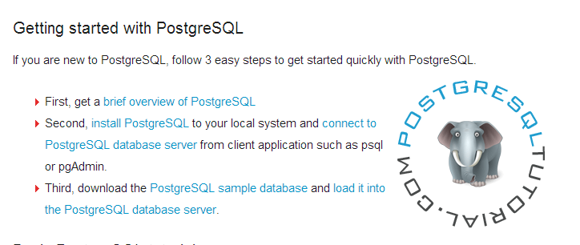
PostgreSQL: Online Tutorials
http://www.postgresqltutorial.com/

Slide 51
RStudio vs R
Prefer Rstudio https://www.rstudio.com/ide/download/
User friendly Interface
Not standardized so use with caution
Null always TRUE
Unpredictable results
Unpredictable upgrades
Help
Rseek: http://www.rseek.org/
Notes:
Just some cautionary notes about R and Rstudio
Select all animals which are female will return animals with no sex (null) as well

Slide 52
Questions?
Wish list?
Cohort data
Separate files for animal detections on other lines
Station Group mapping function
If you can think it and describe it in English, we can program it.

