Slide 1
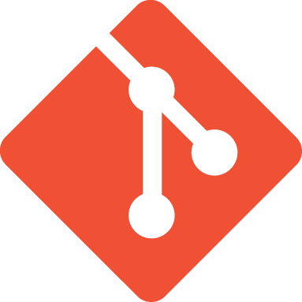
OTN and GitLab
A primer on version control at OTN
Notes:
So, here at OTN we’ve recently updated our source control solution, and in so doing we’ve made it possible to roll out to all of OTN’s HQP. There were a few people at the Symposium who expressed a desire to start sharing their code with the larger OTN, and while we’ve been in a bit of a ‘soft launch’ phase to this point, we’re looking forward to rolling this out to everyone very soon.

Slide 2
Version Control
Can:
Bring you back from a mistake you made.
Show you the difference between two versions of a project
Let you share your project with others
Review the history of your collaborative project and see who contributed what and when
Notes:
So first let’s talk about what version control can do for you. It can help bring you back to a usable state if you’ve made edits that you later regret. It can show you what’s changed between two versions of a piece of software or text-based project. It can help you share your project with others and collaborate with them on improvements. It can let you review the history of the collaborative project in order to see who contributed what, and when.

Slide 3
Different implementations
CVS, SVN, SharePoint, Mercurial, Git
Different philosophies that arrive at a similar set of features.
Git is very popular due to its low overhead, easy installation and portability.
Notes:
There are lots of different ways to enact version control, lots of different systems, but they all tend to arrive at a similar feature set. So in choosing one solution, you tend to identify things that are important to you outside of the core feature set. Git was chosen because it has high portability, a very low overhead in terms of working with your projects while maintaining source control, and easy installation options for all operating systems.

Slide 4
How Git Works (basically)
Register a folder and (some of) the files inside it with Git. This creates a repository. Sometimes known as a ‘repo’
> git init
This repository has no files yet, so we add some.
> git add readme.txt
> git add *
And commit it as a version we’d like to save for posterity.
> git commit –am ‘This is my original version’
Notes:
So, here’s what Git does for you. Graphical clients for git, of which there are many, will all do slightly different things while making it easier for you the user to accomplish what you’re trying to do, but underneath, here’s what is being done. You’ll register a folder on your machine with Git using git init, and it will begin to track the changes made in that folder. When you initialize a folder, it can be thought of as a repository. Git doesn’t pull in the files inside the folder until you tell it to, so you can add them using ‘git add’. Once you have added the files you want in your first version, you commit it using git commit. The –a flag says commit every file that changed to this commit, and the –m flag specifies the message to include with the commit. This is generally meant to be more descriptive than my example above, but first versions are difficult to comment on.

Slide 5
What are ‘commits’?
You make changes to your files, but a snapshot isn’t taken until you request it.
A commit, a snapshot of your files in time, can be thought of as a point on a graph.
If it’s not the first commit, it will have an arrow pointing to its parent(s).
The entire history of commits is downloaded when you grab someone else’s Git repository, giving you a perfect copy of the repository.
Notes:
A ‘commit’ is maybe best thought of as a snapshot, or a single point in time. Point is a great word, because git treats commits like points on a graph. There will be arrows pointing to the ancestors of your snapshots, a whole history of how the files got to this point. When you grab someone else’s Git repo, you are grabbing the whole history, giving you a perfect copy of the repository.

Slide 6
GitLab - Working Together
GitLab is one of many ways to host and distribute Git repositories. (GitLab, BitBucket)
Provides user authentication, private repositories, and is hosted on local equipment
Good fit for OTN, preserves privacy but allows collaboration within our HQP and HQ groups.
Hosted at https://utility.oceantrack.org/gitlab/
HQP can upload and share Git repositories specifically with other users and groups
Can explore the repository’s files and history and contributors in the web interface
Notes:
One of the core reasons to put a project in this sort of version control system is to collaborate with others. GitLab, our chosen distribution method, is one of many ways to share Git repositories. GitLab was the choice for us because of its user authentication, its capacity for completely private repositories, and the fact that we could host it here at Dal on our own equipment. This will let our people work on their code exactly the way they intend to, sharing it with nobody, with a few people, with just other OTN personnel, or with the world, whatever they prefer. So, here’s the link to the GitLab. Your user credentials are your Dalhousie NetID and password. You’ll be added to your applicable groups automatically soon, for right now it’s still a manual process. Once you’re authenticated, you can upload and share repositories with other users, other groups, or everyone. You can also explore repository files, history, and contributors via the web interface. Let’s look at some of those screens now and find our way around.

Slide 7
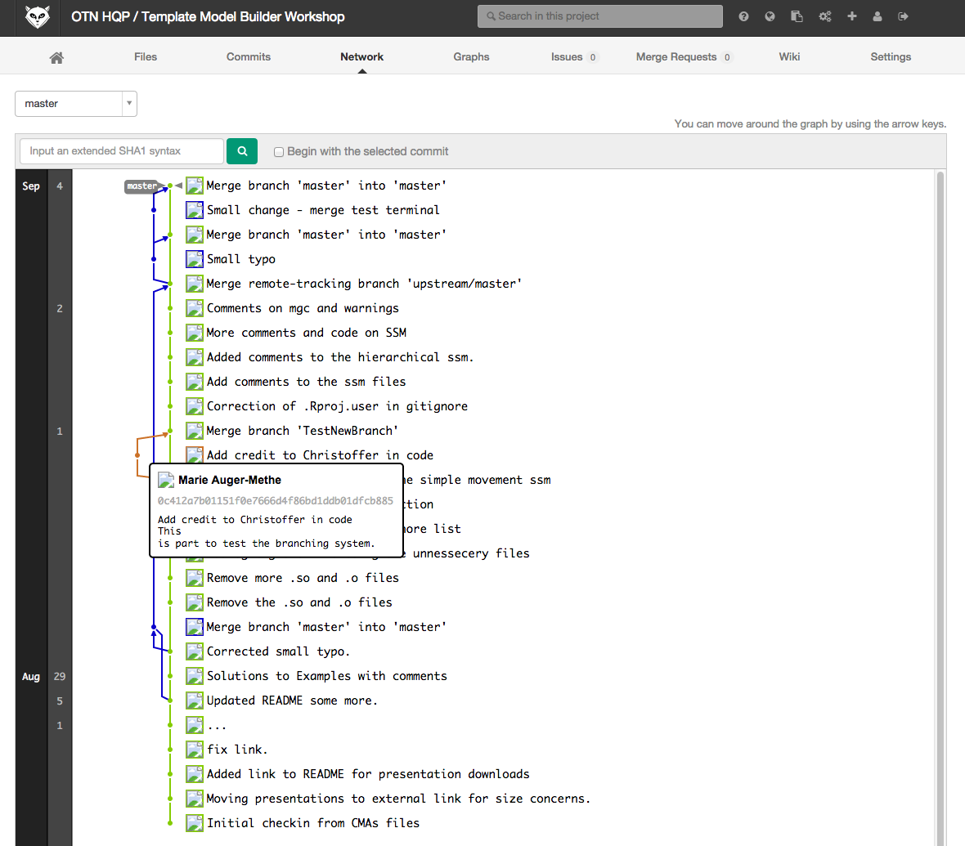
A Repository in GitLab – Network View
Latest
version
Repository owner
and name
Highlighted
commit w/
message
Branches
and merges
Notes:
Here’s the network view of one of the GitLab projects. Each little dot represents a commit, with the history back to the original commit at the bottom of the graph. You can see the branches changing colors as they break away from the main project, and the merges when the features created are added back into the main tree. Each commit message is visible here, giving a quick overview of what the commit did to the repository.

Slide 8
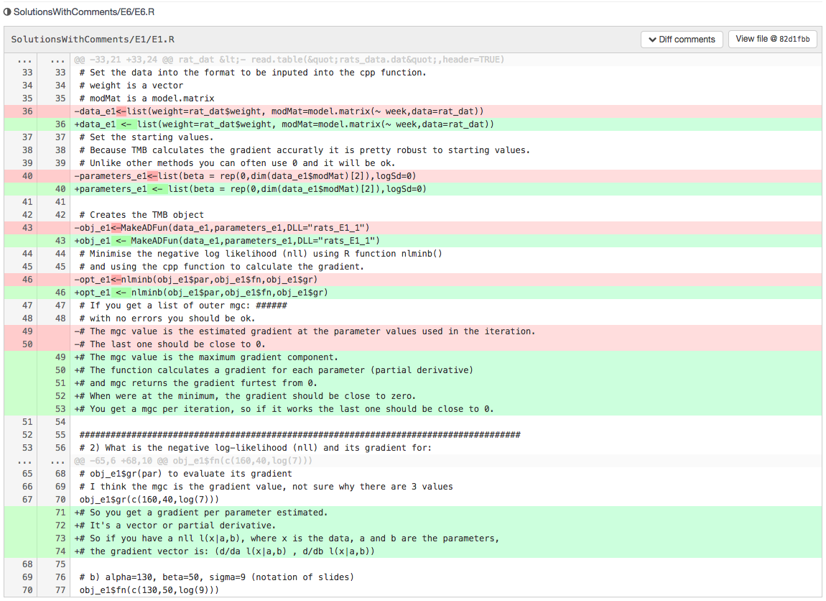
A Repository in GitLab – Commit View
Removed Line
Inserted Line
Notes:
Here’s the commit view. You can see line for line what was added and removed, on a file-by-file basis. Very useful for debugging, for discovering what changed and when. Between authors and commit comments, you’ll also know by who, and for what reason.

Slide 9
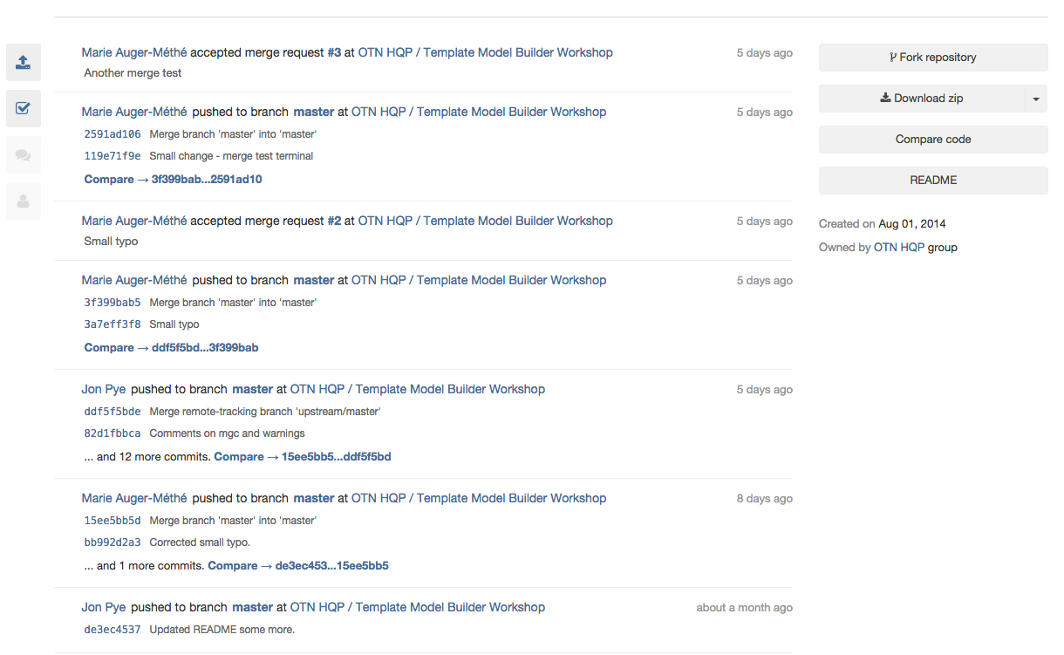
A Repository in GitLab – Overview
Copy a repository to work on privately
Download the latest version without version history
Notes:
Here’s the main overview page, which shows you a time-based history of commits, merges, comments, and issues. You can fork the repository from here, to take away a copy for yourself to work on. You can also download a zip file of the latest master version, without all the histories. Just the latest (hopefully) working version.

Slide 10
Accessing GitLab
Use your Dalhousie credentials to access OTN’s GitLab
Edit your profile to add your name
You can be added to one or more GitLab groups (OTNDC, OTNHQP, OTN Gliders)
Browse the code already submitted, and create your own repositories.
Notes:
So, as mentioned before, you use your Dal credentials to access the GitLab. External people will be added in on a case-by-case basis for now. You can browse through the code that’s been submitted, and create repositories of your own.

Slide 11
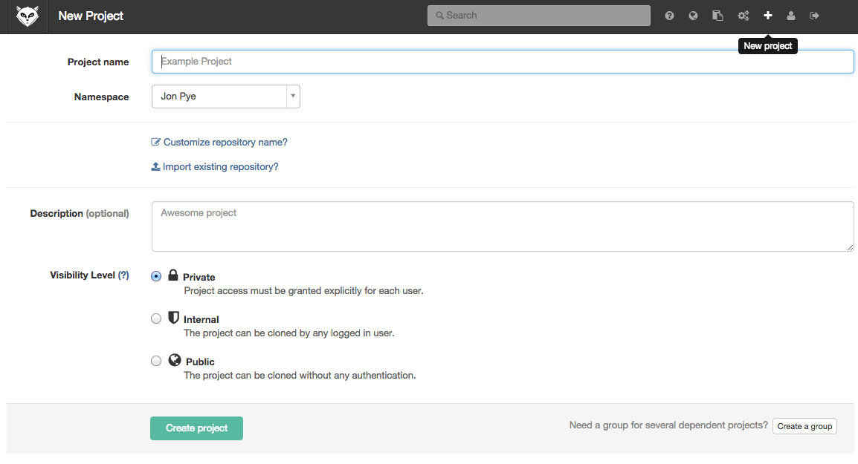
Creating a new project
Click the + icon
Give it a name
Assign it visibility
Create Project
Notes:
To create a new project, you click the + sign on the top bar, give your project a name and visibility level, and hit Create Project. The new, blank project will show you a screen explaining how to add a Git repository to the new project placeholder.

Slide 12
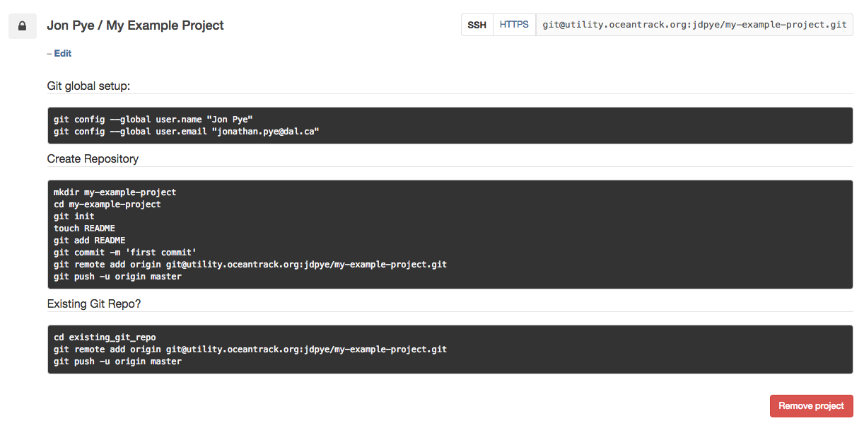
git and Gitlab
Register your local repository with GitLab or download it and start working in the downloaded folder:
Notes:
If this is your first project, you should execute the Git Global Setup commands on the top box there. If you haven’t got a repository yet for this project, you can create one using the ‘Create Repository’ commands in the middle. If you already have one, you simply go into that folder and execute the commands in the bottom window here to point the Git repository to this new remote origin.

Slide 13
Generating and installing your authentication (ssh) keypair
Windows: Install Git for Windows (git-scm.com)
Run ssh-keygen.exe
Place the ssh key that is generated in /Users/[your user]/.ssh/
Copy the contents of the public key (.pub extension) into GitLab
Mac/Linux
In Terminal, type > ssh-keygen –t rsa –C “[your dal email]”
Accept all default settings, note the ‘public key’ filename
Type > cat ~/.ssh/[the public key filename]
Paste the output into GitLab
Notes:
To authenticate your commits with GitLab, you’ll have to give it a public key to authenticate your private key with. For Windows users, Git for Windows will provide a exe file that will generate your keys for you. Copy the contents of the .pub key that gets generated into the text box in Gitlab, and put the private key into your /Users/yourname/.ssh/ folder.
Mac and Linux people, we are going to go to the Terminal and type this out: It’ll generate a new keypair, go ahead and accept all default settings, and have a look at what’s in the public key by typing cat ~/.ssh/[the public key filename]. Paste that output to GitLab.

Slide 14
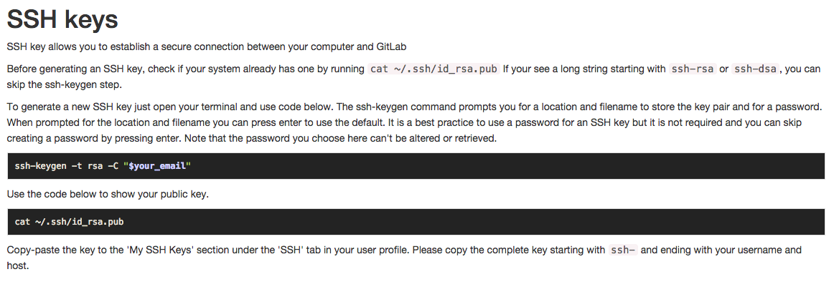
GitLab’s instructions on SSH Keys
https://utility.oceantrack.org/gitlab/help/ssh/ssh.md
Notes:
Gitlab tells you this itself, but it doesn’t give the Windows folks too much help. I’m happy to help out as well if you’re having trouble authenticating to GitLab. Once your keys are set up, once per computer you want to commit from, you are ready to start pushing contributions to GitLab.

Slide 15
Pushing commits to GitLab
Sync your repository to the GitLab with
> git push –u origin master
Changes will be reflected on the site and others can see your work and grab it from your repository.
Notes:
And you’ll do that by pushing your repository to origin, since that’s what GitLab registers its hosted repositories as in the tutorial. Once you push to GitLab, its online browser will reflect your changes, others can see your work, and they can grab it from the repository.

Slide 16
More GitLab Extras
Issue reporting – users of your code can tell you when there are problems.
Wiki – Included for each project
Snippets – Code/text you want to share outside of a project. An example of how to do something in a certain language, for example
Notifications – when someone changes something in a project you own
Notes:
Gitlab also has a few bells and whistles that might be helpful to collaborators. You can register and report issues within projects and branches, there are project-level wikis that let you talk about the project with the other collaborators. You can also paste and share code-snippets with other GitLabbers, maybe examples of how to define something in a certain language, something that is applicable to a lot of places. GitLab will also send you notifications when things change in projects you are the owner of.

Slide 17
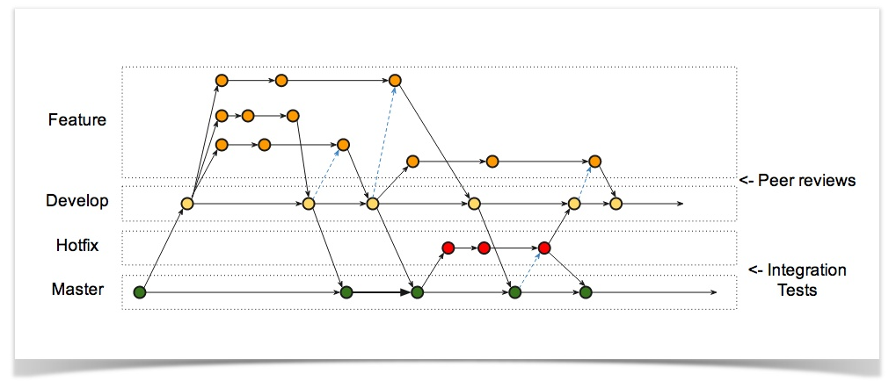
GitLab @ OTN
https://utility.oceantrack.org/gitlab/
An example of a branching model of software development
Notes:
So, that’s the GitLab. Hopefully it will be a useful tool for sharing our tools across the Network. You can find it at this URL. Thanks for your time!

