Slide 1
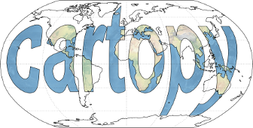
Creating Maps with Geoserver
Accessing geospatial layers in Python and QGIS
Notes:
Alright. I’m going to talk about using OTN’s Geoserver to retrieve geospatial data layers and also to go over a couple of open source tools to help create maps for publications, posters, presentations, data exploration, etc..

Slide 2
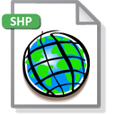
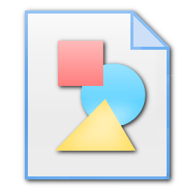
What is Geoserver?
Open source solution for sharing geospatial data
Access, share, and publish geospatial layers
Define layer sources once, access them in many formats
KML
.csv
Shapefiles
Vector
Files
GIS Apps
Raster
Files
Geoserver Layers
GeoJSON
Notes:
A little background on what the Geoserver is and what it does. It’s a tool created by the open source community to serve a set of standards agreed upon by the Open Geospatial Consortium. Its strength is in taking multiple geospatial data sources like OTN’s PostGIS database, Vector files in ESRI’s Shapefile format, or raster files with a defined reference geography, transposing them and serving them up by request in many standard formats. It also provides a fairly sophisticated user authentication layer to allow for user authoring of content and data sources, as well as protecting access to the output data layers.

Slide 3
Geoserver @ OTN
Layers served out of the OTN PostGIS database
A few standard public data products available:
Station deployment information (otn:stations, otn:stations_series)
Public animal release information (otn:animals)
Metadata for projects (otn:otn_resources_metadata_points)
Potential to create private per-project layers for HQP use.
Today: two ways to query the OTN Geoserver
code-based (Python)
GUI-based (QGIS)
Notes:
OTN uses our Geoserver to serve publically available data, such as station location and history and already-public tag release information. This information can be used to map out a history of OTN receiver locations, get a listing of which projects are active in what areas around the world, etc. There is also potential to use this tool on the project level using authentication, leveraging the OTN database to report all known information about OTN projects without publicizing the data. Today we’ll go over two ways to get data from the OTN Geoserver, in straight code using Python, and through a GIS application using QGIS. We’ll explore a couple of features QGIS has that make publication-style plots easier.

Slide 4
Querying Geoserver using Python:
“If you wish to make an apple pie from scratch, you must first invent the universe.” – Carl Sagan
What we’ll need:
Python (2.7 or better)
pip and virtualenv
A virtualenv created for our visualization project
Install the following packages into our new env:
numpy, matplotlib, geojson, owslib, cartopy
Optionally
A nice Interactive Development Environment to work in.
Spyder (free)
PyCharm (cheap and worth it!)
Notes:
I’m sure we’ve all heard this quote, and if you’ve never used python before, maybe you already had it in mind when doing the installations for this part of the demo. To get ready to use Python to ask our Geoserver about its data, we need a not-insignificant amount of installations. I did a bit of legwork trying to guide the installation of these pieces, hopefully if you attempted it, you were successful. If not, we’ll be going over the code on-screen here, not to worry.

Slide 5
Querying Geoserver using Python:
“If you wish to make an apple pie from scratch, you must first invent the universe.” – Carl Sagan
What we’ll need:
Python (2.7 or better)
The following packages:
numpy, matplotlib, geojson, owslib, cartopy
Optionally
A nice Interactive Development Environment to work in.
Spyder (free)
PyCharm (cheap and worth it!)
Notes:
To get ready to use Python to ask our Geoserver about its data, we need to first set up a Python environment with all the packages we’ll use. I went through a few test installs on each operating system when I wrote up the guide to installing these pieces, hopefully if you attempted it, you were successful. If not, we’ll be going over the code on-screen here, not to worry.

Slide 6
Setting up your coding environment
Recommend virtual environments to keep projects and their requirements from overlapping
If you don’t do a lot of programming, this may matter less
Your virtual environment is where you ran virtualenv X
The Python interpreter for that virtualenv is ./bin/python
Windows users: ./Scripts/python
If you’re using a Interactive Development Environment, you can point your IDE at that python executable for running the example.
Notes:
I have a lot of projects on the go, and so I like to create virtual environments to keep things locally independent. The instructions provided ran through how to set one of those up, but for Windows users, you may have found it easier to install everything using executables instead of compiling all the supporting libraries, and if so you don’t have to worry about entering a virtual environment.

Slide 7
Accessing Geoserver using owslib
Many services available via Geoserver
Shape and point data – Web Feature Service
Rather under-documented at the moment:
To connect to a Geoserver that is implementing WFS:
from owslib.wfs import WebFeatureService
wfs = WebFeatureService(url, version=“2.0.0”)
OTN Geoserver url = “http://global.oceantrack.org:8080/geoserver/wfs?”
wfs is now a handle to our Geoserver, and we can run queries like:
wfs.contents = a list of all layers served up by Geoserver
wfs.getfeature(typename=[layername], outputFormat=format)
Using the results of getfeature requests, we can build geospatial datasets
Notes:
Geoserver can serve up vector and raster data, vector being points and shapes defined in a coordinate system, raster being a set of pixels that we can assign to a geographic box area. Today we’re going to be working with vector data, namely station and animal point objects. To access those, we’ll use Geoserver’s Web Feature Service. To access that in Python, we can use some specialized URLs to grab the data in pre-organized format, or we can interact with the WFS server directly using owslib. So this example is just a quick rundown on how to interact directly with Geoserver’s Web Feature Service. We connect using the OTN Geoserver url and we grab a list of the layers that are public. We can also provide credentials if we have them as well to make any protected layers available to us.

Slide 8
Python example: owslib_example.py
Simple script to
connect to Geoserver
grab a layer that defines all stations
generate a printable map
Tools: cartopy, matplotlib, geojson, owslib
Also used: NaturalEarth shapefiles as retrieved by cartopy
naturalearthdata.com
Notes:
So in our example script, we connect to OTN’s Geoserver, we get a station layer, and we generate a nice map. Hopefully with this example, you should be able to take these snippets, extend them for your purposes, grab the things you’re interested in and plot them.

Slide 9
Connecting to Geoserver / getting layers
# Imports to get the data out of GeoServer from owslib.wfs import WebFeatureService import geojson import numpy as np # Imports to plot the data onto a map import cartopy.crs as ccrs import cartopy.feature as feature import matplotlib.pyplot as plt
wfs = WebFeatureService('http://global.oceantrack.org:8080/geoserver/wfs?', version="2.0.0")
# Print the name of every layer available on this Geoserver print list(wfs.contents)
> [‘discovery_coverage_x_mv’, ‘otn:stations_receivers’, ‘otn:stations’, …]
# Get a list of all stations. Lot of metadata associated with this JSON data. # But for now we're interested in the coordinates. json_response = wfs.getfeature(typename=['otn:stations'], propertyname=None, outputFormat='application/json').read() geom = geojson.loads(json_response) flip_geojson_coordinates(geom)
# geom contains a collection of features, and their default coordinate reference system is a stored property of the collection. print geom['type'], geom['crs'] # check our coordinate reference system > FeatureCollection {u'type': u'EPSG', u'properties': {u'code': u'4326'}}
Notes:
So here we are. The example here is a nice even split between code and comments. If you are wondering if you have too many comments in your code, you don’t. If you’re wondering if you might not have enough comments, you don’t have enough comments. First we import the packages we need to bring the data out of the Geoserver, then we’ll import the packages we’ll need to put the data on the map. Now we create the connection to OTN’s Geoserver, (click) We’ll use the WebFeatureService from owslib to create a connection to our Geoserver, (click) and we’ll print the name of every layer available on that resource. (click) There’s otn:stations, that sounds interesting, let’s get that one. We grab it as GeoJSON, and get it ready to give to the mapping function by running it through flip_geojson_coordinates, which is a function that does exactly what it sounds like, re-orders lon,lat into lat,lon. Let’s look at our resulting geom object there (click), by printing the type and coordinate reference system. It is the very popular EPSG type, and the coordinate reference system is EPSG: 4326, meaning WGS 84. I don’t want to get hung up on coordinate reference systems too badly, but this is a very mainstream one to be choosing. When you’re making maps, it will be very appropriate for a lot of contexts.

Slide 10
Geometry to Cartopy
ax = plt.axes(projection=ccrs.PlateCarree()) # PlateCarree just simplest map projection for this example
# Get a list of all features. locs = geom.get("features", []) # Each feature has a lot of reference data associated with, as defined in Geoserver. print locs[0]['properties'].keys()
> [u'station_type', u'notes', u'locality', u'collectioncode', u'longitude', u'stationclass', u'depth', u'latitude’, u'station_name', u'stationstatus']
print locs[0]['properties'].values() [u'Acoustic', … , u'Cape North to St. Paul Island.', u'CBS', -60.33438, u'deployed', 162, 47.06696, u'CBS008', u'active']
# But we also have the coordinates, which is what gets us onto the map. # lons, lats = zip(*[(x["geometry"]["coordinates"][0], x["geometry"]["coordinates"][1]) for x in locs])
# You could also subselect if that fits your project. lons, lats = zip(*[(x["geometry"]["coordinates"][0], x["geometry"]["coordinates"][1]) for x in locs if x['properties']['collectioncode']==”HFX"]) # Do some simple buffering of the map edges based on your returned data. plt.axis([min(lons)-1, max(lons)+1, min(lats)-1, max(lats)+1]) # Plot the lons and lats, transforming them to the axis projection ax.scatter(lons, lats, transform=ccrs.PlateCarree(), edgecolors="k", marker='.') ax.stock_img() # fairly nice looking bathymetry provided by Cartopy # Add the land mass colorings ax.add_feature(feature.NaturalEarthFeature('physical', 'land', '10m', edgecolor='face', facecolor=feature.COLORS['land'])) # You can also define a feature and add it in a separate command states_provinces = feature.NaturalEarthFeature('cultural', 'admin_1_states_provinces_lines', scale='50m', facecolor='none') ax.add_feature(states_provinces, edgecolor='gray') # There's also a very simple method to call to draw coastlines on your map. ax.coastlines(resolution="10m") plt.show()
Notes:
And here’s where we’ll get a map plotted. We create a set of axes from Matplotlib, we give it a projection from cartopy’s projections. Now we’ll bring in all the features in geom and peel off the first one and have a look to make sure it’s what we expect it to be. Now we could print every feature on here, but I’m just interested in plotting the halifax line. So we’ll take just our lons and lats from the larger point objects list using a list projection with a simple constraint on collection code.

Slide 11
Geometry object into Cartopy map
ax = plt.axes(projection=ccrs.PlateCarree()) # PlateCarree just simplest map projection for this example
# Get a list of all features. locs = geom.get("features", []) # Each feature has a lot of reference data associated with, as defined in Geoserver. print locs[0]['properties'].keys()
> [u'station_type', u'notes', u'locality', u'collectioncode', u'longitude', u'stationclass', u'depth', u'latitude', u'station_name', u'stationstatus']
print locs[0]['properties'].values()
> [u'Acoustic', … , u'Cape North to St. Paul Island.', u'CBS', -60.33438, u'deployed', 162, 47.06696, u'CBS008', u'active']
# You can subselect here if you need only some of the stations lons, lats = zip(*[(x["geometry"]["coordinates"][0], x["geometry"]["coordinates"][1]) for x in locs if x['properties']['collectioncode']==”HFX"])
# Do some simple buffering of the map edges based on your returned data. plt.axis([min(lons)-1, max(lons)+1, min(lats)-1, max(lats)+1])
# Plot the lons and lats, transforming them to the axis projection ax.scatter(lons, lats, transform=ccrs.PlateCarree(), edgecolors="k", marker='.’)
ax.stock_img() # fairly nice looking bathymetry provided by Cartopy
# put up some nice looking grid lines gl=ax.gridlines(draw_labels=True) gl.xlabels_top = False gl.ylabels_right = False
# Add the land mass colorings ax.add_feature(feature.NaturalEarthFeature('physical', 'land', '10m', edgecolor='face', facecolor=feature.COLORS['land']))
# You can also define a feature and add it in a separate command states_provinces = feature.NaturalEarthFeature('cultural', 'admin_1_states_provinces_lines', scale='50m', facecolor='none') ax.add_feature(states_provinces, edgecolor='gray’)
# There's also a very simple method to call to draw coastlines on your map. ax.coastlines(resolution="10m”)
plt.show()
Notes:
And here’s where we’ll get a map plotted. It looks like heavy lifting, but we’ll step through it. (click) First we create a set of axes using Matplotlib, and we give it a map projection from cartopy’s projections. (click) Now we’ll bring in all the features in geom and maybe we should just peel off the first (zeroth) one (click) and have a look to make sure it’s what we expect it to be.(click) And check the values of those columns too. (click) Now we could print every feature on here, but I’m just interested in plotting the halifax line. So we’ll take just our lons and lats from this large list of point objects using a list projection with a constraint (only where collectioncode == HFX). (click) Once we have our lats and lons, we can constrain the map’s dimensions using their max and min values,(click) and use matplotlib’s scatter function to plot the data onto the map. (click) We are keeping track of the map projection we picked, and we are sure to include it into each plotting step. We’ll do a bit of prettying-up of the plot by using NaturalEarth features in a few different ways. First we’ll use a stock_img function to bring in a background bathymetry layer(click), we’ll draw some gridlines using matplotlib(click), we’ll use add_feature to pick a specific NaturalEarth feature (click), do It in two steps to save the feature into a python variable first (this would be good if you were looping over a bunch of plots) (click), and lastly, call the built-in Cartopy .coastlines() function to draw our coastlines.(click) All of those methods rely on NaturalEarth open data layers, [ which just changed where it is storing its files. So there’s an off chance that if you’re trying this right now, it’s not able to find these feature files. ]And then we’re ready to show our plot!

Slide 12
Matplotlib/Cartopy Output
Notes:
And here you’ll get a window with this image in the middle. If you’re not happy with the bounds, you can now resize them with the python window’s provided tools. You can save the result to a file at any time and get the image you’re looking at at that moment. I’d suggest that if you weren’t already a python programmer, and you were looking to create something of publication quality, you might be better off interacting with the Geoserver using a GIS toolset. So we’ll leave this example here, and explore that option a bit.

Slide 13
Geoserver data using GIS tools (QGIS)
Lots of tools available to plot data from Geoserver and combine it with data from other sources
ArcGIS, QGIS, cartodb.com
QGIS is free and open-source, so it will be our example
Download available at:
http://www.qgis.org
Complete manual online at:
http://docs.qgis.org/2.2/en/docs/user_manual/
Notes:
There are many tools that will interface with Geoserver’s implementations of Web Feature Service, Web Mapping Service, etc. ArcGIS is happy to use it, QGIS can use it, Geoserver can provide data formats that can be fed into online GIS manipulators such as cartodb.com. In this instance, QGIS is robust in terms of features, it’s free to use, and it runs on the client computer, so we’ll use it as our example.

Slide 14
What we’ll need – using QGIS
Open source tradeoffs:
QGIS is easy to use, but can sometimes be hard to install
NaturalEarth (again, but we’ll get it directly this time)
Grab the NaturalEarth Quickstart pack from naturalearthdata.com
http://kelso.it/x/nequickstart - includes QGIS and ArcMap pre-made projects
Notes:
As you might have experienced with the installation guides, there are sometimes hurdles to using open source software. QGIS has ironed that out fairly well on the Windows side of things, but we Mac users may have had to download some extra bells and whistles to get QGIS running. We Mac people are used to that by now, though.
We need to grab the same NaturalEarth layer package that Cartopy used in order to explicitly add it on our own here in this example.

Slide 15
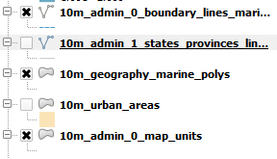
QGIS – using NE Quickstart’s .qgs
Open Natural_Earth_quick_start_for_QGIS.qgs
Lots of very nice layers pre-styled for you
Can take it as it is, or choose to hide some of the ones you don’t need by deselecting:
10m_admin_1_states_provinces
10m_urban_areas
etc.
Notes:
Luckily, Natural Earth provides these nice project presets for Arc and QGIS. We’ll go ahead and open up the pre-made .qgs file by clicking Open, navigating to where we downloaded NaturalEarth and opening quick_start_for_QGIS.qgs
This does a lot of styling for us across a lot of layers of geographical data. We don’t necessarily want everything that this gives us though, so we’ll de-select a bunch of layers that we aren’t interested in. You can decide what you want to keep and get rid of here, and you can also change the style for individual layers to tailor it to what you’re trying to plot. At long zoom levels, the river systems don’t plot very well at their default thicknesses, but when you’re in a regional map they provide decent resolution for large and small rivers.

Slide 16
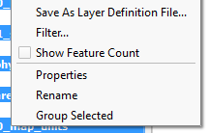
QGIS – using NE Quickstart’s .qgs
Open Natural_Earth_quick_start_for_QGIS.qgs
Lots of very nice layers pre-styled for you
Let’s hide some of the ones we don’t need by deselecting
10m_admin_1_states_provinces?
10m_urban_areas?
etc.
Now we’ll group the layers to get them out of the way.
Select all layers, right click, Group Selected
Name it ne_quickstart
Notes:
Luckily, Natural Earth provides these nice project presets for Arc and QGIS. We’ll go ahead and open up the pre-made .qgs file by clicking Open, navigating to where we downloaded NaturalEarth and opening quick_start_for_QGIS.qgs
This does a lot of styling for us across a lot of layers of geographical data. We don’t want everything that this gives us though, so we’ll de-select a bunch of layers that we aren’t interested in. You can decide what you want to keep and get rid of here, and you can also change the style for individual layers to tailor it to what you’re trying to plot.
Now that we have our backdrop sorted out, let’s group everything together by selecting all the layers and right clicking, then clicking Group Selected. Give the layer group a name, and we’ll be able to tuck it out of the way all at once.

Slide 17
QGIS – using NE Quickstart’s .qgs
Notes:
And here’s what the NE Quickstart gets you, for everybody not doing this. We’ll drill in on our project area once we’ve added our Geoserver data layers to the map.

Slide 18
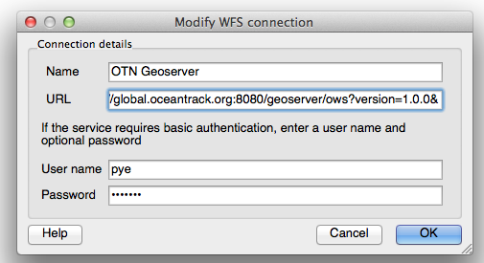
Adding our Geoserver to QGIS
Layer - Add WFS Layer
Click New button to add a new source for our WFS layers
Geoserver’s URL a bit different for QGIS:
http://global.oceantrack.org:8080/geoserver/ows?version=1.0.0&
Username/password not required for public layers
Can provide authorization for private layers here
Notes:
The real advantage to the grouping of background layers is that we can make sure they all stay in the background, arranged relatively in a way that makes good sense. The preset also does some useful things with rivers and lakes at high zoom levels that it would take some time to figure out manually. Now let’s add OTN’s Geoserver to QGIS. QGIS will remember these credentials and let you come back to this server to get new layers in future projects.

Slide 19
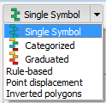
Adding/styling a Geoserver layer
Highlight the layer you want, click Add
The layer appears in your layer list – make sure it’s above the ne_quickstart we added earlier (will be drawn on top)
Double-click to open Layer Properties. Hit Style sub-tab
Change Single Symbol to Categorized
For Column, use ‘collectioncode’
Hit Classify button
Hit Apply
Stations are grouped and color-coded for you
Further refine station classifications – render certain lines
Can delete all undesired classification groups
Could use rule-based filtering in Style
Notes:
So I’ll run through the steps, and then show the output right after this slide.
First we add the stations layer. Highlight it and click Add.
It goes on top of your layer list, meaning it’s drawn last. But the style we have is maybe not what we had in mind. We’ll go and change that. Double-click the layer to open its Properties. We’ll go to the Style sub-tab and create sub categories for all our stations using the Categorized symbol setting.
So where it says Single Symbol, we change that to Categorized, and we can now subdivide our data by one of its metadata columns. A really useful one for Stations is ‘collectioncode’, so we’ll pick that. We then can hit classify, and then it will assign a random color to each unique collectioncode in the list. Now we can edit each of these subdivisions individually, and we can even get rid of some or most of them (causing them to no longer be rendered on our map), I’ll get rid of everything but HFX.

Slide 20
Notes:
So here we’ve added the Stations layer, we’re in its Properties window. We’ve selected Categorized as our layer type and have classified all our different stations by their collection code.

Slide 21
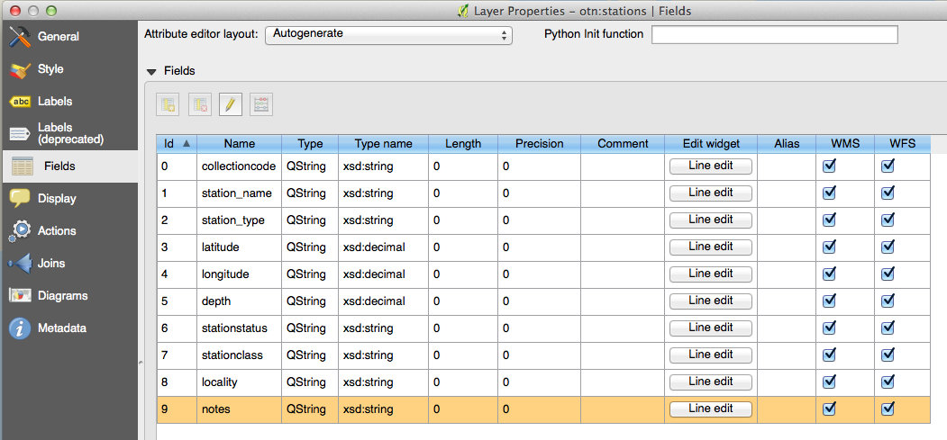
Metadata from the Geoserver layer is available here
Notes:
Here are the properties for each point

Slide 22
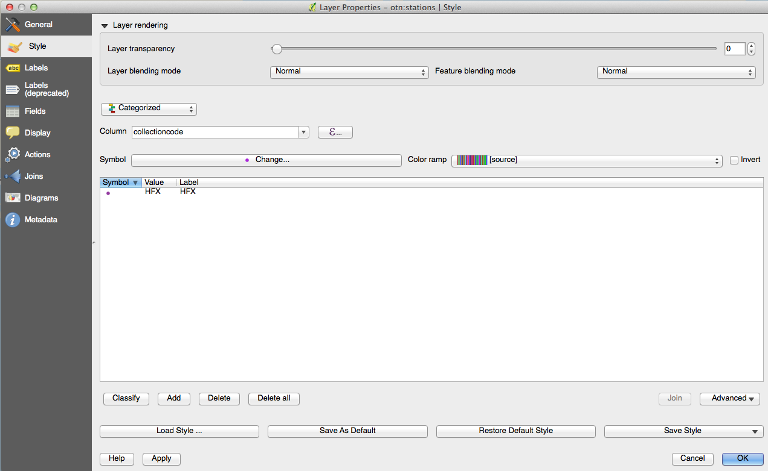
Notes:
But for now, let’s just get rid of every classification but HFX…

Slide 23
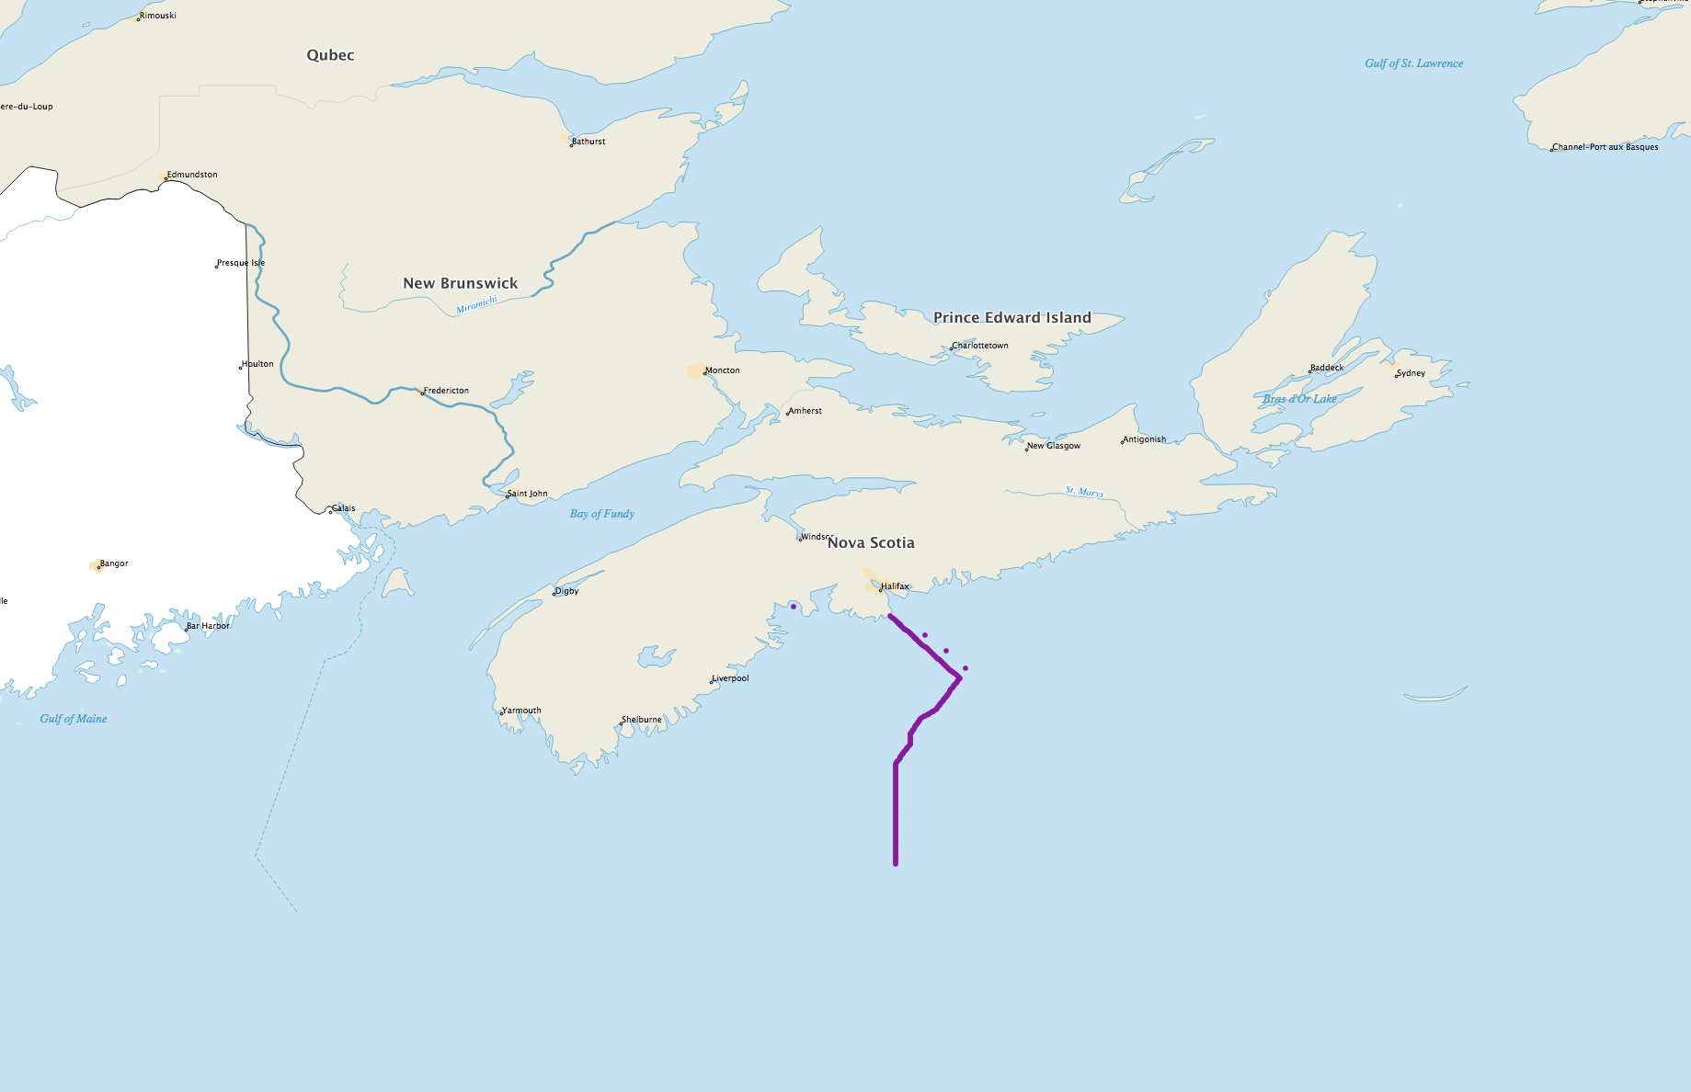
Notes:
And we end up with a very similar result as we had in our Python example.

Slide 24
Notes:
So here we’ve added the Stations layer, we’re in its Properties window. We’ve selected Categorized as our layer type and have classified all our different stations by their collection code. (click)
Here’s some of the other metadata available for the OTN stations layer. We can group on any of these, use them as labels on the map, create equations using their values to define new strings to print as labels, or to use as styling values for size or color, transparency or shape(click)
We’ll get rid of every line except HFX in the classifications list here (click) and that will show us a map that is very much like the one we created in Python.

Slide 25
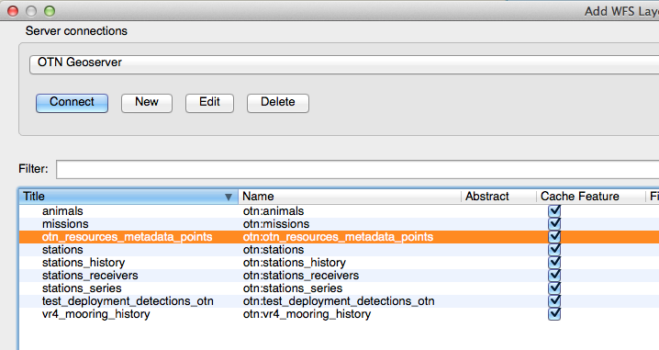
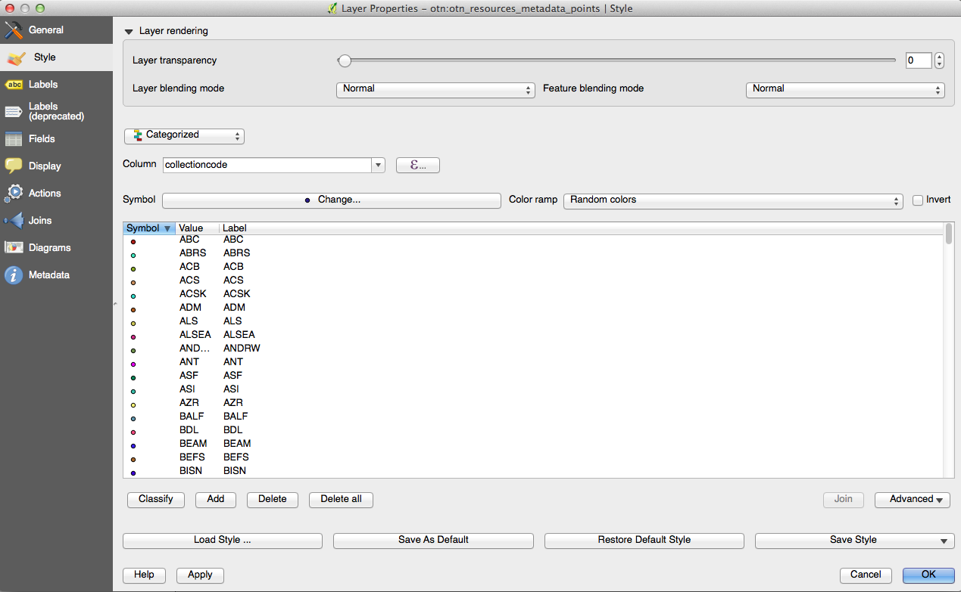
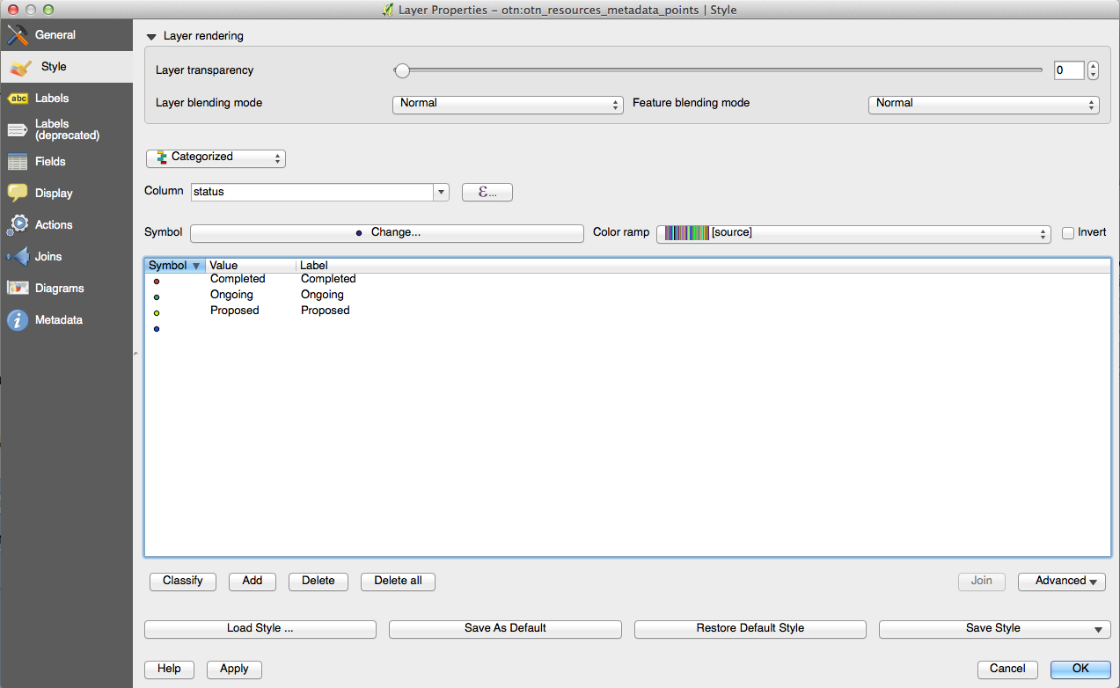
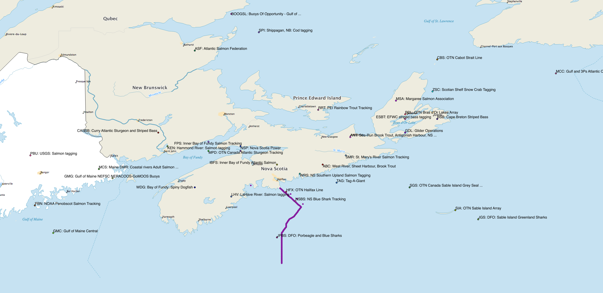
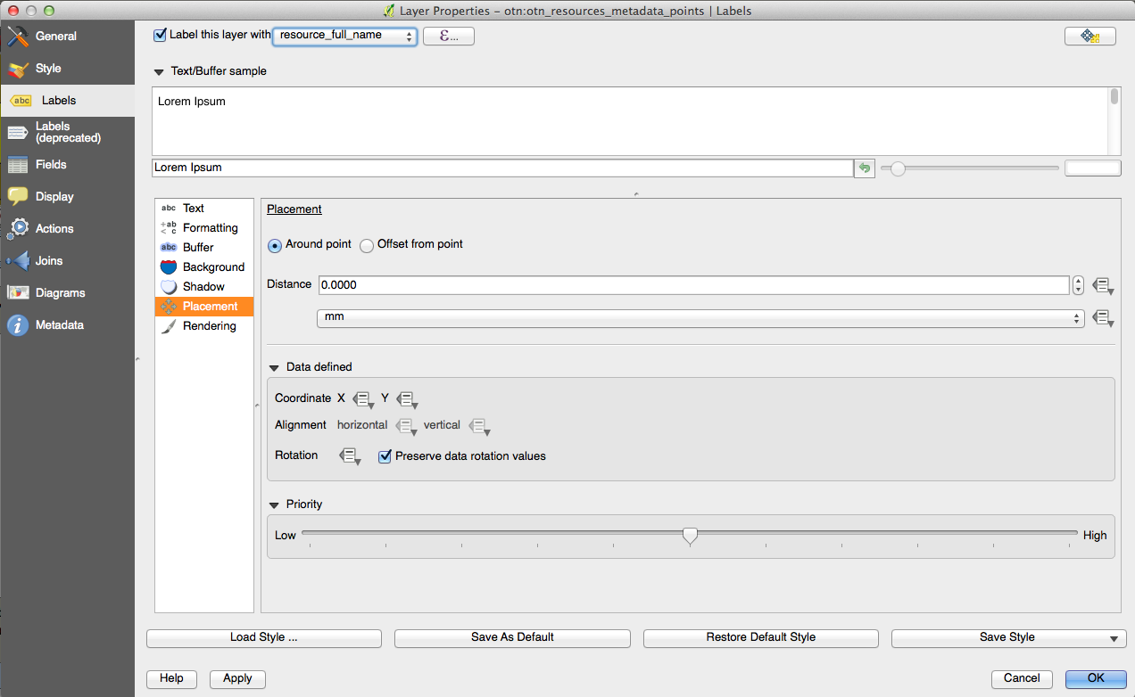
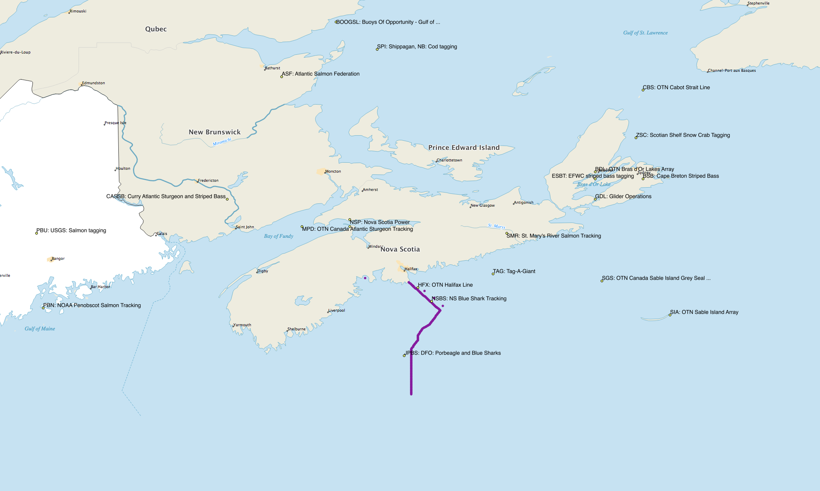
Adding WFS layer: otn_resources_metadata_points to the map
Notes:
If you’re following along in QGIS, you could try adding another WFS later from the OTN geoserver, so this time let’s grab a metadata layer, otn_resources_metadata_points, and we’ll use it to mark all the other projects in the area. (click) We’ll also label them by their resource_full_name values via the Layer Properties. So let’s do that now. (click) We'll head over to the Labels tab of this layer's Properties menu, and select the full_name column as the label text. Let’s have a quick look at that. (click) It's a little busy-looking here on the scotian shelf, so we'll recategorize and make sure we only display the Ongoing resources. We do that by deleting the other classifications in the Style tab just like we did before with stations, so they aren't rendered onto our map. And there’s a map of just the active tags.

Slide 26
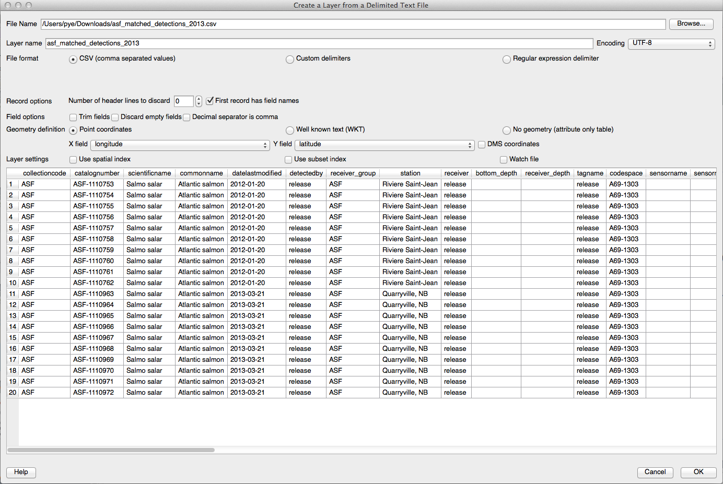
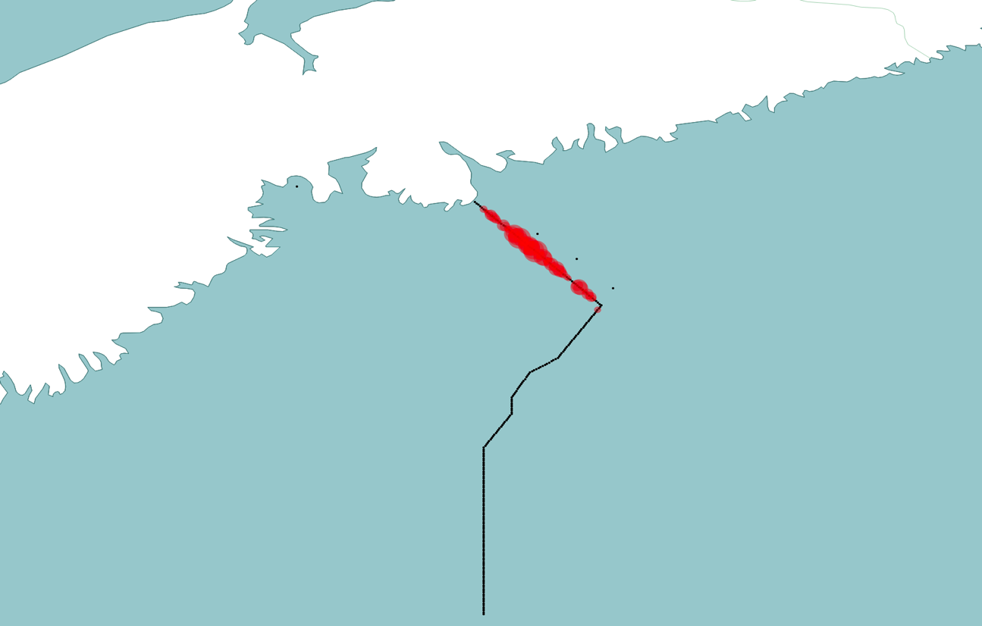
Tools make everything easier
Now that we have our stations, let’s use some detection data
Layer – Add Delimited Text Layer
Select a Detection Extracts file from the OTN Repository
Since this file has Latitude and Longitude, QGIS recognizes its location information and plots it onto a layer
All associated data from the file is available to use for filtering/styling/summarizing
Detection Extracts not special, any .csv with lat/lon columns can be ingested this way.
Notes:
So I would argue that we arrived much more quickly at a useful, printable map with QGIS. GIS tools made things easier for us, and we were able to spend our time styling things the way we wanted to. So now we have our stations on a pretty good looking map, let’s look at how to add in some detection data. So we’ll use a Detection Extracts file from the OTN repository as an example of how to bring in your own data. To do this, we click the Layer menu – and select Add Delimited Text Layer. I’m using blue shark data here because it was something I already had downloaded and I know the researchers won’t mind.
Since this CSV file has got labeled Latitude and Longitude columns in it, QGIS can translate these rows of data into points with associated metadata values equal to the contents of the other csv columns. Our Detection Extracts files are well-described spatially, but certainly it’s not hard to get your data into a form that QGIS can ingest. Any lat/lon referenced CSV can be similarly ingested into QGIS, including things like summary files on a per-station basis, or model output.
In the case of summary files, if we had some numerical data associated with our detections, we could adjust their style according to the value of each data point, by using a Graduated rule on that column

Slide 27
Tools make everything easier
Now that we have our stations, let’s use some detection data
Layer – Add Delimited Text Layer
Select a Detection Extracts file from the OTN Repository
Since this file has Latitude and Longitude, QGIS recognizes its location information and plots it onto a layer
All associated data from the file is available to use for filtering/styling/summarizing
Detection Extracts files not special, any .csv with lat/lon columns can be ingested this way.

Slide 28
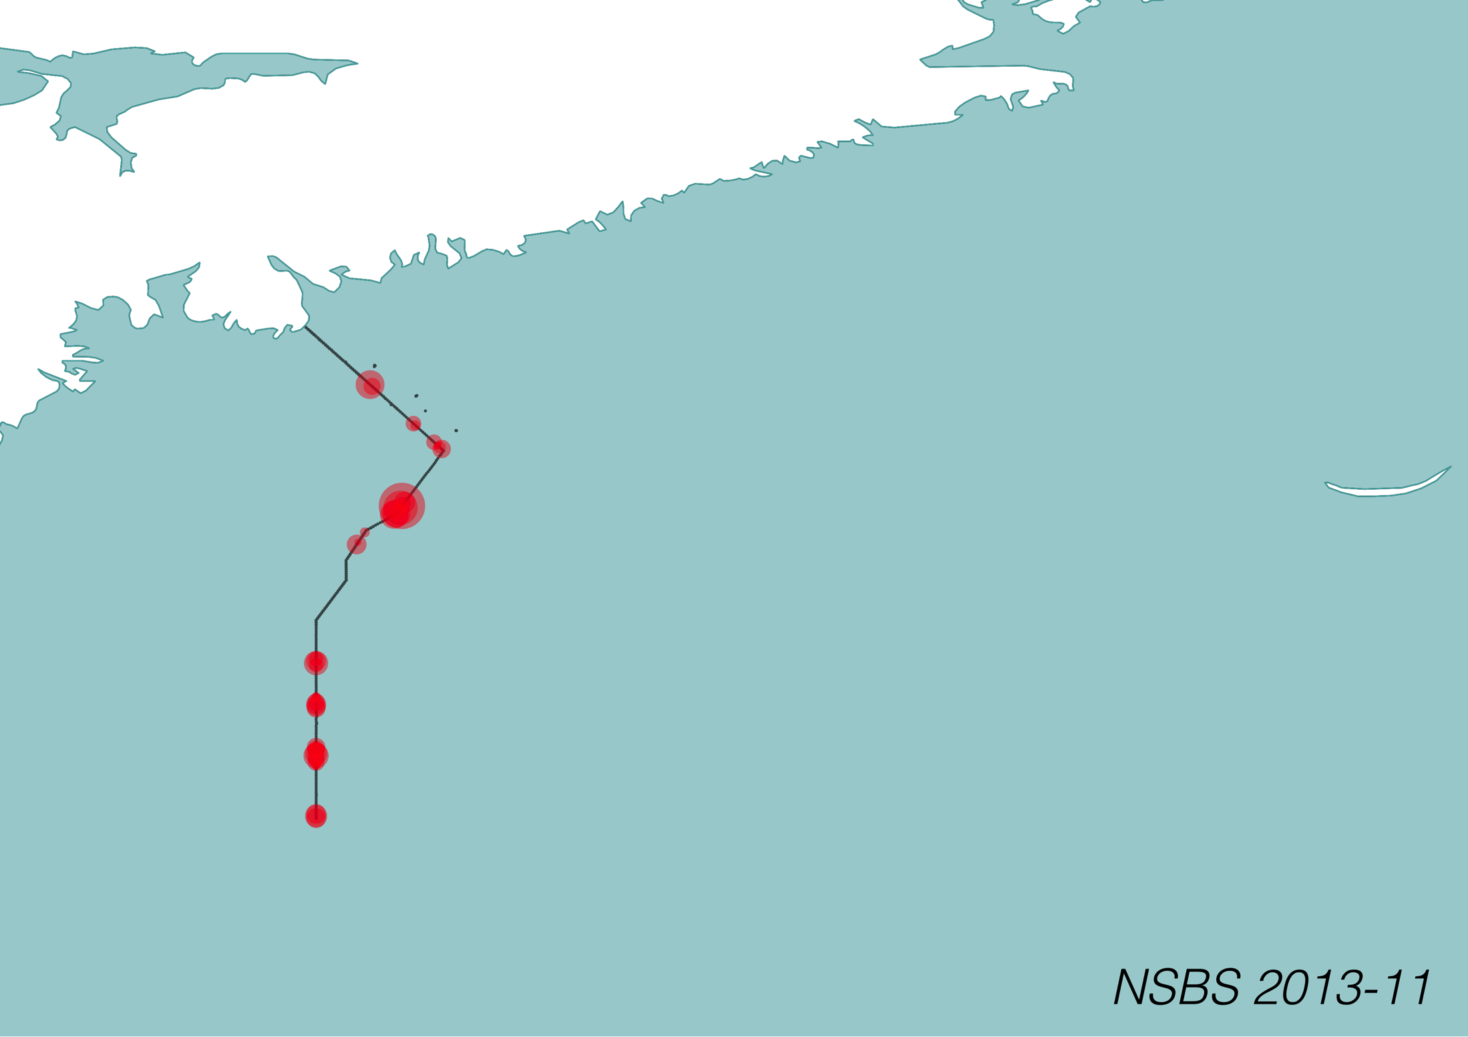
Detection data styling
Can create summarized data files that give location and the information you wish to convey
EG: Summary of detection count by station, sized by number of detections:
Notes:
Now that we know how to bring in CSV data, we can start to include in our data sets the information we need to create the images we want. Here’s a CSV we generated with all blue shark detections for the month of November summarized by station. Since there’s scalar data associated with each station (detection count), we can make the bubble size a function of that number and QGIS handles the styling details.

Slide 29
QGIS Print Composer
Lock in a certain style and image layout for printing
Define map areas, inset maps, logos, title graphics, legends
When map layers are updated, legends are repopulated and maps redrawn in-place.
Notes:
Once you’ve got your map and data layers well defined, you’ll need details like titles, legends, maybe even inset maps, hopefully the OTN logo…. And when you come back a month or a year from now and make a map with the latest data, you might like to keep that layout and format the same. QGIS’s Print Composer will let you define this layout and hold onto it for future renderings of this project. Update your data layers, and it will redraw the maps, re-populate the legend, and preserve the look and feel across multiple iteration sof your data. Let’s have a quick look at that.

Slide 30
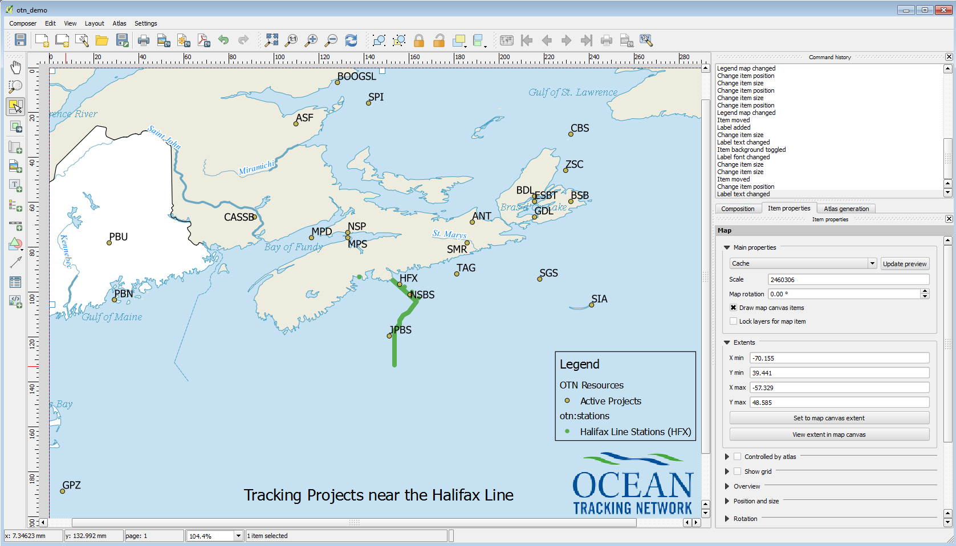
QGIS Print Composer
Notes:
The legend is populated initially with all the layers included in the map. You can then exclude background layers like our Natural Earth layers from the legend to simplify, and rename the layers you do want in the legend for clarity. Using the Print Composer, you can keep this layout and use it in other geographical areas, for other data sets, always preserving the layout and background layers. This is an really useful tool to keep geospatial figures consistent and coherent across data sets, but still let you play with the rendering of the content layers.

Slide 31
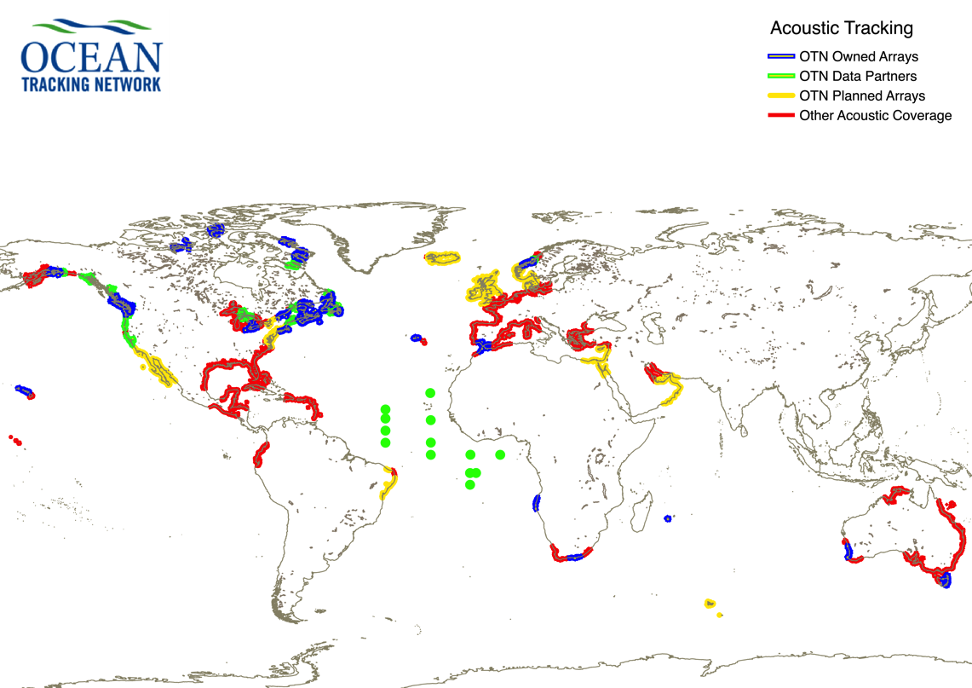
Geospatial Queries in QGIS
Objects in QGIS are shapes, so intersections between shapes / buffer zones from point data can be queried
Results of that query can be highlighted, eg:
Global coverage
By intersection b/t buffer around station points and coastline shapefile
Add high seas buoys manually afterward
Notes:
Now, just as a teaser, some ideas on what else can be done once your data is in a suite like QGIS. Since we’ve imported our stations and our detections and maybe even our release locations as shapes, we can now use spatial queries to do things like define buffer zones around our stations, determine the intersections between those buffer zones and other points or shapes, etc. (click) Here I’ve created buffer zones around our stations, and marked where they intersect with the coastline shapefile. I’m able to define a new style for this new intersection layer, and highlight the areas where OTN is actively detecting. I grabbed the geoJSON from Vemco’s website and was able to lay their active detection areas on top of that as well. That’s them in red. This is a huge topic with hopefully more interesting applications in your work, but rendering maps of station coverage at different assumed tag/receiver ranges would be a good potential use of this tool.

Slide 32
OTN’s Geoserver – for you to use
Geoserver provides layers with data from the OTN DB
Using Python/QGIS, plot formats are reproducible when data is added to the OTN Database
QGIS easier to get started with, and lets you spend more time playing with your data’s style and formatting.
More useful information / learning tools:
Cartopy: http://scitools.org.uk/cartopy/docs/latest/
QGIS: http://www.qgistutorials.com/
OTN GitLab: https://utility.oceantrack.org/gitlab/
Notes:
So we’ve touched on a couple of methods you can use to access OTN’s Geoserver layers for creating figures for publication, and gone through some of the features of QGIS that can help you style these layers and generate a print-friendly figure. Hopefully this has been useful, and we hope to work with you to make the tools we discussed today even easier to use on OTN datasets for presentations.
The examples are up on the OTN Gitlab, which is a directory of shared repositories available for use for all of OTN. I hope that the GitLab will be useful to you for future collaborative efforts.

