Slide 1
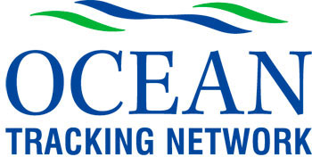
Marine Fishes as a data management case study
Robert Branton
Ocean Tracking Network
Dalhousie University,
Halifax Canada
Bob.Branton@dal.ca

Slide 2
Using Atlantic cod as an example, let us see how various existing data systems are enabling reuse of scientific data and information…
Why Atlantic cod?
Authority
Discovery
Access
Interoperability
Sustainability

Slide 3
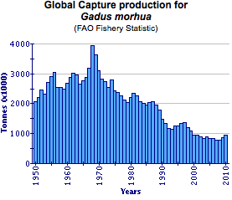
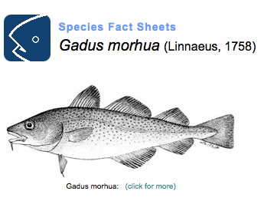
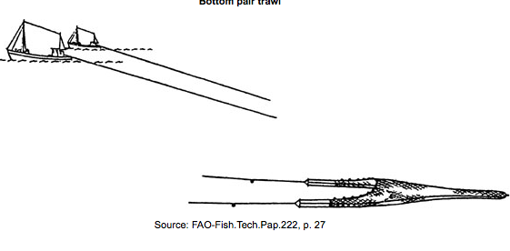
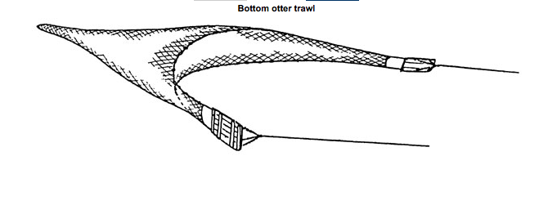
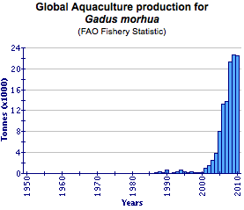
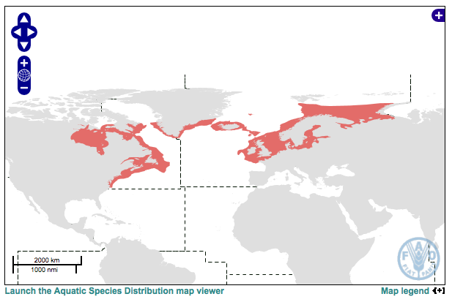
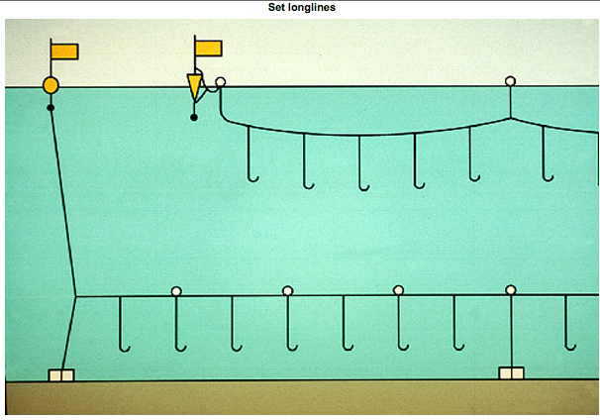
Why Atlantic cod? www.fao.org/fishery
FAO fact sheets …
Among the most important of all commercial fishes, cod has been called "beef of the sea". The Atlantic cod has been exploited ever since man began to fish in the seas of Europe. Its value as a prime food-fish is enormous ...
/ +3

Slide 4
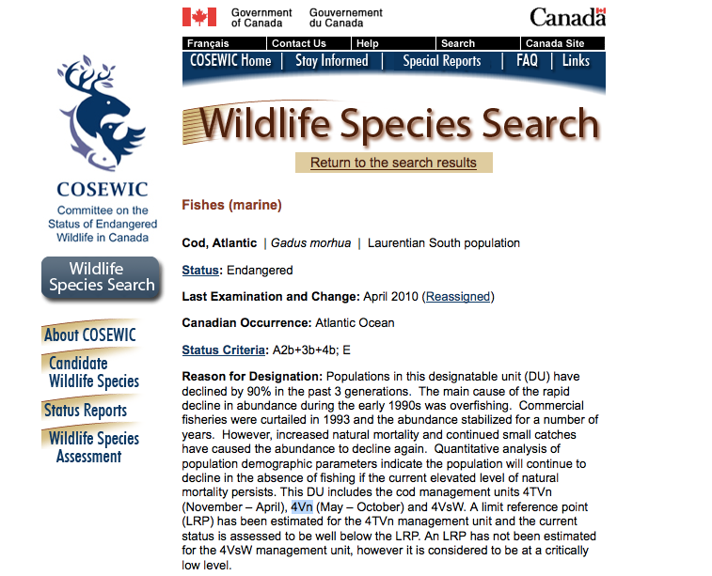
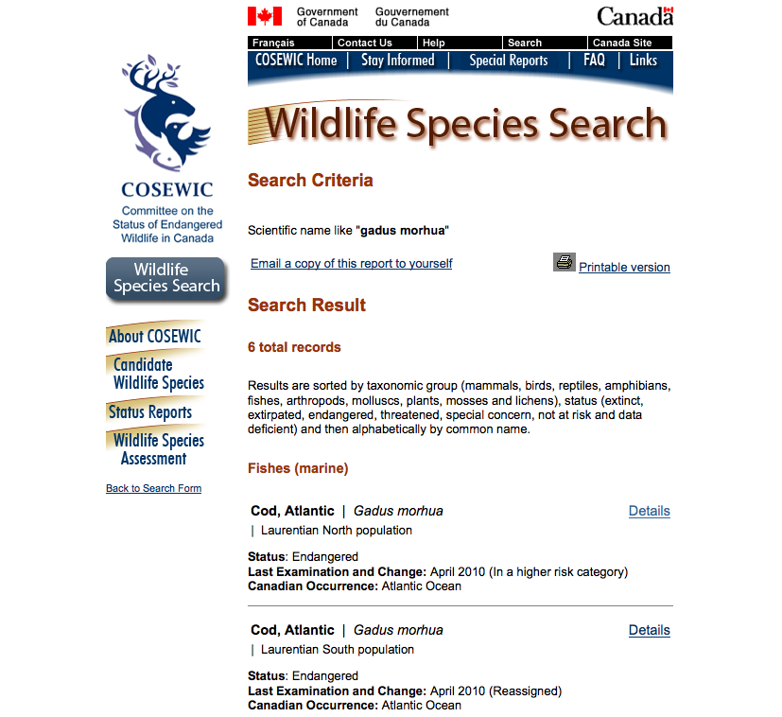
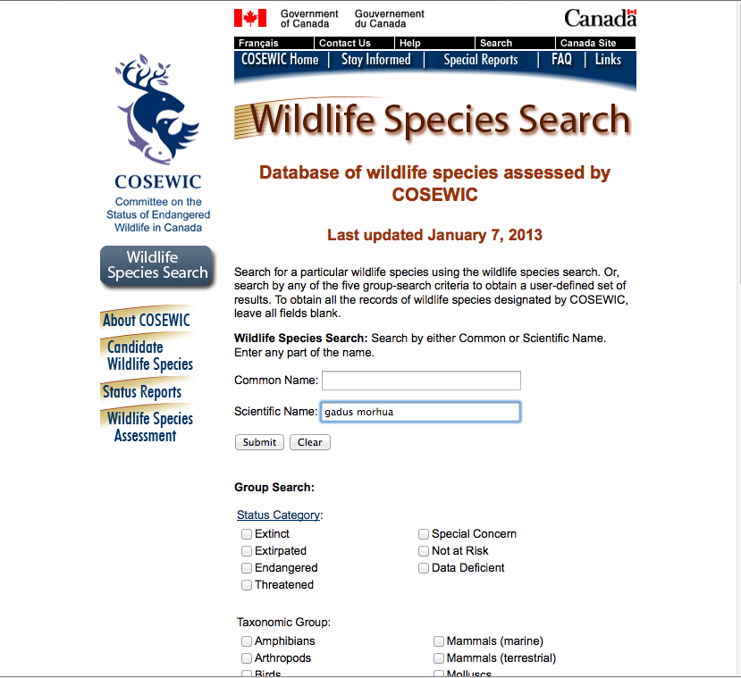
Why Atlantic cod? www.cosewic.gc.ca
/ +3

Slide 5
Authoritative
Using reliable names and hierarchical classifications …
World Register of Marine Species (WoRMS)
FishBase
MarineRegions.org

Slide 6
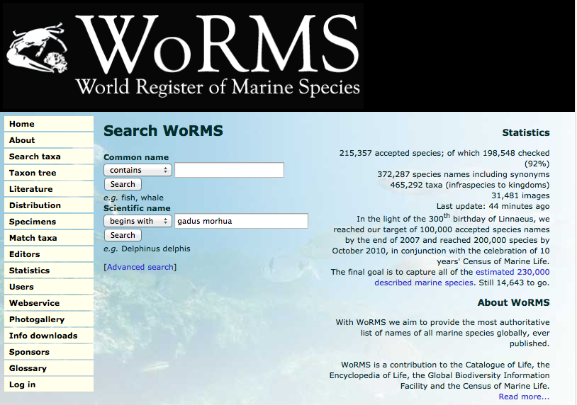
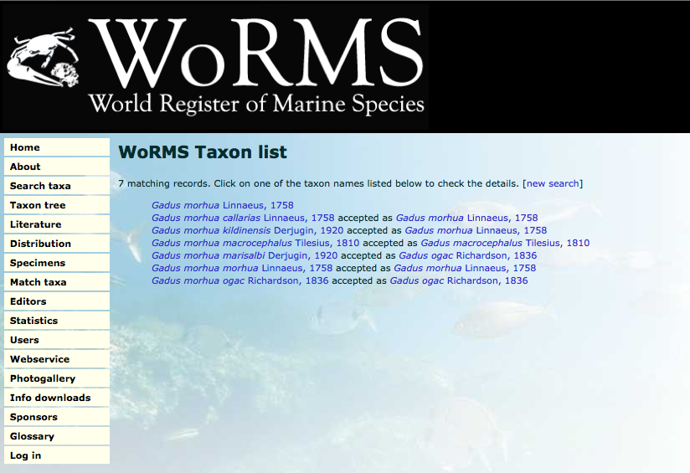
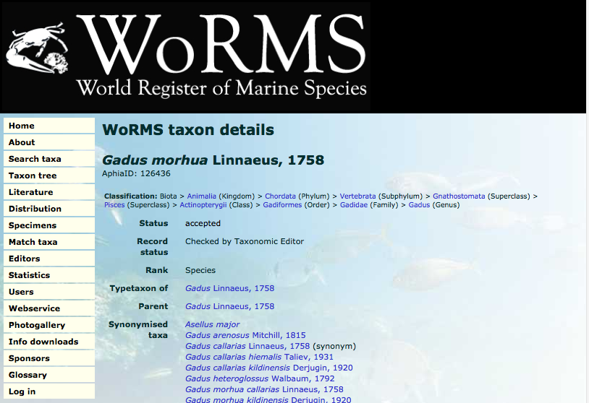
WoRMS – World Register of Marine Species www.marinespecies.org
/ +3

Slide 7
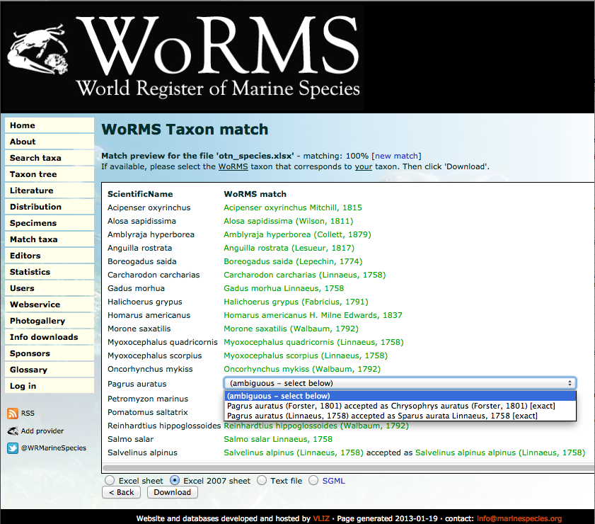
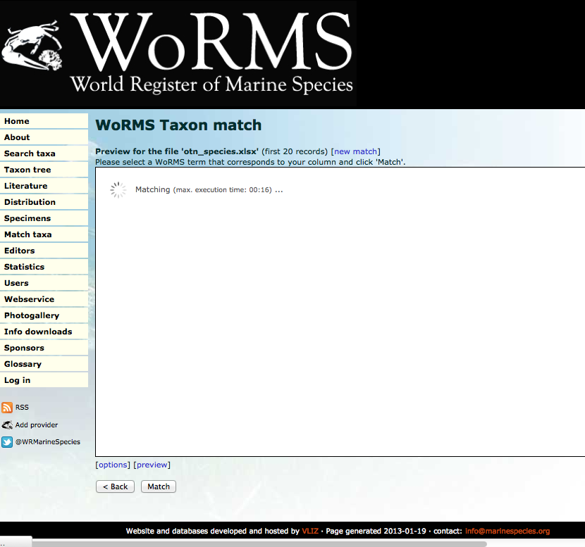
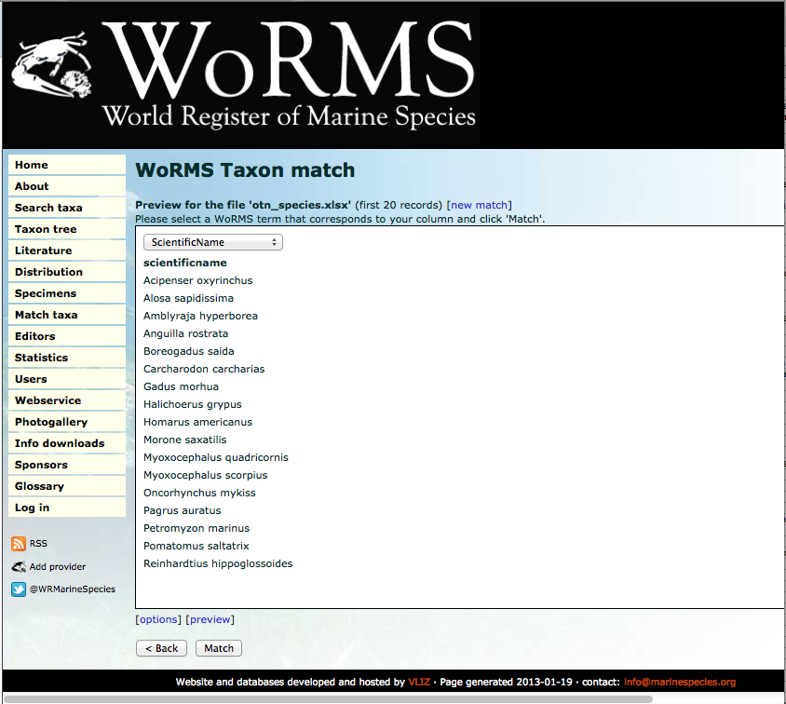
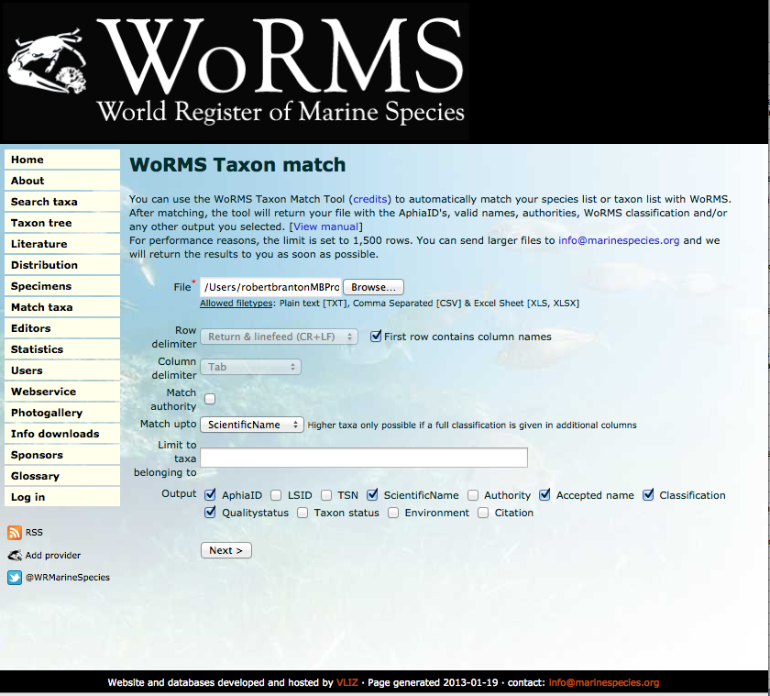
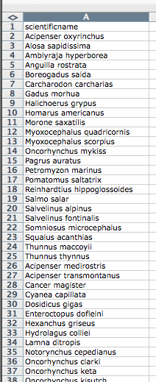
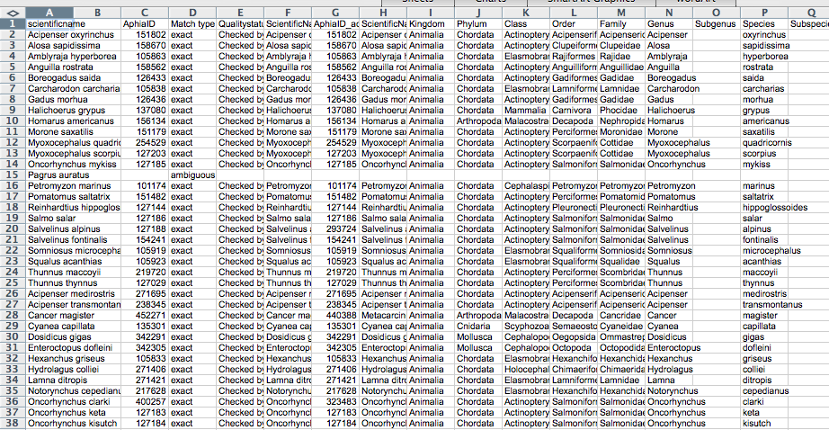
WoRMS – Match taxa
Using lists of names.
/ +6

Slide 8
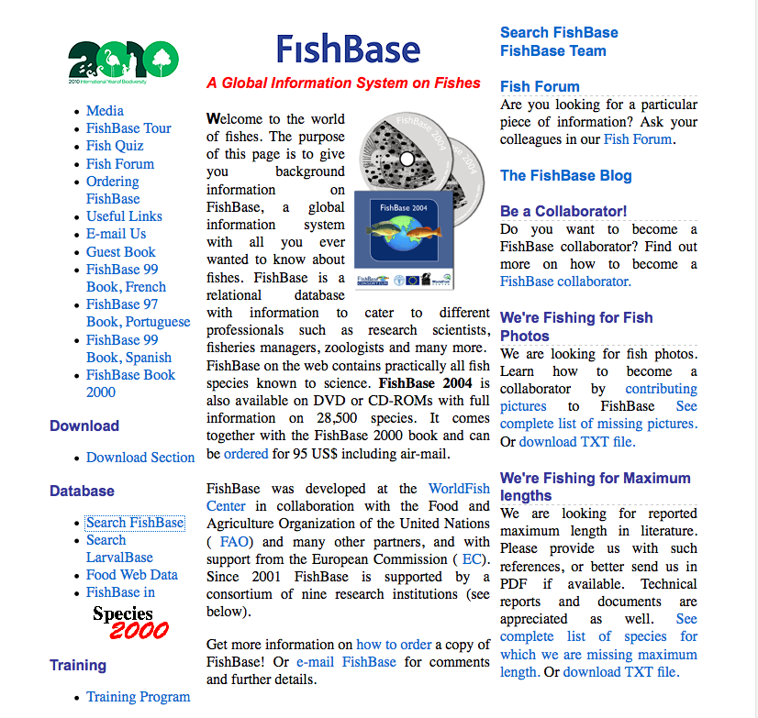
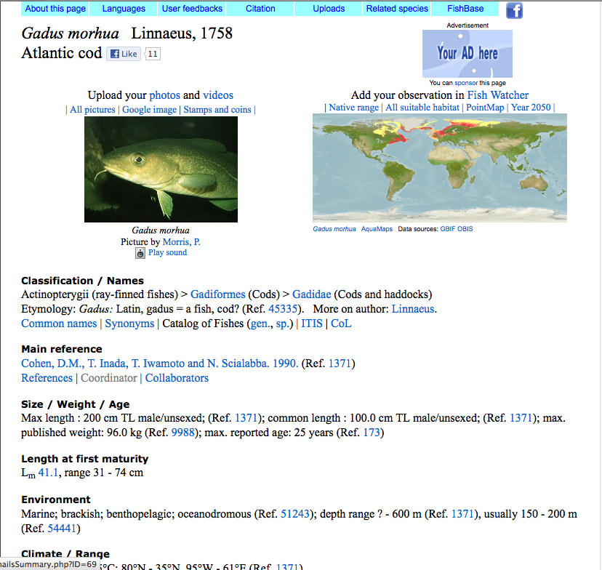
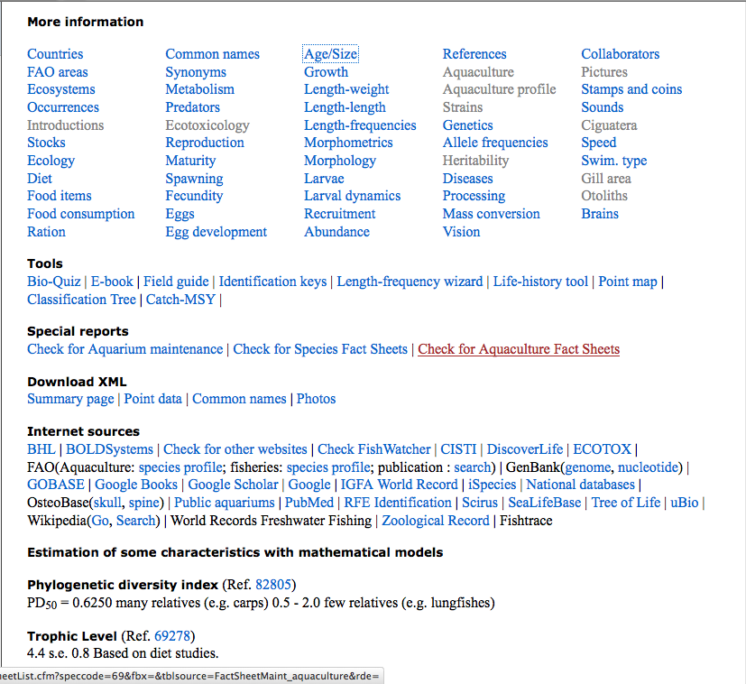
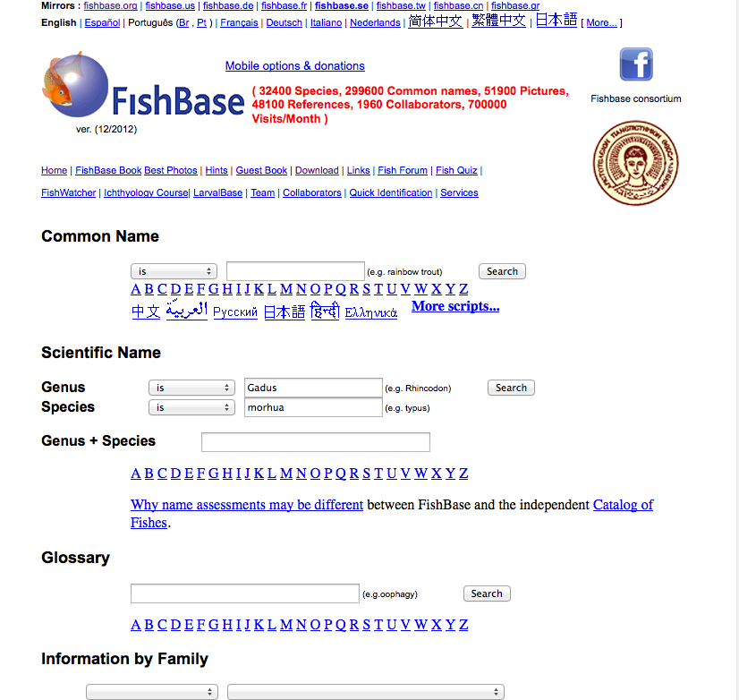
FishBase www.fishbase.org
/ +4

Slide 9
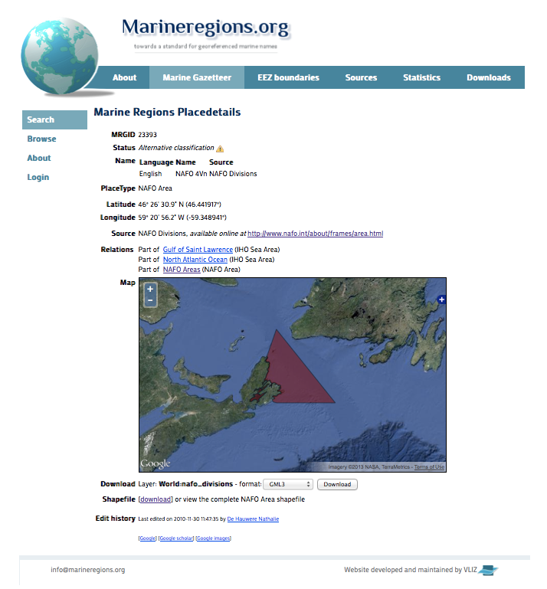
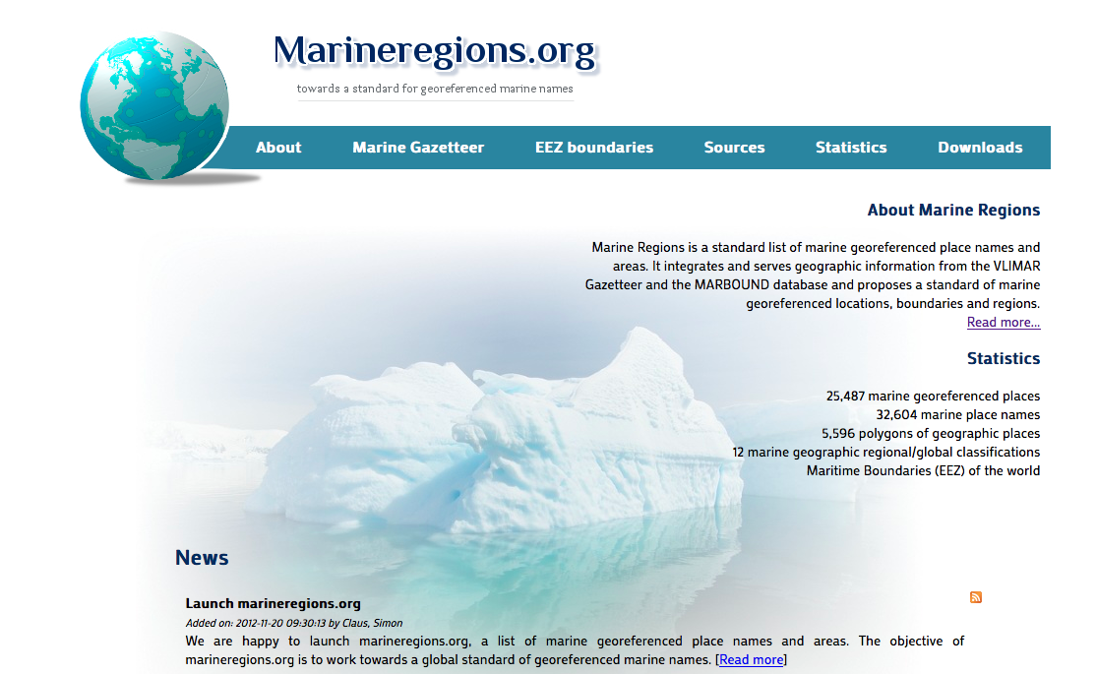
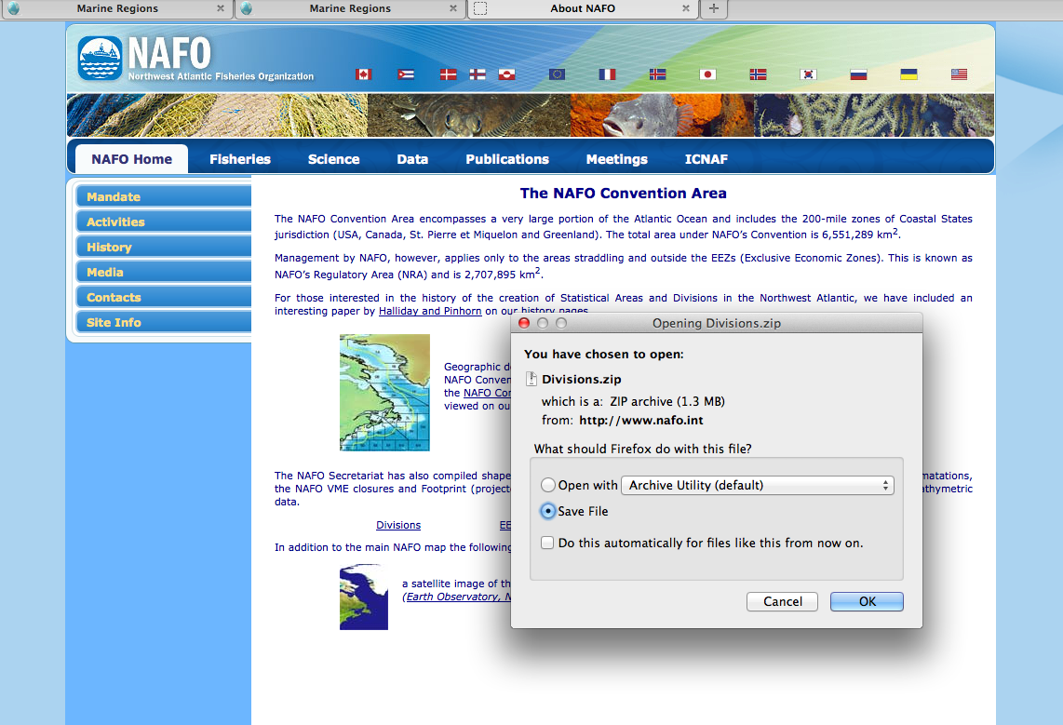
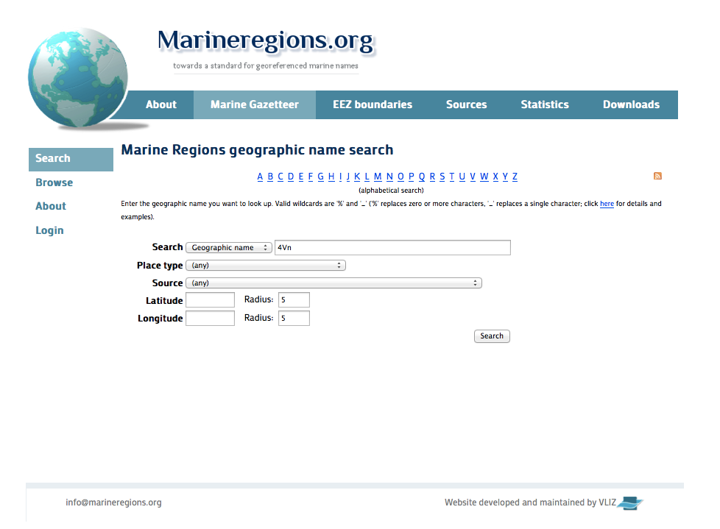
MarineRegions.org www.marineregions.org
/ +4

Slide 10
Discoverable
Listed in publicly searchable online catalog systems …
Global Change Master Directory (GCMD)
GOOGLE, BING
Wikepedia

Slide 11
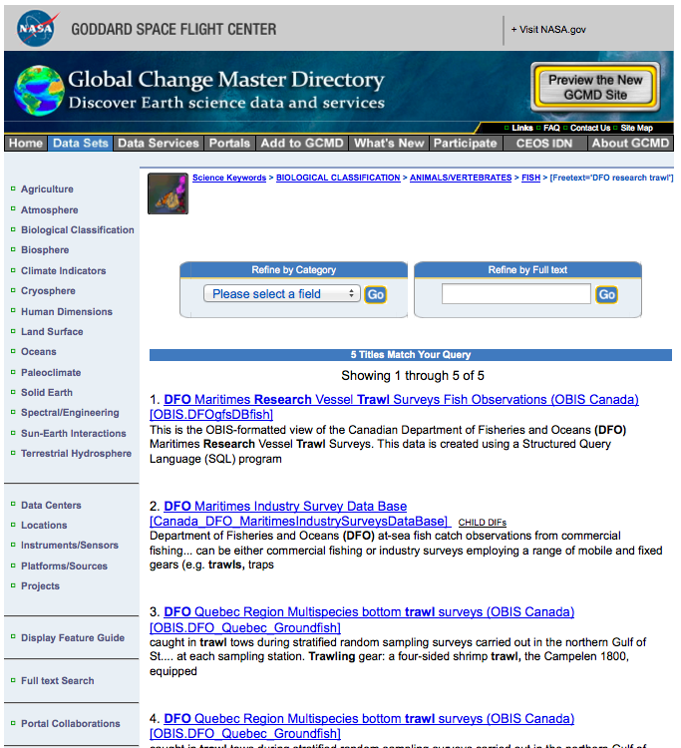
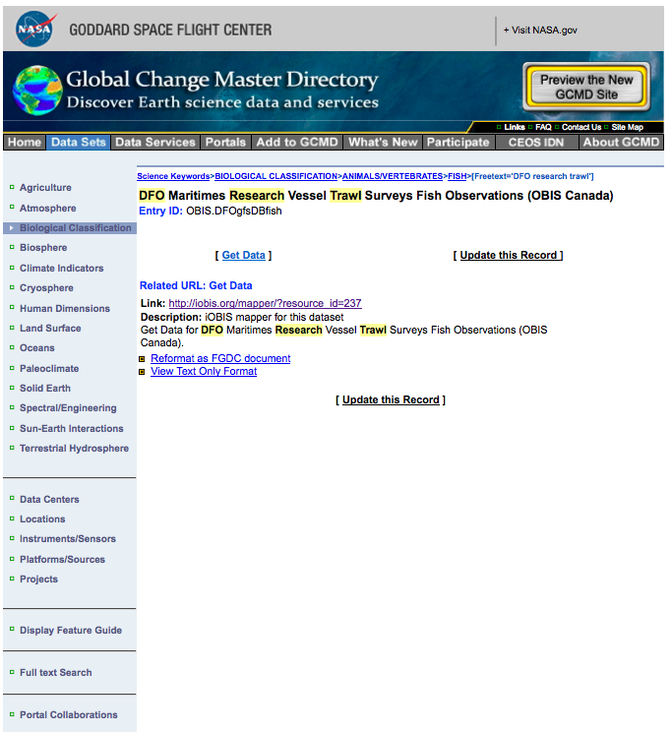
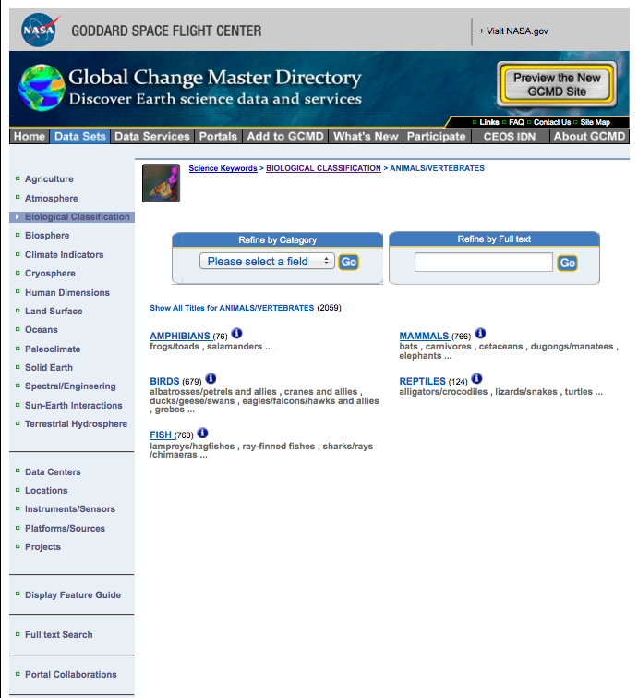
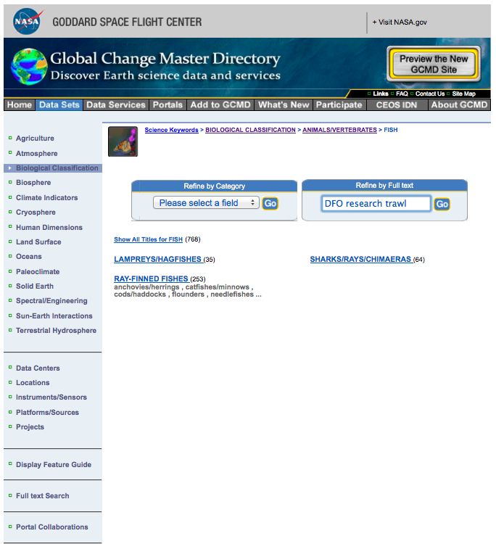
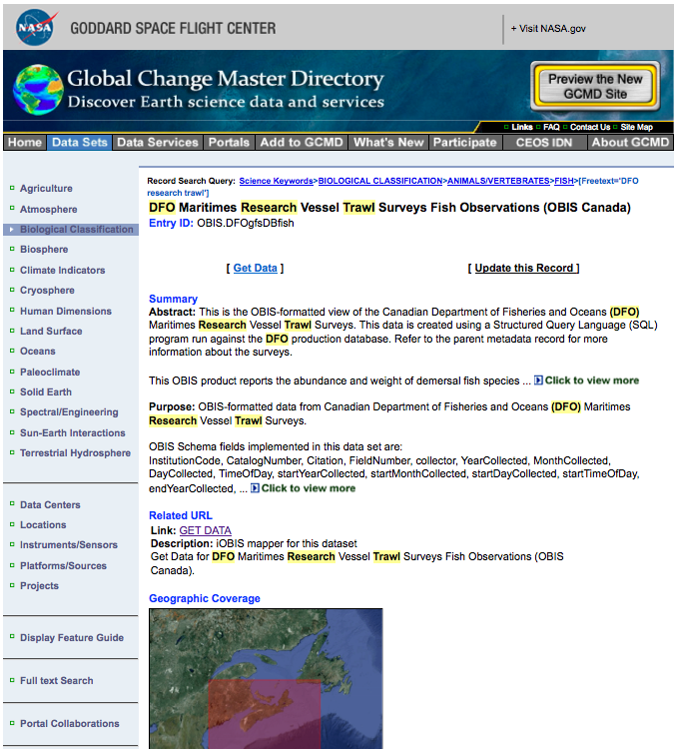
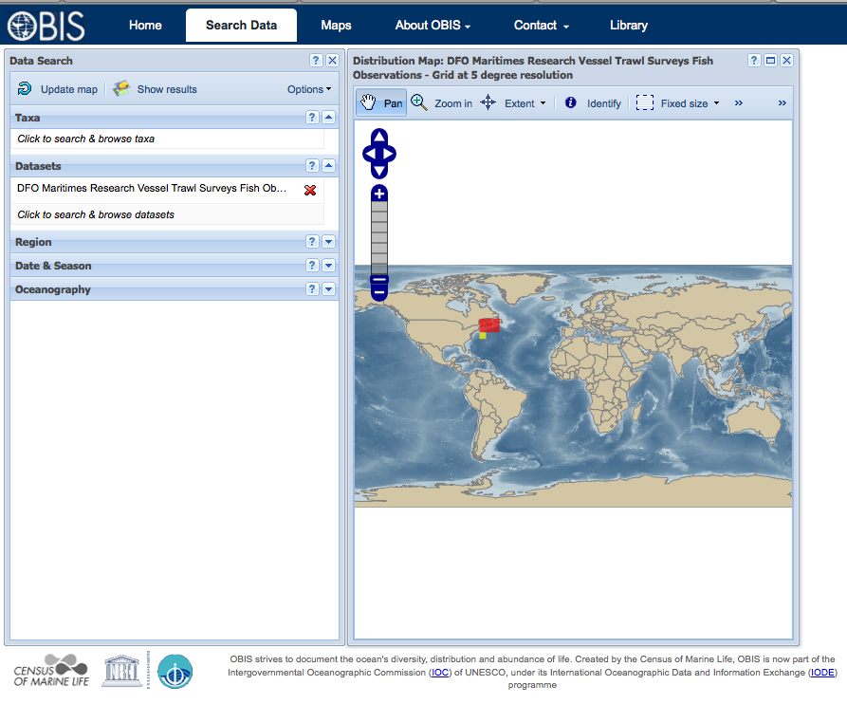
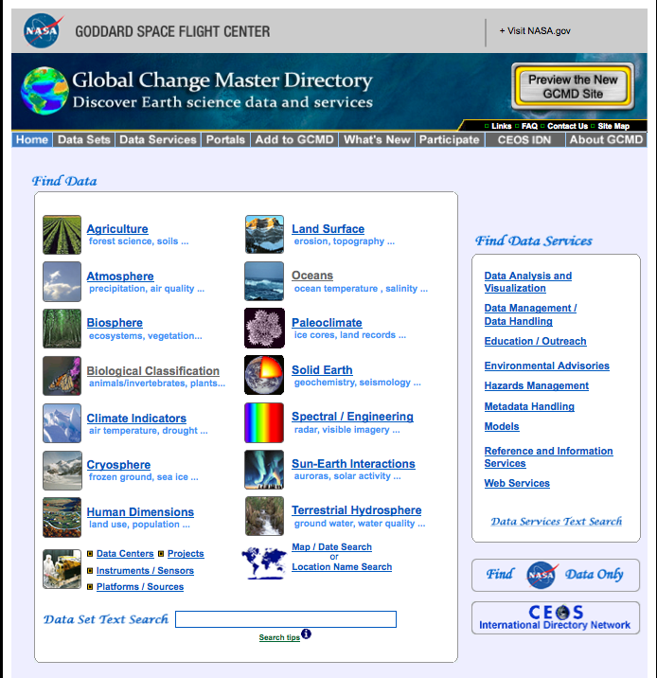
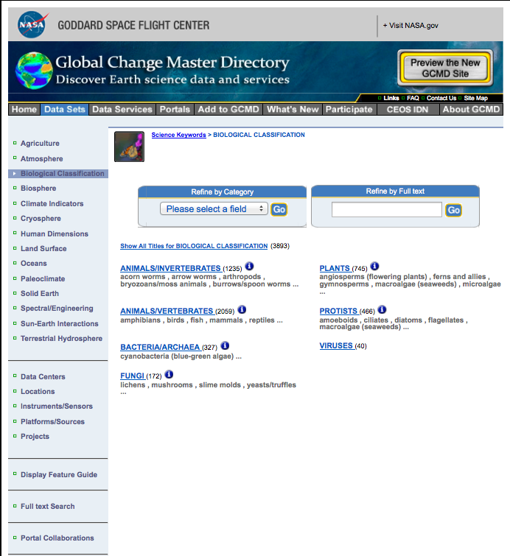
Global Change Master Directory (GCMD) gcmd.nasa.gov
/ +8

Slide 12
GCMD via Commercial Search Engines
✔
✗

Slide 13
Accessibility
Downloadable via geo-referenced systems on marine species …
Sea Around Us Project
Ocean Biogeographic Information System (OBIS)
Ocean Tracking Network (OTN)

Slide 14
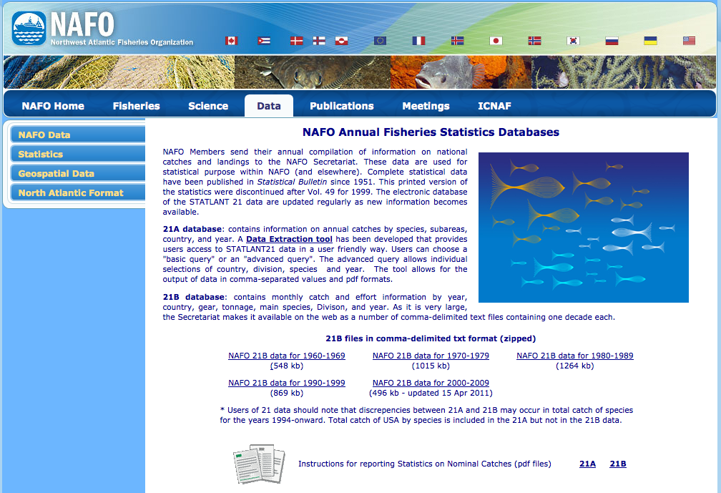
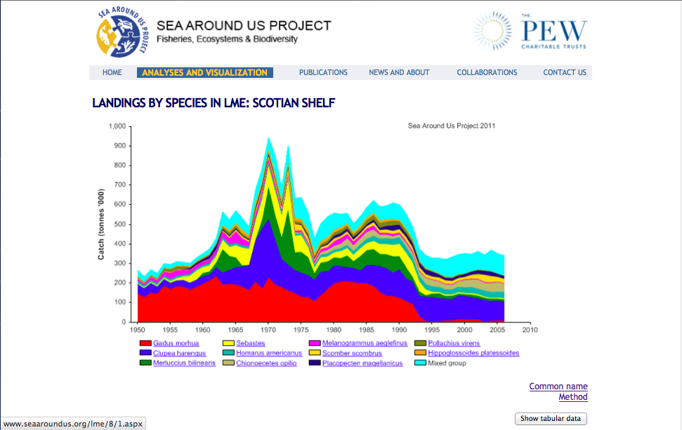
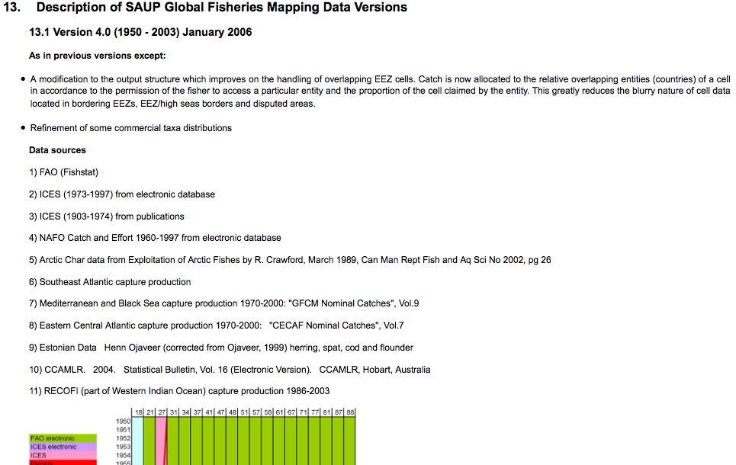
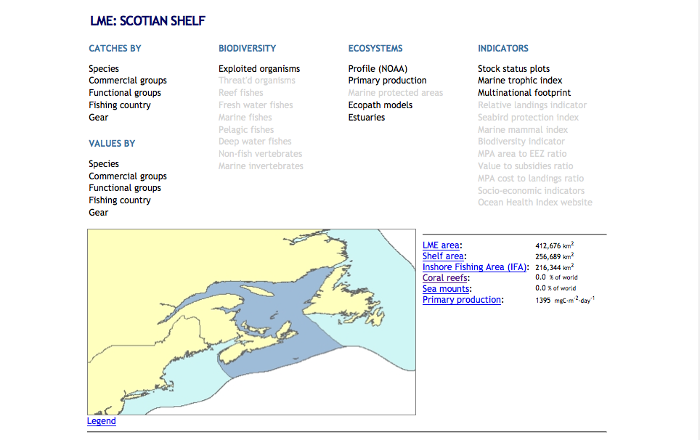
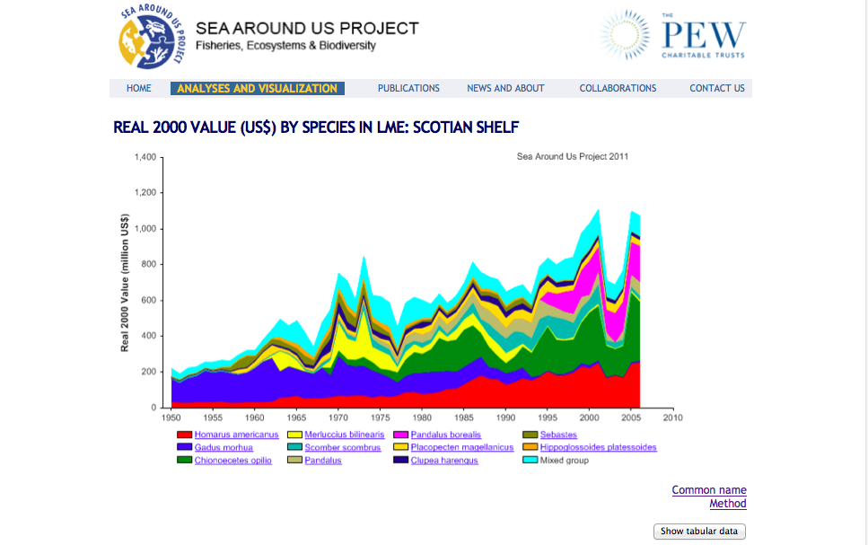
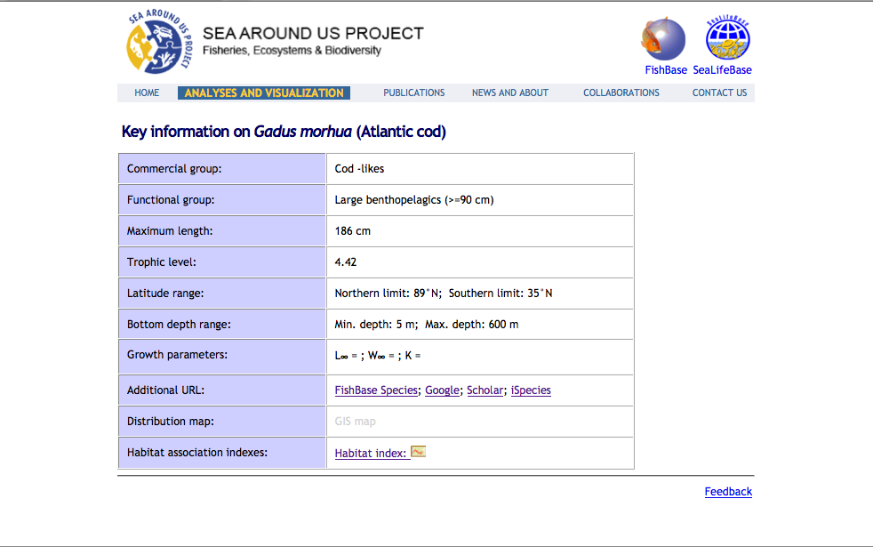
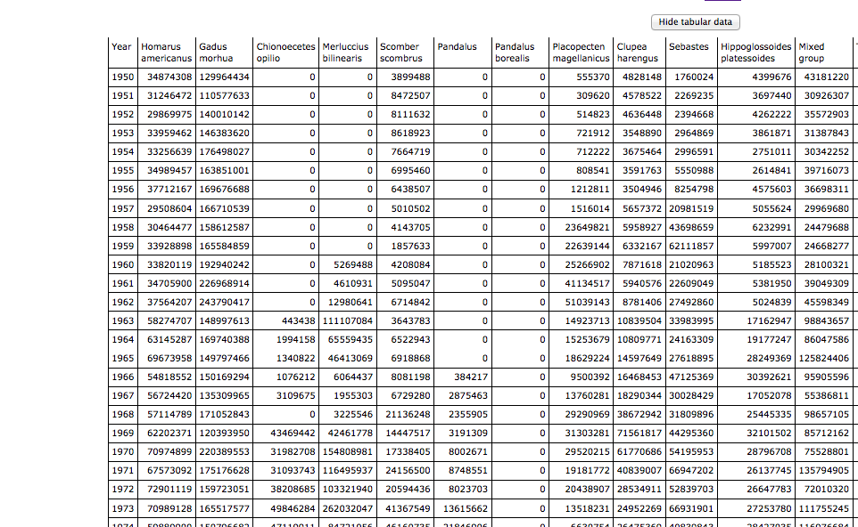
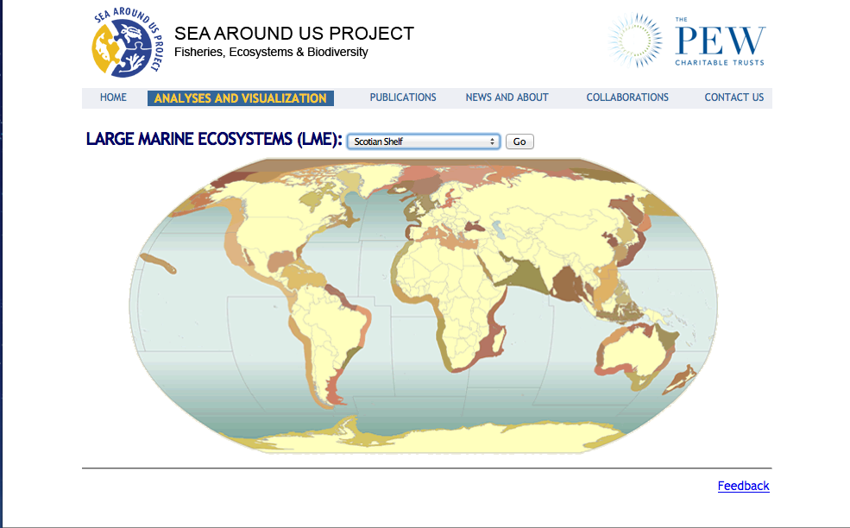
Sea Around Us Project
/ +8

Slide 15
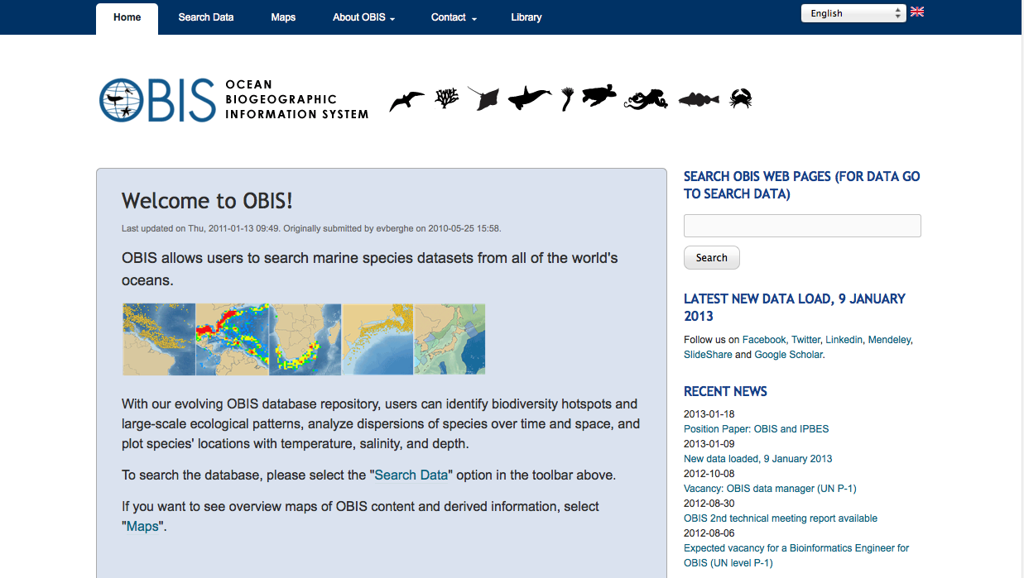
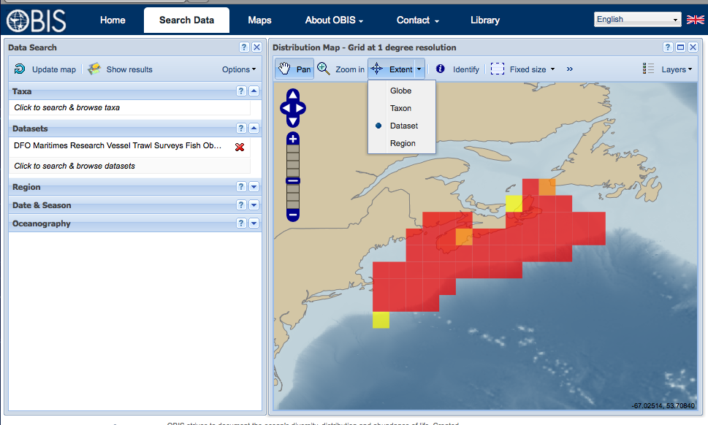
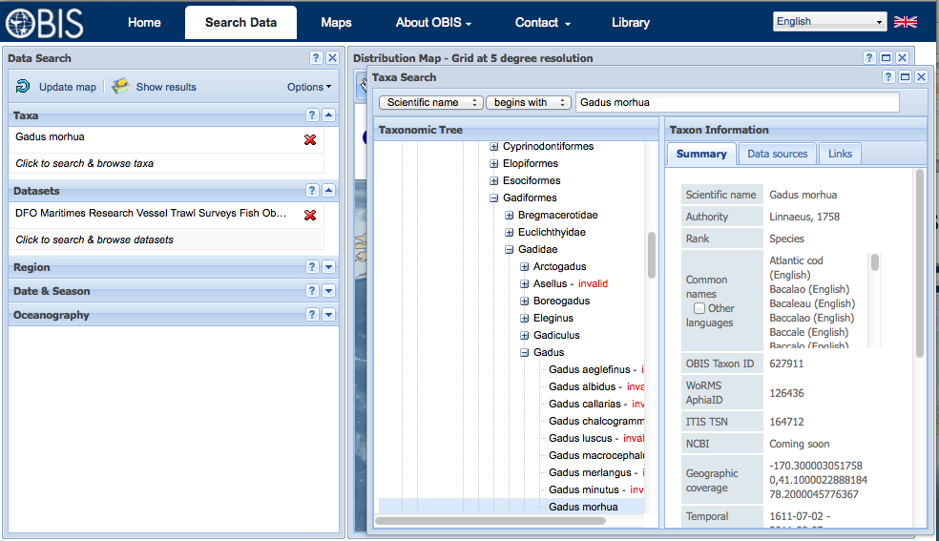
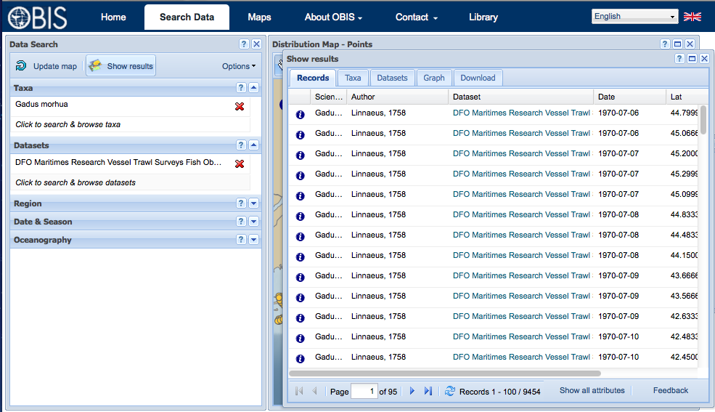
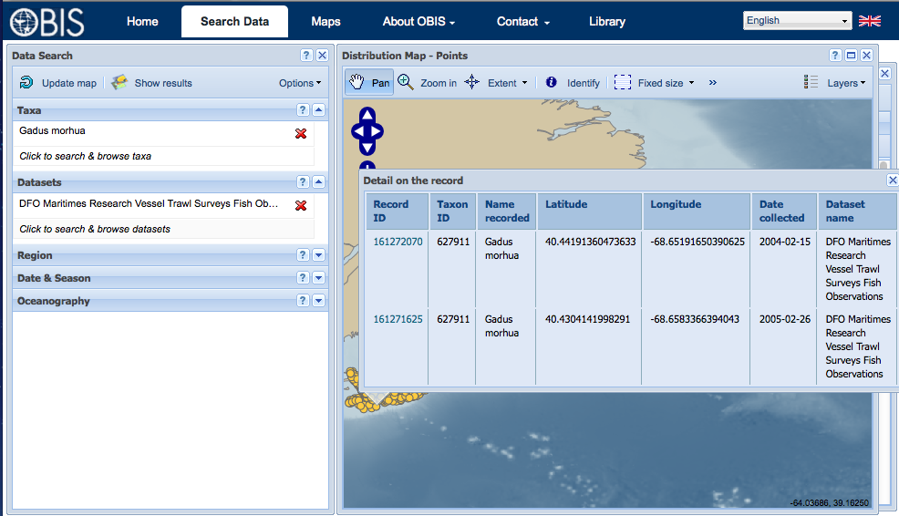
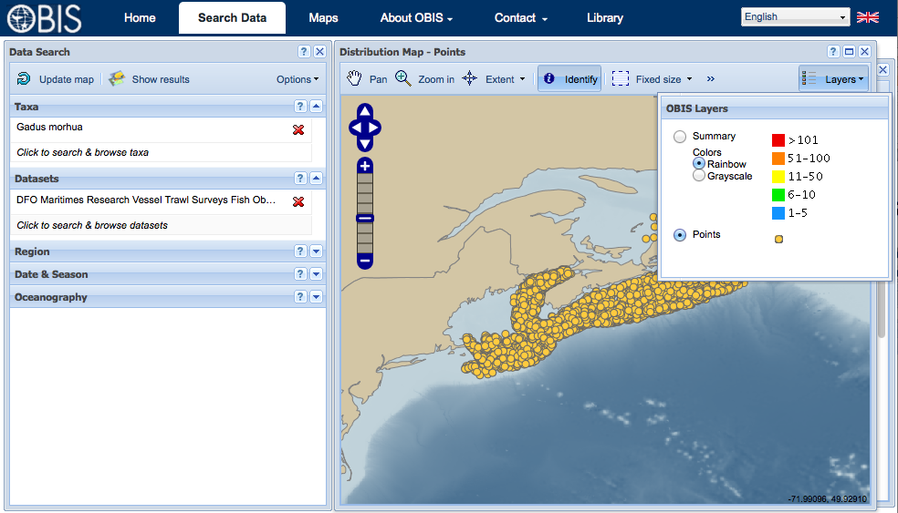
Ocean Biogeographic Information System (OBIS) http://www.iobis.org
/ +9

Slide 16
R Statistical Computing icesjms.oxfordjournals.org

Slide 17
Ocean Tracking Network members.oceantrack.org/data
/ +5

Slide 18
Ocean Tracking Network http://oceantrackingnetwork.org
The Ocean Tracking Network (OTN) data warehouse at Dalhousie University in Halifax Canada now holds 29 million records on 28 thousand tagged animals from 70 plus institutions in 13 countries, including 8 million records recently acquired from the former Pacific Ocean Shelf Tracking (POST).
OTN receiver deployments (small white dots) overlayed with total number of unique tags detected by station (log scaled and colored by type of detection, where ANIMAL is green, MYSTERY is red and SENTINEL is yellow).

Slide 19
Interoperability
Integration with data and software from other disciplines
Comma Separated Variable (CSV)
Shapefiles
Keyhole Markup Language (KML)
Web Mapping and Feature Services (WMS, WFS)
Network Common Data Form (NetCDF)

Slide 20
GeoMapApp www.geomapapp.org
/ +3

Slide 21
Parallel WMS/NetCDF Services
Global union of physical oceanographers and animal trackers.
OTN’s PostgreSQL/POSTGis data system serving as base for IOOS POST-NANOOS US Animal Acoustic Telemetry (AAT) data integration project.
Notes:
21
Describe what has worked well and what you would recommend to other data managers who are working with similar data
Show or describe an example of how this data is used internally or by other organizations in research, decision making, policy development etc.

Slide 22
Intelligent Open Access
2011 Canadian Research Data Summit
all data from public funded research to be made openly available in a timely manner as a condition of funding
Exceptions being sought by OTN include:
not reporting location information on endangered species as a means of protecting them from illegal harvest,
protecting the thesis data for Highly Qualified Personnel who are in training.
http://rds-sdr.cisti-icist.nrc-cnrc.gc.ca/eng/events/data_summit_2011
Notes:
.In 2011 the Canadian Research Data Summit resulted in a unified position of Canadian funding agencies—including OTN’s principal funding agencies CFI, NSERC, and SSHRC—to require that all data from publically funded research be made openly available in a timely manner. Meeting this standard will be a condition for all grantees to maintain funding from these agencies. It is anticipated that this standard will be implemented at some point within the next year. However, it is also anticipated that there may be exceptions provided in some circumstances to the policy that permit investigators to restrict access to data for limited periods. Examples from the OTN context could include not reporting location information on endangered species that network investigators are tracking to protect the animals from illegal harvesting, and protecting the thesis data for Highly Qualified Personnel who are in training.

Slide 23
Preformed Data Citations
OTN is fairly close to recently released ‘Recommended practices for citation of data published through the GBIF network’ - www.gbif.org/orc/?doc_id=4659
For individual collections …
For regional and global collaborations …
2012 work plan calls for provision of ISO/NetCDF standard discovery metadata.

Slide 24
Sustainability
www.iode.org
www.meds-sdmm.dfo-mpo.gc.ca
www.iobis.org
Notes:
The "International Oceanographic Data and Information Exchange" (IODE) programme of the "Intergovernmental Oceanographic Commission" (IOC) of UNESCO main purpose is to enhance marine research, exploitation and development, by facilitating the exchange of oceanographic data and information ...
As a condition of CFI funding, Dalhousie University and Canada’s Department of Fisheries and Oceans (DFO) were required to have a formally signed comprehensive collaboration agreement whereby OTN data would routinely copied to Canada's Intergovernmental Oceanographic Commission (IOC) designated National Ocean Data Centre (NODC), that is the Integrated Scientific Data Management Services Branch of DFO in Ottawa Canada. The required agreement is in and we that OTN and DFO are now in the process of acting on the agreement.
The rational for this NODC based copy has many benefits, including: OTN data could be integrated with established oceanographic databases and potentially flowed directly into international systems such as the Ocean Biogeographic Information System (OBIS), DFO scientists on the other hand would simultaneously and effortlessly conform to both the DFO and OTN data policy and Dalhousie. Furthermore, OTN would have a built-in fail-safe decommissioning process.
As part of this process OTN will use the ISO Marine Community Profile developed by the IODE and the Ocean Biogeographic Information System schemas.
24

Slide 25
Questions ?
Links:
COSEWIC: www.cosewic.gc.ca
FAO: www.fao.org/fishery
GBIF:www.gbif.org/orc/?doc_id=4659
GCMD: gcmd.nasa.gov
GEOMapApp: www.geomapapp.org
FishBase: www.fishbase.org
IMBER - www.imber.info
ICESjms: icesjms.oxfordjournals.org/content/67/4/638.short
IODE: www.iode.org
ISDM: www.meds-sdmm.dfo-mpo.gc.ca
MarineRegions.org: www.marineregions.org
NAFO: www.nafo.int
OBIS: www.iobis.org
OTN: members.oceantrack.org
Sea Around Us: www.seaaroundus.org
WoRMS: www.marinespecies.org

Slide 26
Why Atlantic cod, Gadus morhua Linnaeus, 1758?
‘Since first encountered by native North Americans, then later by European Adventures and fisherman, the abundance of fish in the Northwest Atlantic never failed to amaze.’
George Rose
‘It is difficult to overestimate the economic and social impact of cod.’
Wade Kearley
www.boulderpublications.ca/boulderpublications.ca/Nature.html
Status: Endangered (Varies by Stock) - Committee on the Status of Endangered Wildlife in Canada (COSEWIC) 2010 - www.cosewic.gc.ca

