Slide 1
OTN HALIFAX LINE
global research and technology development initiative
20th Annual Fisherman and Scientists Research Society Conference
20-21 February 2013, Truro, Nova Scotia
World’s Longest Acoustic
Receiver Line
Robert Branton
Dalhousie University, Halifax Canada
Bob.Branton@dal.ca
http://global.oceantrack.org

Slide 2
About this presentation
generating knowledge on valued species
What is Tracking
Challenges
Animals and Institutions
Oceanographic instruments
Data Management
members.oceantrack.org/data/discovery

Slide 3
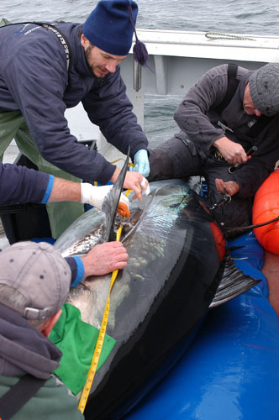
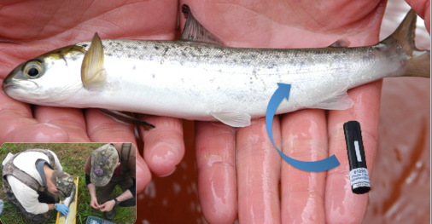
Surgically Implanting Pinger Tags
Tracking instruments …
VEMCO acoustic tags
Optional Sensors
Temperature
Depth
Acceleration
www.vemco.com/products/transmitters

Slide 4
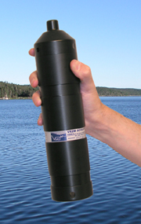
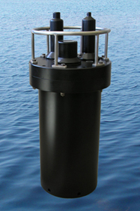
Operating Passive Acoustic Moorings
Tracking instruments …
VEMCO receivers
~ 800 metre spacing
~ 50-200 metre depth
models / battery life
VR2W / 1 yr
VR3 / 3 yr
VR4 / 5 yr
www.vemco.com/products/receivers

Slide 5
Uniting animal trackers with oceanographers
Basic Challenges …
http://www.bio.gc.ca/science/monitoring-monitorage

Slide 6
Avoiding intense fishing in Emerald Basin and on Sambro Bank
Basic Challenges …
Sambro
Bank
Emerald
Basin
2010 FSRS/OTN Workshop + public consultations at Port Mouton & Sambro
www.mar.dfo-mpo.gc.ca Atlas of Human Activities

Slide 7
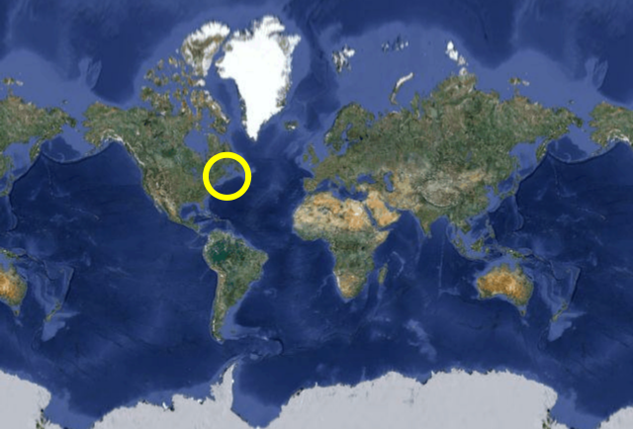
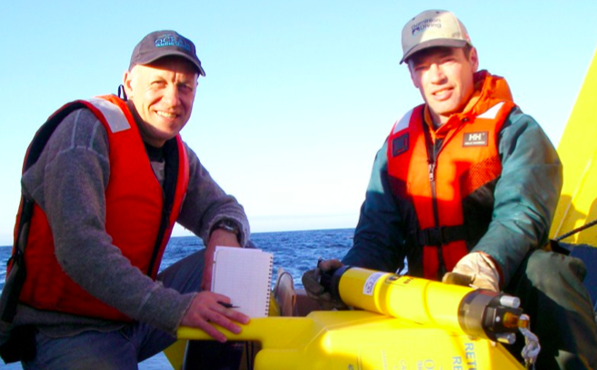
A massive undertaking that took 4 years to complete!
Basic Challenges …
Halifax
harbour
1st receiver
April 2008
59+ missions
265 moorings
205 km long
1st full offload of all receivers
Nov 2013
_{OTN Field Ops Team}
continental
shelf break
265th receiver
May 2012
Ian Beveridge, Duncan Bates
290 unique tags – 175,621 detections

Slide 8
Acipenser oxyrinchus / Atlantic sturgeon
Animals so far detected …
Acadia University (MPD)
Delaware State University (DAS)
100-200 cm
© Claude Nozères, DFO

Slide 9
Gadus morhua / Atlantic cod
Animals so far detected …
DAL-DFO-BIO: Dalhousie University and DFO, Bedford Institute of Oceanography (SGS)
40-110 cm
Credit: Heinz Wiele, DFO

Slide 10
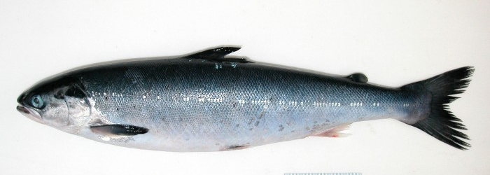
Salmo salar / Atlantic salmon
Animals so far detected …
DFO-BIO: Bedford Institute of Oceanography (IBFS,LHV,SMR,WRS)
NOAA-NMFS-NEFSC: National Marine Fisheries Service, Northeast Fisheries Science Center U Maine (PBN)
USGS: U.S. Geological Survey (PBU)
smolts
10-25 cm
© Aron Spares, Dal
45-100 cm
adults
© Claude Nozères DFO

Slide 11
Squalus acanthias / spiny dogfish
Animals so far detected …
DFO-BIO: Bedford Institute of Oceanography (WDG)
60-90 cm
© Canadian Shark Research Lab
www.marinebiodiversity.ca/shark

Slide 12
Thunnus thynnus / Atlantic tuna
Animals so far detected …
Stanford U: Stanford University / Tag A Giant Program (TAG)
160-300 cm
© birdologist
www.tagagiant.org/

Slide 13
Satlantic Benthic Pods
Oceanographic Instruments …
Year long time series of
Bottom pressure
Temperature
Salinity
satlantic.com/benthicpod

Slide 14
Stand alone moorings
Oceanographic Instruments …
Teledyne Acoustic Doppler Current Profilers
Seabird Conductivity Temperature and Pressure Recorders
Remotely monitoring ocean currents throughout the water column…
www.rdinstruments.com/quartermaster.aspx
www.seabird.com/products

Slide 15
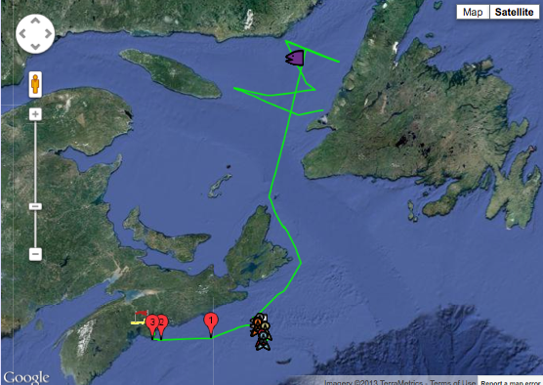
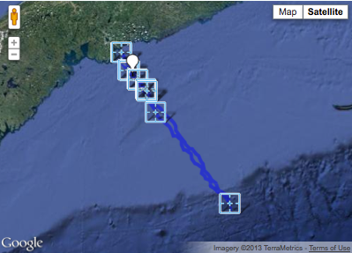
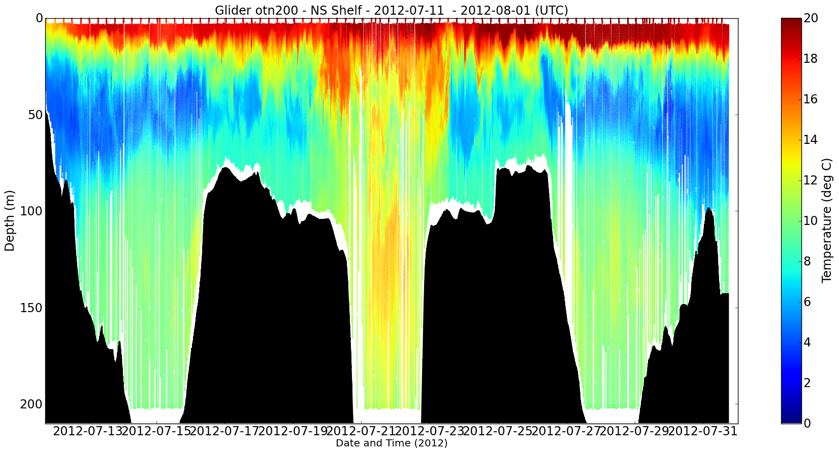
Remotely operated / autonomous vehicles
Oceanographic Instruments …
Liquid Robotics Wave Glider
WEBBResearch Slocum Glider
liquidr.com/technology/wave-glider.html
www.webbresearch.com/electricglider.aspx

Slide 16
Credits
operated by regional experts
just one part of a global network…
Halifax Line
Scientific Contacts …
Hebert, Dave - david.hebert@dfo-mpo.gc.ca
Smith, Peter C. - peter.c.smith@dfo-mpo.gc.ca
Institution …
DFO-BIO: Fisheries and Oceans Canada, Bedford Institute of Oceanography
HFX

Slide 17
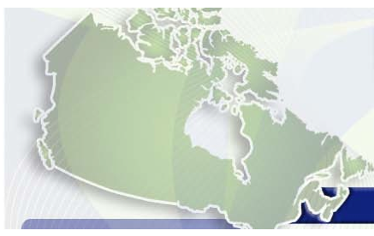
Intelligent open access to publicly funded research data
Data management …
all data to be available in timely manner as condition of funding
except:
endangered species
thesis data of Highly Qualified Personnel in training
http://rds-sdr.cisti-icist.nrc-cnrc.gc.ca/eng/events/data_summit_2011
Notes:
.In 2011 the Canadian Research Data Summit resulted in a unified position of Canadian funding agencies—including OTN’s principal funding agencies CFI, NSERC, and SSHRC—to require that all data from publically funded research be made openly available in a timely manner. Meeting this standard will be a condition for all grantees to maintain funding from these agencies. It is anticipated that this standard will be implemented at some point within the next year. However, it is also anticipated that there may be exceptions provided in some circumstances to the policy that permit investigators to restrict access to data for limited periods. Examples from the OTN context could include not reporting location information on endangered species that network investigators are tracking to protect the animals from illegal harvesting, and protecting the thesis data for Highly Qualified Personnel who are in training.

Slide 18
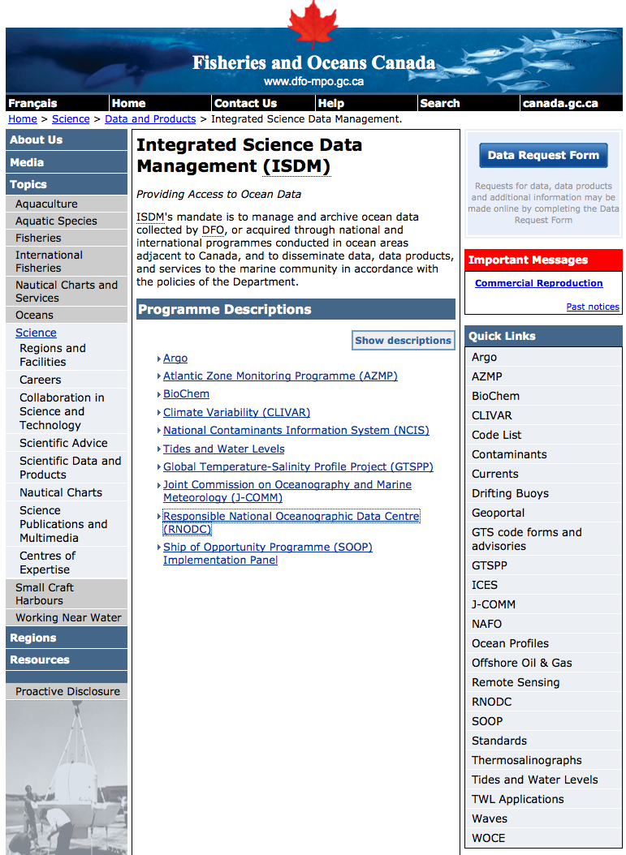
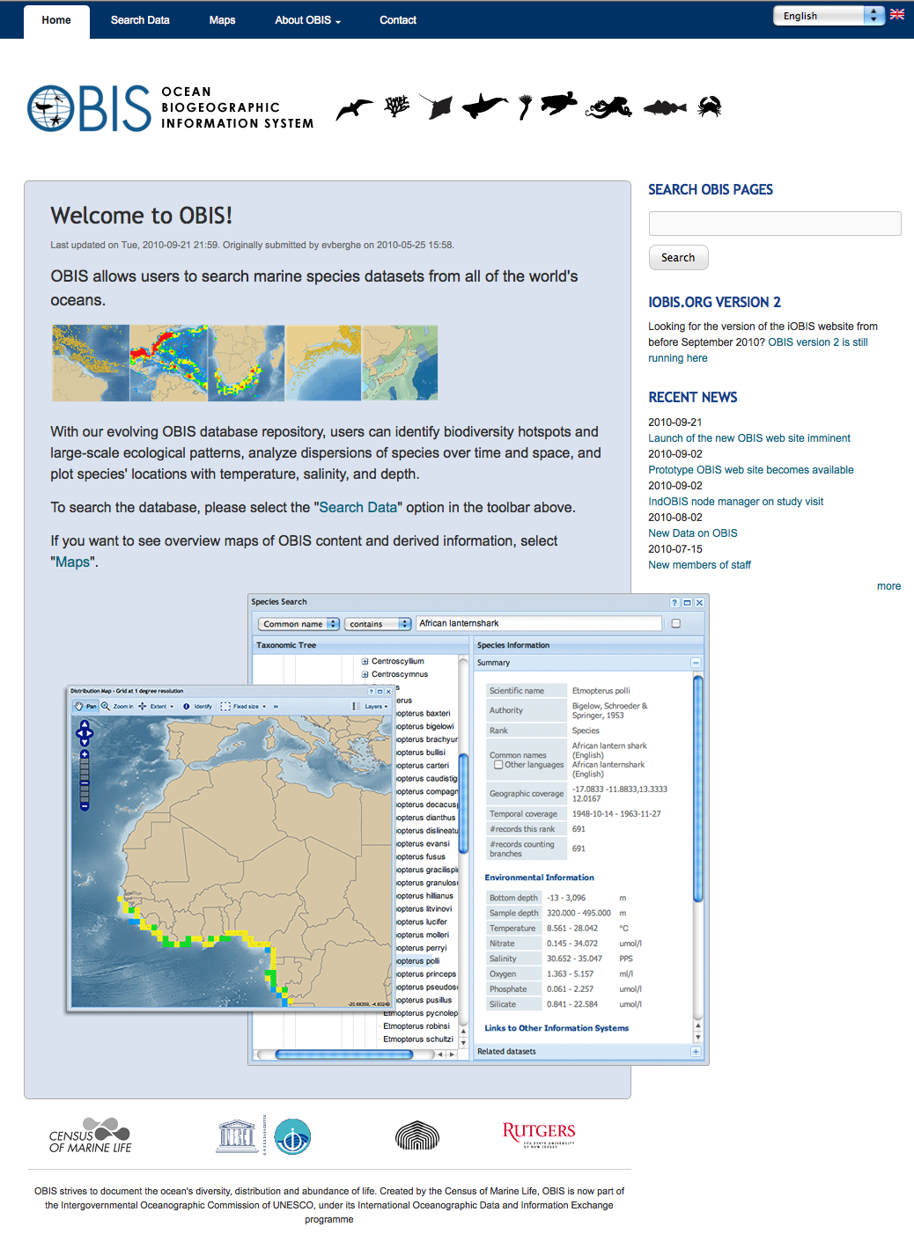
Data management …
Built in long term sustainability and global accessibility
www.iode.org
meds-sdmm.dfo-mpo.gc.ca/isdm-gdsi
iobis.org
Notes:
The "International Oceanographic Data and Information Exchange" (IODE) programme of the "Intergovernmental Oceanographic Commission" (IOC) of UNESCO main purpose is to enhance marine research, exploitation and development, by facilitating the exchange of oceanographic data and information ...
As a condition of CFI funding, Dalhousie University and Canada’s Department of Fisheries and Oceans (DFO) were required to have a formally signed comprehensive collaboration agreement whereby OTN data would routinely copied to Canada's Intergovernmental Oceanographic Commission (IOC) designated National Ocean Data Centre (NODC), that is the Integrated Scientific Data Management Services Branch of DFO in Ottawa Canada. The required agreement is in and we that OTN and DFO are now in the process of acting on the agreement.
The rational for this NODC based copy has many benefits, including: OTN data could be integrated with established oceanographic databases and potentially flowed directly into international systems such as the Ocean Biogeographic Information System (OBIS), DFO scientists on the other hand would simultaneously and effortlessly conform to both the DFO and OTN data policy and Dalhousie. Furthermore, OTN would have a built-in fail-safe decommissioning process.
As part of this process OTN will use the ISO Marine Community Profile developed by the IODE and the Ocean Biogeographic Information System schemas.
18

Slide 19
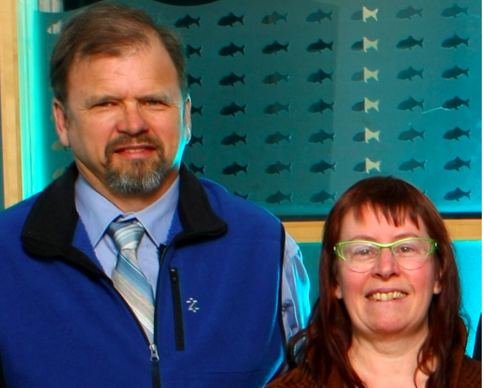
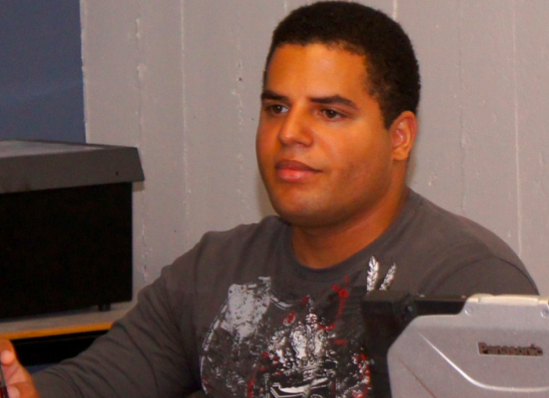
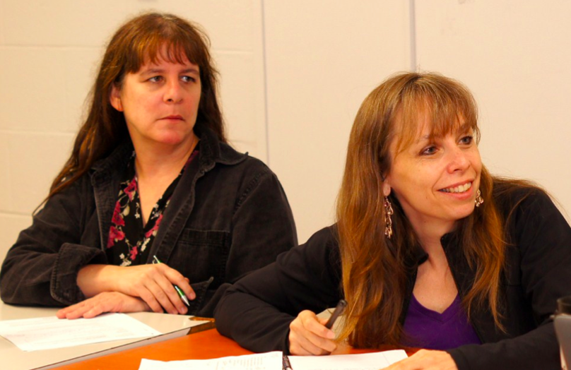
Thank you
Data management …
Supported by: OTN Data Management Team …
Bob Branton, Marta Mihoff, Brian Jones, Lenore Bajona, Susan Dufault
Some browsing suggestions:
oceantrackingnetwork.org
members.oceantrack.org/data
global.oceantrack.org/docs/2012-otn-annual-report
Bob.Branton@dal.ca

Slide 20
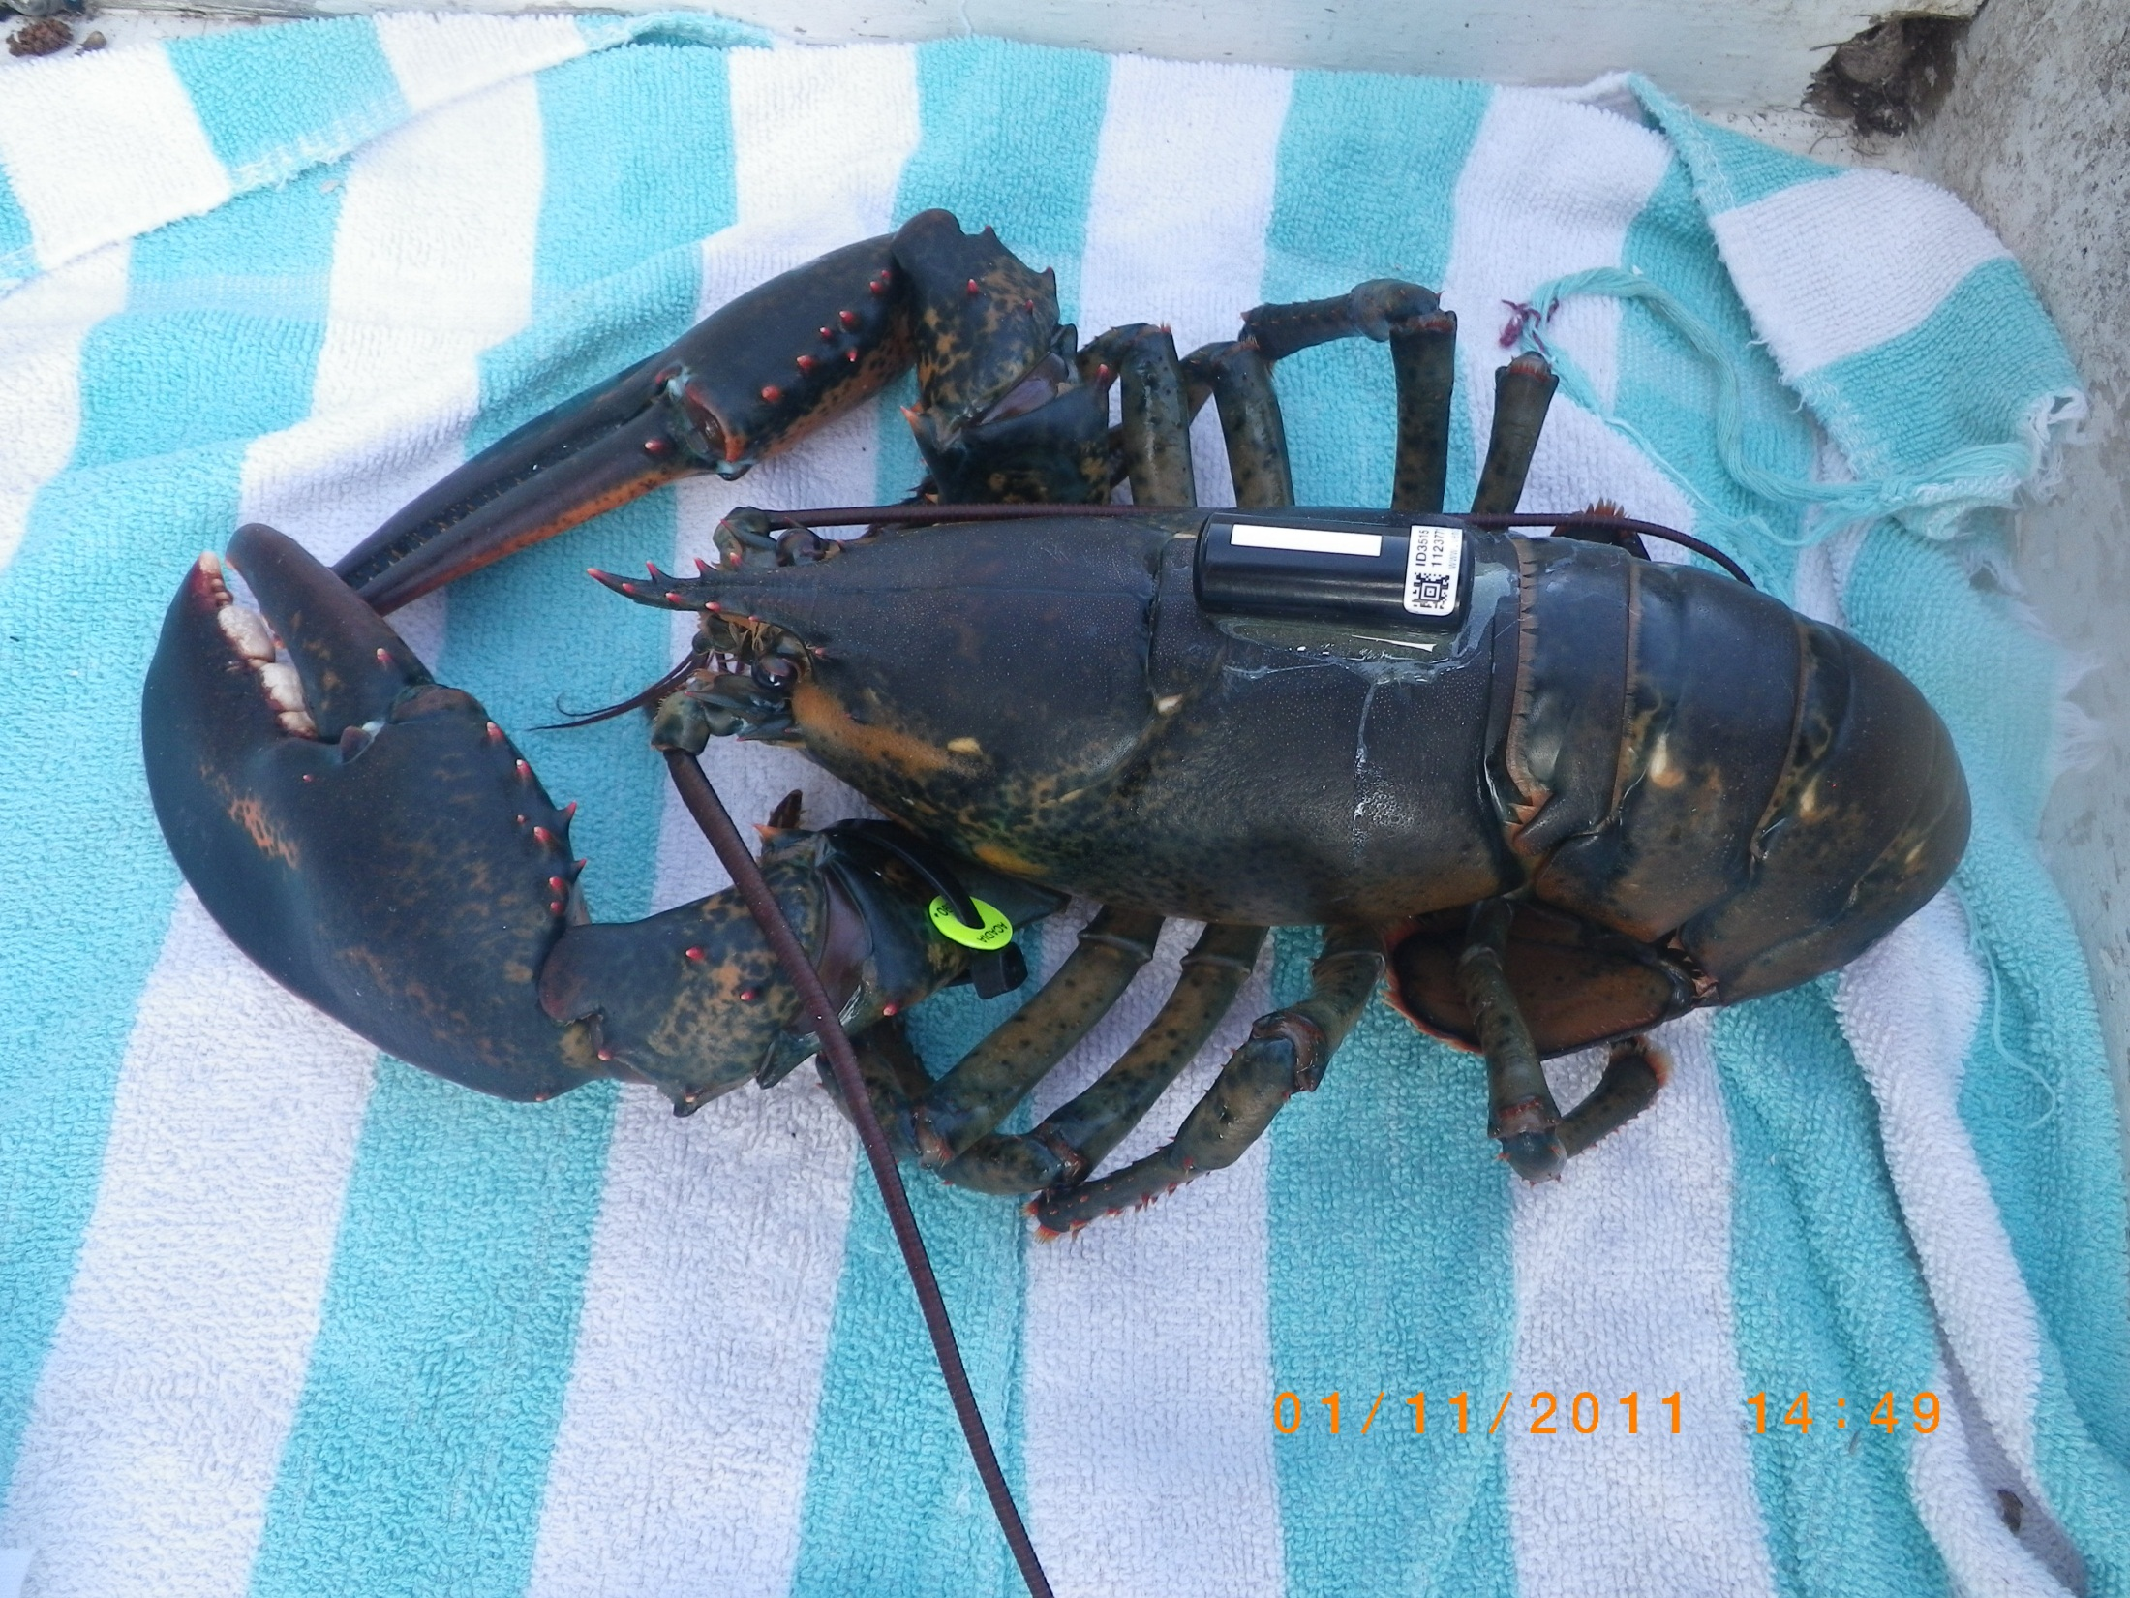
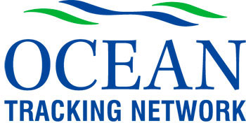
20th Annual Fisherman and Scientists Research Society Conference
20-21 February 2013, Truro, Nova Scotia
The End

