Slide 1
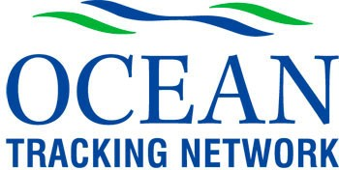
OTNCanada - Leading the Way to Intelligent Open Access
Bob Branton
OTN Director of Data Management
Bob.Branton@dal.ca
OTNCanada Science Advisory Committee – Dec 2-3, 2013

Slide 2
Need to keep current
OTN’s data procedures and policies, from inception, have been aligned with international standards and best practices, as wall as designed to meet conditions of national and international funding agencies.
To remain current, OTN must periodically review its data management, and update procedures and policies to emerging expectations.

Slide 3
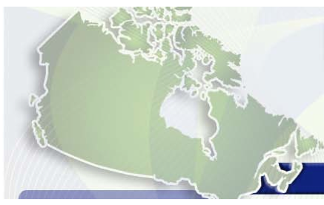
Effective Use and Reuse
OECD - 2006
CFI / NSERC - 2011
Develop policies covering responsibilities of various parties involved in data-related activities
Negotiate data sharing arrangements at initial proposal stage.
Reward initial contributors with temporary exclusive use of data.
Develop a secure and easy to use Internet systems.
Be explicit about standards and promote / adopt most advanced practices.
2011 Canadian Research Data Summit
data from public funded research should be openly available in a timely manner as a condition of funding
Exceptions being sought by research biologists:
not reporting location information on endangered species as a means of protecting them from illegal harvest,
protecting the thesis data for Highly Qualified Personnel who are in training.
Intelligent open access!
Notes:
OTN’s original 2008 data policy (members.oceantrack.org/data/data-collection/otn-data-policy) was modeled on the Organization for Economic Cooperation and Development (OECD) 2006 Principles and Guidelines for Access to Research Data. Much has changed since 2008, especially with regards to the evolution of national and international standards for data sharing. In 2011 the Canadian Research Data Summit resulted in a unified position of Canadian funding agencies—including OTN’s principal funding agencies Canada Foundation for Innovation (CFI), Natural Sciences and Engineering Research Council (NSERC), and Social Sciences and Health Research Council (SSHRC) — to require that all data from publically funded research be made openly available in a timely manner. Meeting this standard will be a condition for all grantees to maintain funding from these agencies. However, it is also anticipated that there may be exceptions to the policy provided in some circumstances that permit investigators to restrict access to data for limited periods. Examples from the OTN context could include refraining from reporting location information on endangered species that network investigators are tracking, in order to protect the animals from illegal harvesting, and protecting thesis data for Highly Qualified Personnel (HQP) who are in training. In anticipation of this, OTN has posted a revised policy at: members.oceantrack.org/data/data-collection/policyhighlights. The POST 2010 policy document can found at: http://www.postprogram.org/files/POST_Data_Access_Policy.pdf.

Slide 4
OTN Data Mgt Workshop, June 2013
Outline
data policy overview
members’ portal tour
Google flyover
public downloads
private detection extracts
forms and templates
common holdups and how to avoid them
user/manager panel
new product suggestions
43 attendees

Slide 5
Improved Tracker Metadata
Map of tags released (red), detected (green) and detection counts (gray)
Cross tabulation of detected tags by tracker (x) and detector (y), OTN detectors - red)
Weekly counts of active tags (red), detected tags (green), total detections (gray)
Individual tag release dates (red), operation ranges (grey) and detection ranges (green) sorted by expiry date
0-10 year embargo period modeler
expiry and embargo counts
embargo forecast
also by ocean, family, scientific name, common name & collection

Slide 6
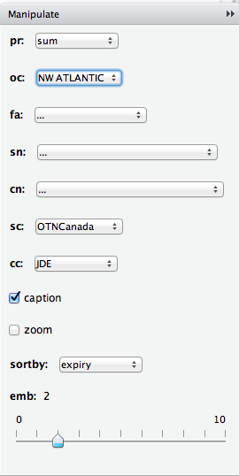
Other examples
Rstudio - interface
Currently in development using R and RStudio. Next step: provide tracker Pis with private copies of relevant species (embargo = 2) years for review and sharing just like detection extracts.

Slide 7
ARCGIS-online Mapper in collaboration with Dalhousie GIScience
Public tag release project metadata by collection code & scientific name …
Private detection data extracts by individual animal combined with Public deployment metadata …
Links to OTN Discovery Metadata, WoRMS, OBIS and Google Images
Similar results can be obtained using open source and or desktop software such as Quatum GIS

Slide 8
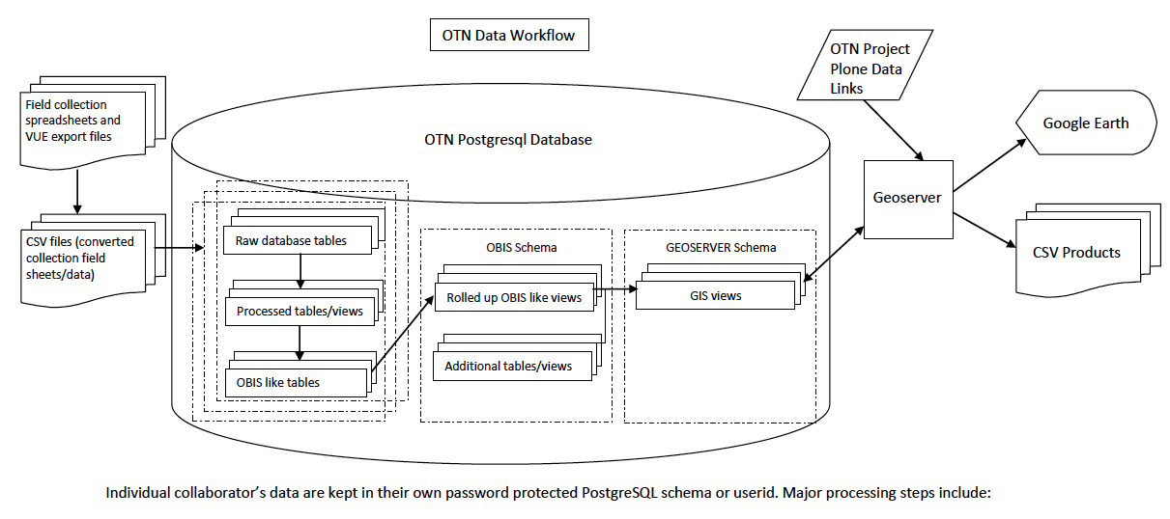
What to do about OTN’s other data? Moving beyond the data warehouse
Community Data
Other Data
Accepted by journals e.g. Nature, Evolution
Data packages may contain > 1 dataset
DOIs permanently linked to published paper
Embargos allowed
Courtesy Lenore Bajona - OTN
Courtesy Michelle Lloyd, Kate Crosby - CHONe
Versions of these slides were presented at recent CASRAI 2013 Conference in Ottawa.

